Slide 1
Drought impact on vegetation Activity (FVC)
Carla Barroso, Célia Gouveia
IPMA, 25/07/2018

Slide 2
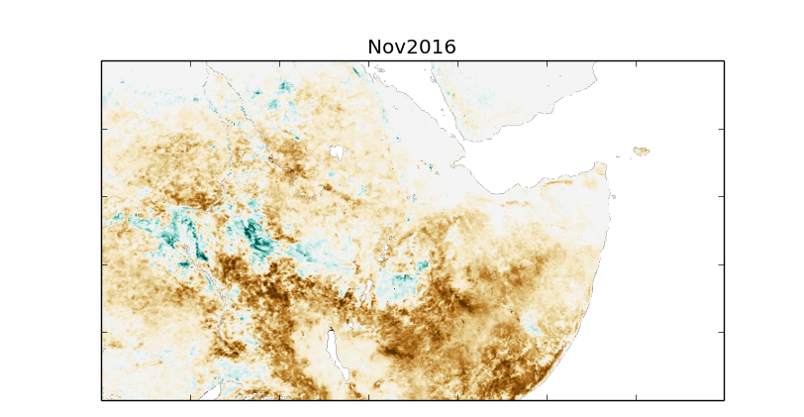
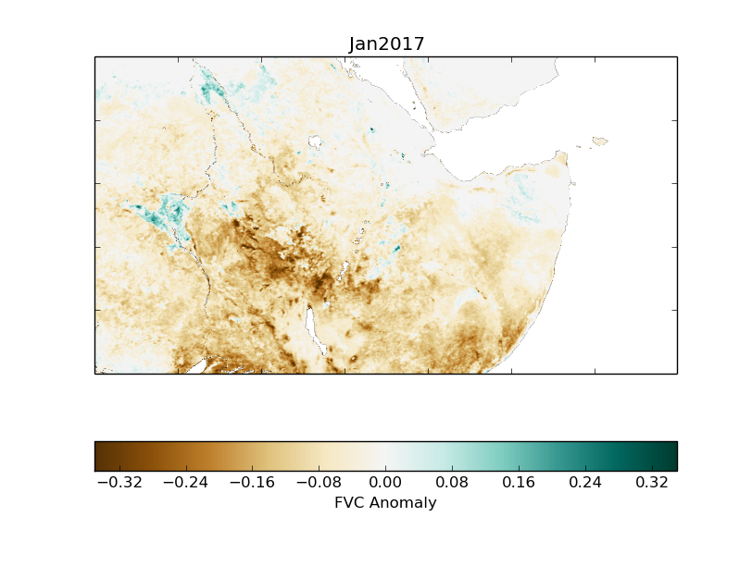
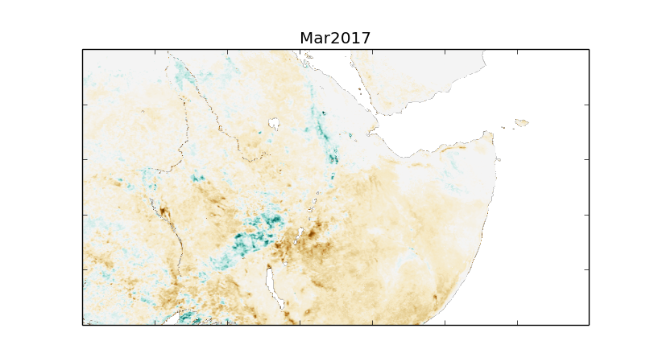
Motivation
Severe and prolonged hydrological droughts are frequent over the Greater Horn of Africa. Since October 2016 this region has been stricken by an extreme drought that had a strong impact in vegetation conditions during the growing season being responsible by significant losses in crops and pasture productions.
The image shows the evolution of the drought impact on the Fraction of Vegetation Cover (FVC) between November 2016 and March 2017. Areas with less vegetation cover than usual are represented in brown.

Slide 3
Procedure
Producing monthly composites from daily input
Open the MSG Toolbox (.bat file)
Select a ROI (either by entering the geo coordinates or by selecting on a map) and give it a name
Press the Start Task button at the bottom (right hand side) to save the ROI

Slide 4
Procedure
Producing monthly composites from daily input
Select the Compositing tab. Here indicate where data is stored in your PC and give the dates of your data.
Select Scenario New and introduce the following settings:

Slide 5
Procedure
Producing monthly composites from daily input
Go back to the Settings Window tab and click Save.

Slide 6
Procedure
Producing monthly composites from daily input
In the compositing window click the Add task button
You can check the status of the processing in the Processing window:
Once the processing is finished check the output.
Repeat the procedure for all the years between 2004 and 2015 and for 2017

Slide 7
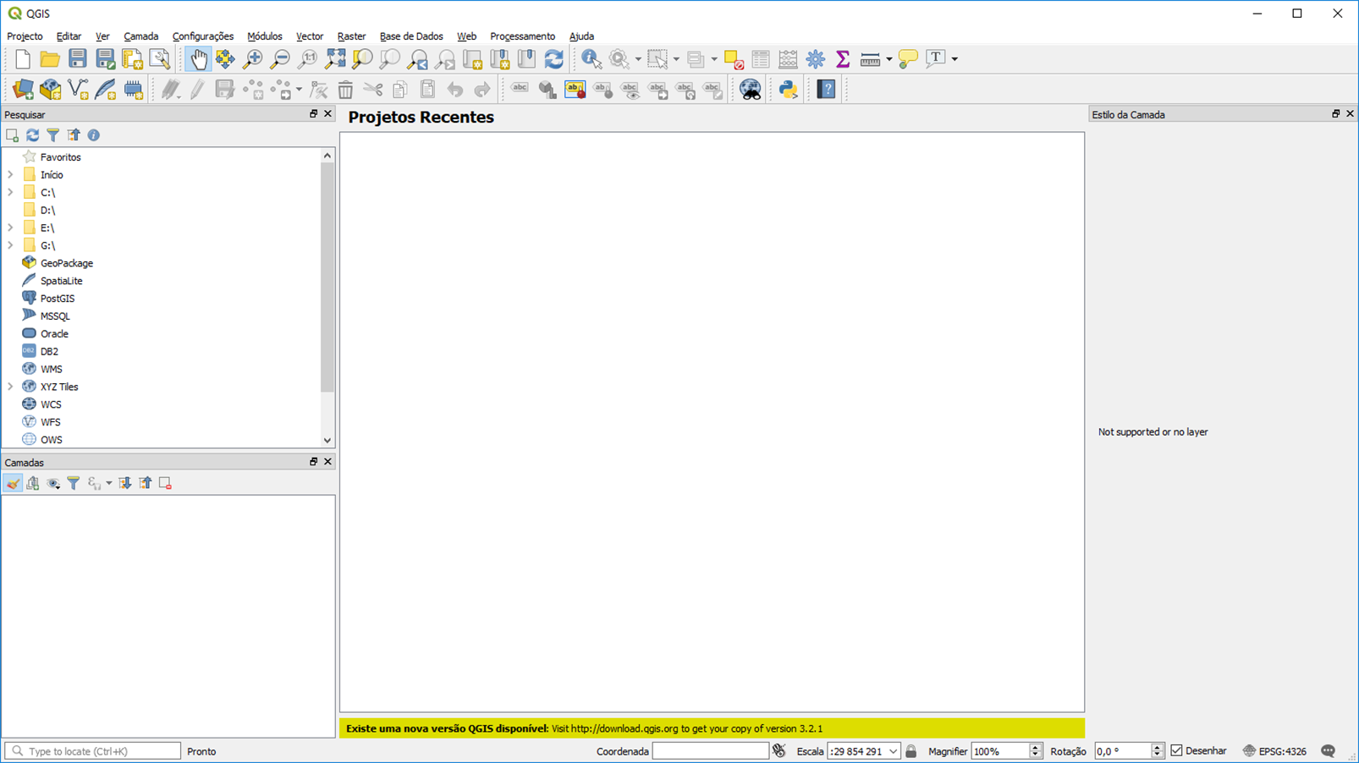
Procedure
Producing monthly climatology
Open QGIS

Slide 8
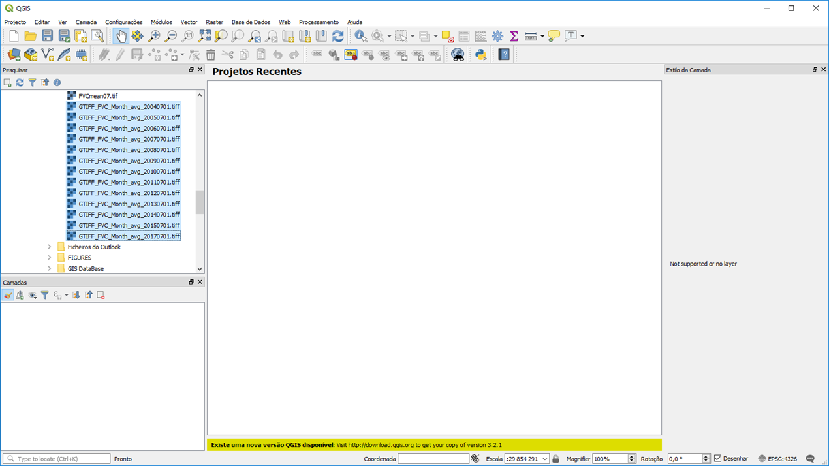
Procedure
Producing monthly climatology
Drag the LSASAF files converted to geotiff into Qgis3)

Slide 9
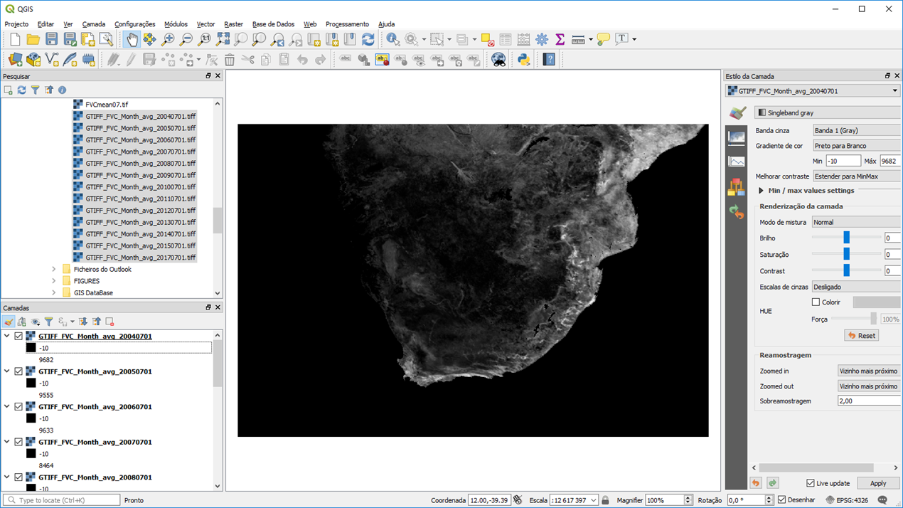
Procedure
Producing monthly climatology
Select the colours in layer figure (double click – red arrow)

Slide 10
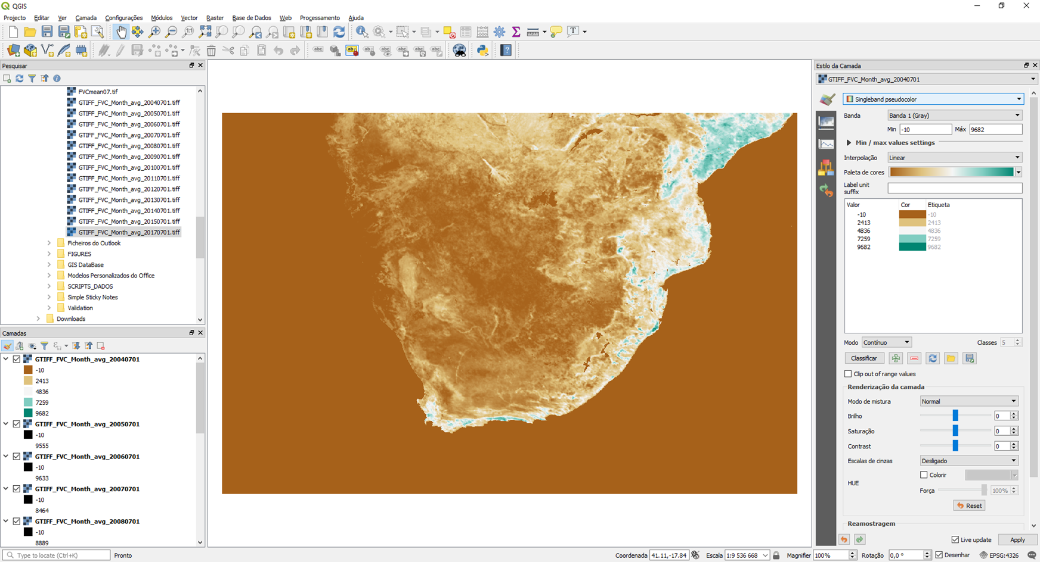
Procedure
Producing monthly climatology
Select the colours in layer figure (change colour pallet and type)

Slide 11
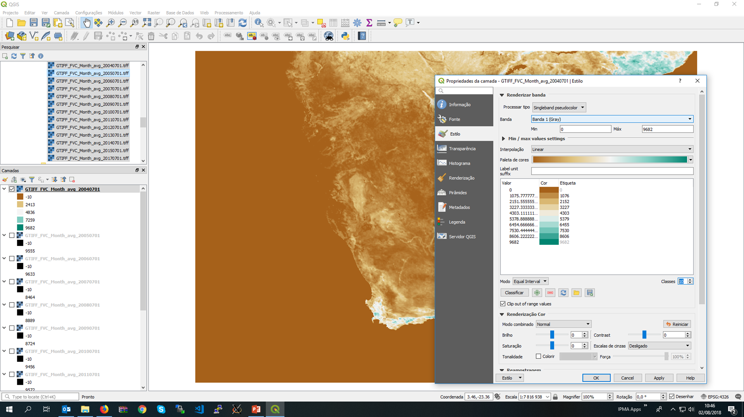
Procedure
Producing monthly climatology
Select the colours in layer figure (change mode, classes number and…)

Slide 12
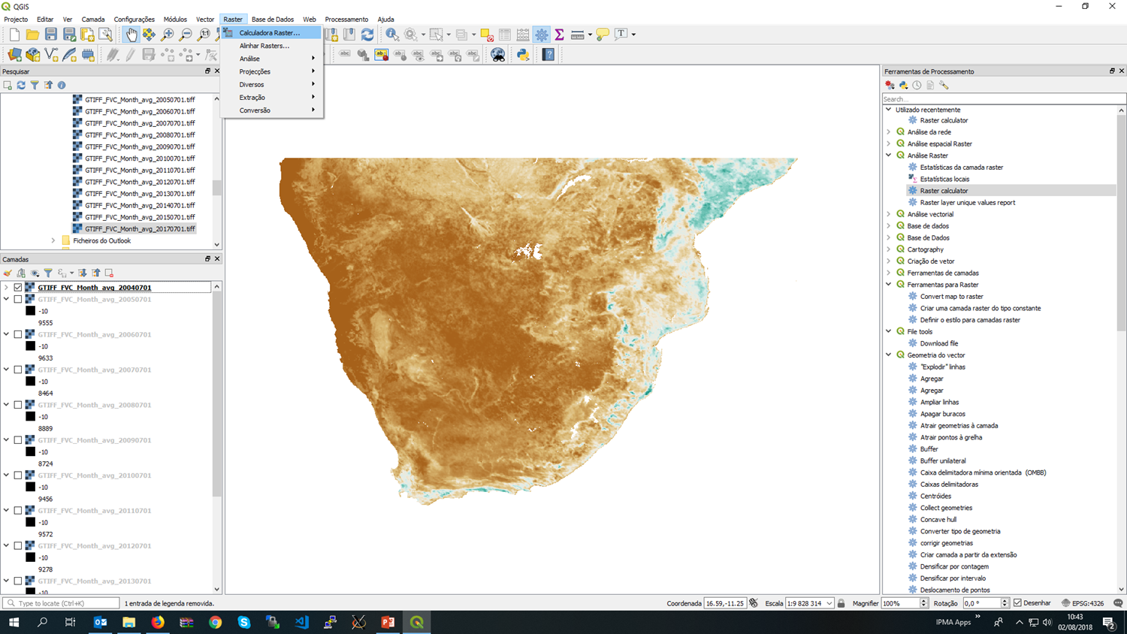
Procedure
Producing monthly climatology
Open raster calculator

Slide 13
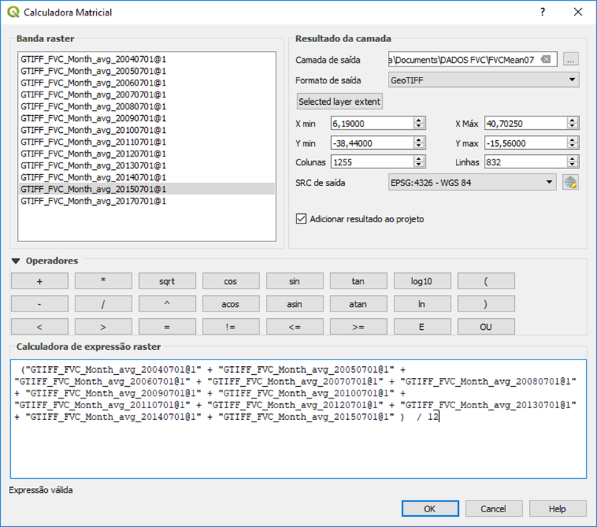
Procedure
Producing monthly climatology
Give a name to output file and define the average formula

Slide 14
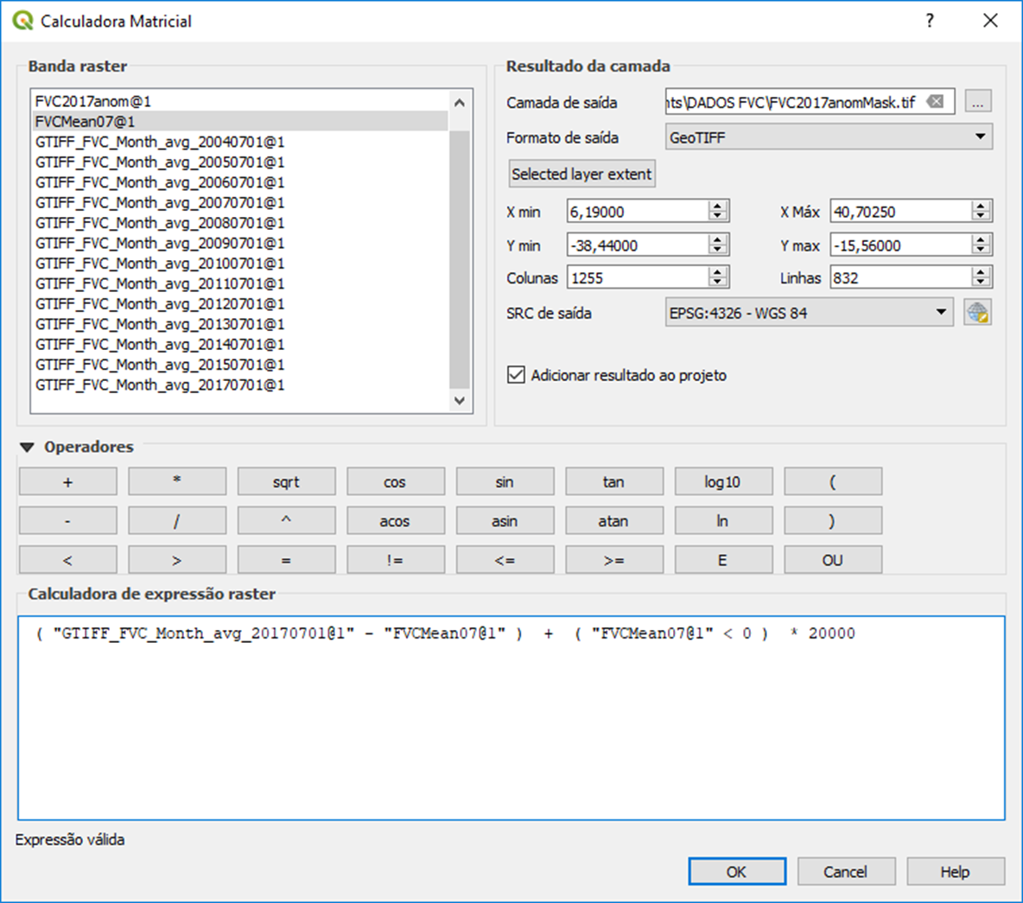
Procedure
Producing monthly anomaly
Give a name to output file and
Define the anomaly formula
Mask the missing values (sea)

Slide 15
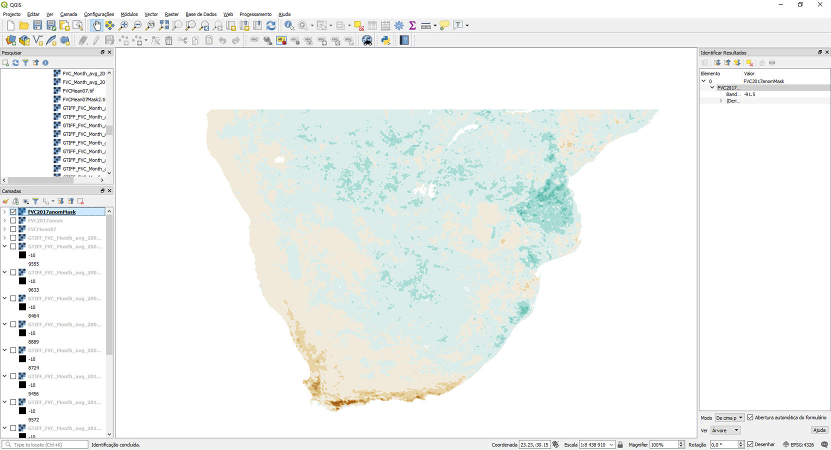
Final Result
Region with vegetation in stress (FVC anomaly values < 0) during July of 2017

Slide 16
THANK YOU!

