Slide 1



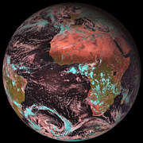
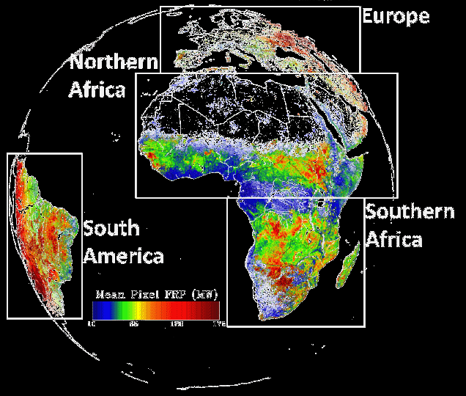
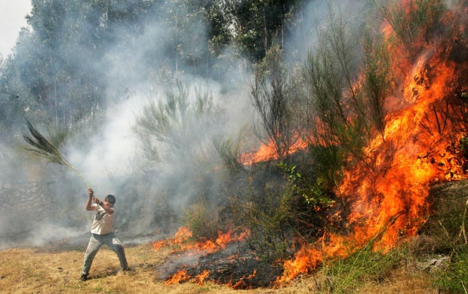
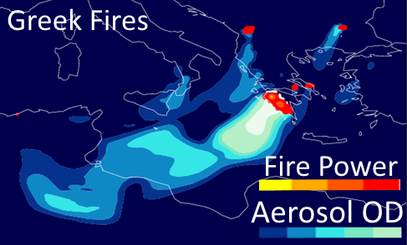
LSA SAF FRP-PIXEL Product (capabilities, validation, applications)
Martin J. Wooster, Weidong Xu,
Gareth Roberts,
and Jiangping He
SALGEE2017 workshop Yerevan 18-21 Sep 2017
Background
SEVIRI
FRP-PIXEL
Applications

Slide 2
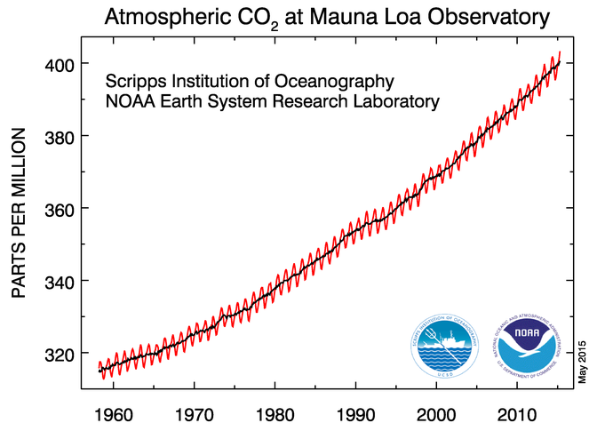
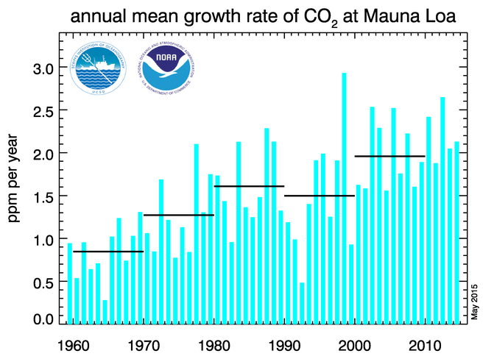
Biomass Burning Atm. CO2 Contribution
Strongest
El Ninos
Fire CO₂ emissions average 2.0 Pg C yr⁻¹
Deforestation & forest degradation is 2nd
largest anthropogenic CO₂ source after
fossil fuel combustion.
Together estimated as ~ 15% of net
global annual average CO₂ emissions.

Slide 3
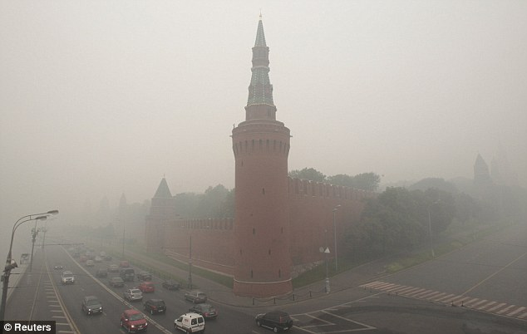
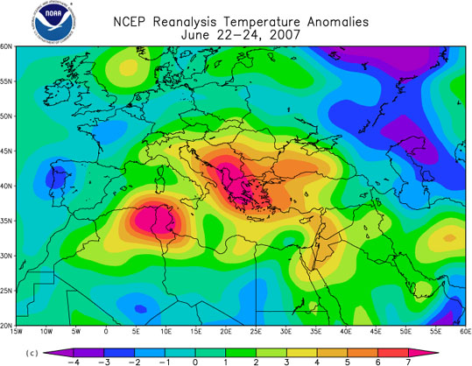
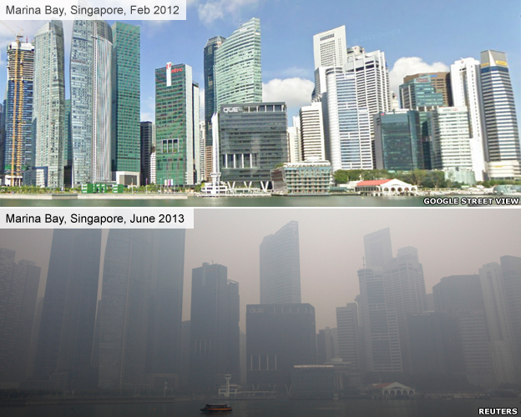
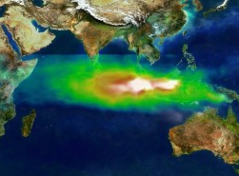
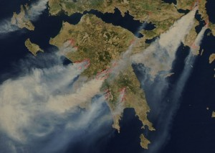
Biomass Burning Emissions
Biomass burning a major air pollution source (PM_{2.5}, VOCs, tropospheric O₃, CO..).
Respiratory effects.
SE Asia + 200 days/yr⁻¹ > WHO AQ targets.
Moscow Peat /Forest Fires
during ‘heatwave’ (2010)
Munich Re : ~ 56 k additional deaths
European Heatwave 2007
Singapore (Feb 2010)
1997 ENSO Fires
TOMS Aerosol (SE Asia)
Pollution Index Record (June 2013)
Aug 2007 Greek Fires
Notes:
Mounting evidence suggests that air pollution contributes to the large global burden of respiratory and allergic diseases including asthma, chronic obstructive pulmonary disease, pneumonia and possibly tuberculosis.
Emissions from landscape fires affect both climate and air quality¹. In this study, we combine satellite-derived fire estimates and atmospheric modeling to quantify health effects from fire emissions in Southeast Asia from 1997 to 2006. This region has large interannual variability in fire activity due to coupling between El Niño-induced droughts and anthropogenic land use change^{2,3}. We show that during strong El Niño years, fires contribute up to 200 μg/m³ and 50 ppb in annual average fine particulate matter (PM_{2.5}) and ozone (O₃) surface concentrations near fire sources, respectively. This corresponds to a fire contribution of 200 additional days per year that exceed the World Health Organization (WHO) 50 μg/m³ 24-hour PM_{2.5} interim target (IT-2)⁴ and an estimated 10,800 (6,800–14,300) person (~2%) annual increase in regional adult cardiovascular mortality. Our results indicate that reducing regional deforestation and degradation fires would improve public health along with widely established benefits from reducing carbon emissions, preserving biodiversity, and maintaining ecosystem services.
Munich Re estimated that in all, 56,000 people died from the combined effects of the smog and the heat wave. The 2010 wildfires were the worst on record to that time; in 2012, however, new wildfires broke out, and they proved even more extensive and damaging.^{[8]}
Situation expected to worsen under future climate change

Slide 4
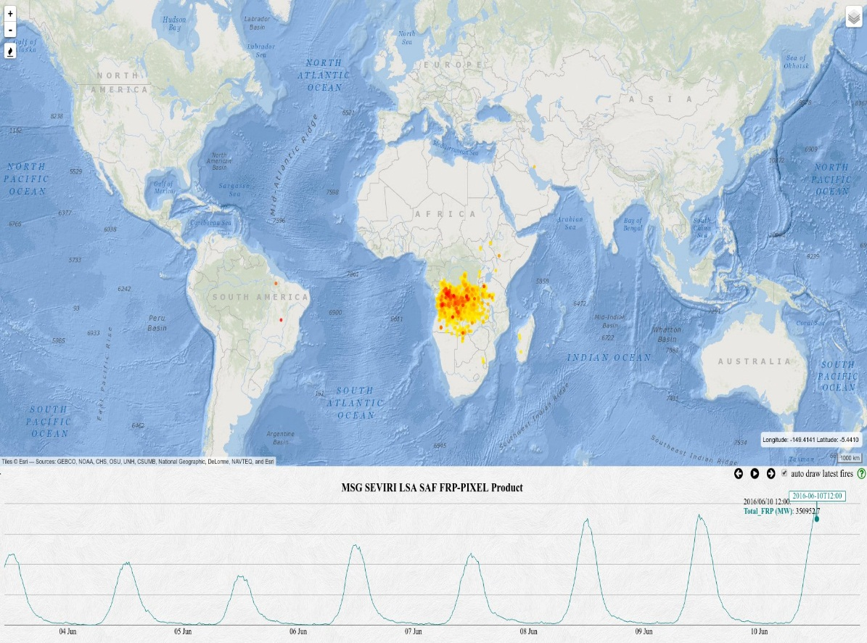
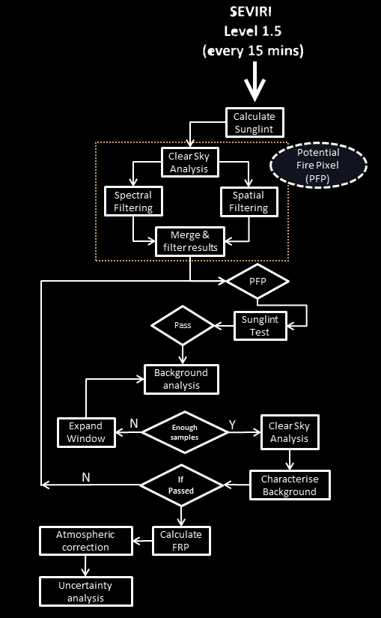
Operational FRP-PIXEL Product
KCL developed an online web mapping system for visualizing the near real-time FRP-PIXEL data and the FRP diurnal cycle http://wildfire.geog.kcl.ac.uk/firemap/
Delivered operationally to all as part of EUMETSAT Land Surface Analysis Satellite Applications Facility (LSA SAF)
Landsaf.meteo.pt/

Slide 5
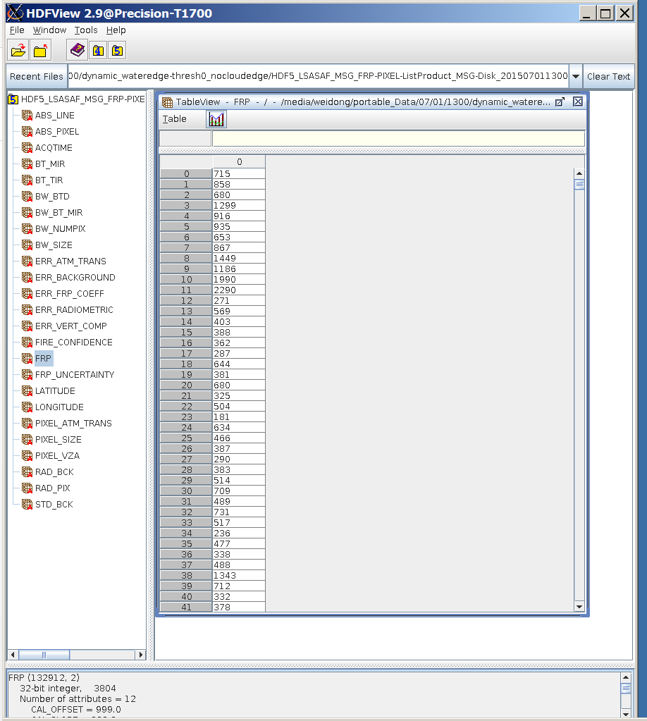
Operational SEVIRI FRP-PIXEL
List Product
>99% process success
15 mins temporal resolution
Product available in 2 hours after overpass
Input to CAMS
Delivered operationally to all as part of EUMETSAT Land Surface Analysis Satellite Applications Facility (LSA SAF)
Landsaf.meteo.pt/

Slide 6
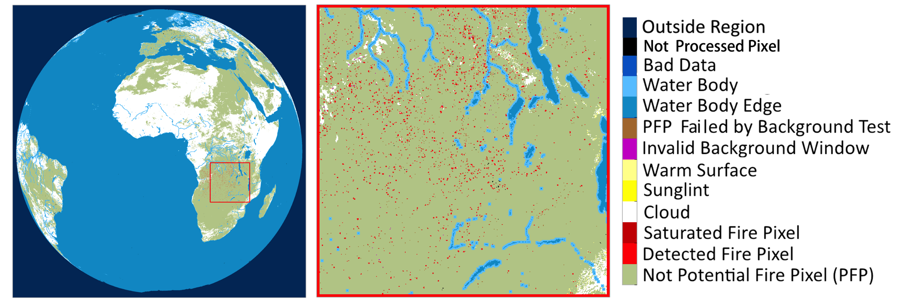
Operational SEVIRI FRP-PIXEL
Quality Product
>99% successful process rate
15 mins temporal resolution
Product available in 2 hours after overpass
Delivered operationally to all as part of EUMETSAT Land Surface Analysis Satellite Applications Facility (LSA SAF)
Landsaf.meteo.pt/

Slide 7
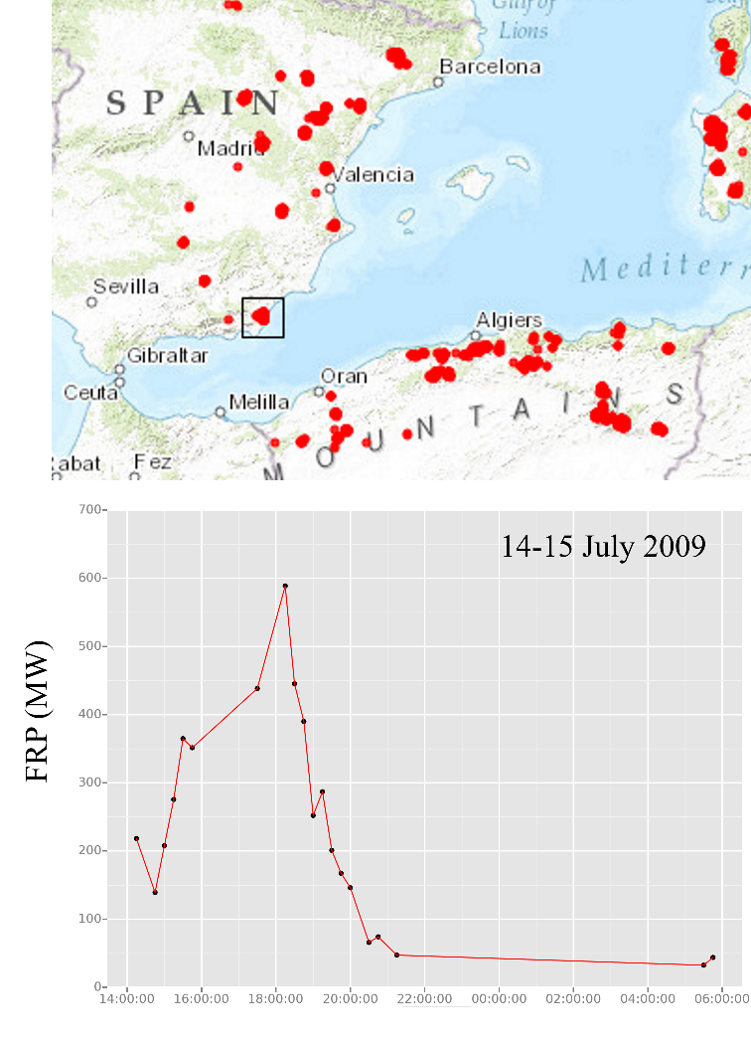
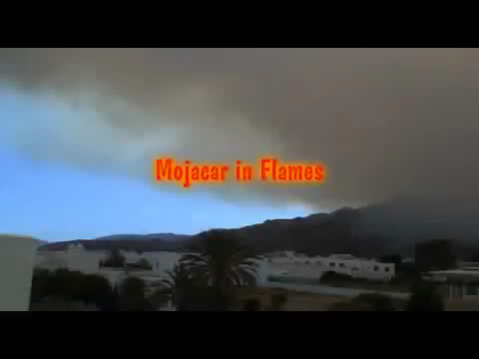
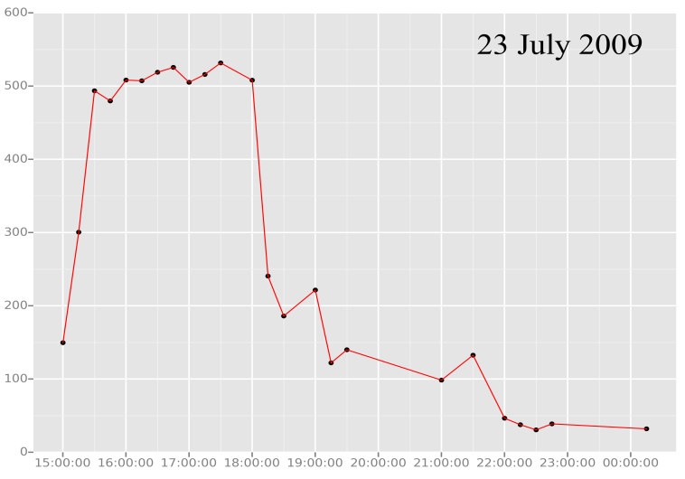
Example Wildfire - July ‘09 Spain
Fire expanded & burned initially exactly matching News reports.
^{Fire flared} again on 23rd July, as illustrated in FRP-PIXEL product.

Slide 8
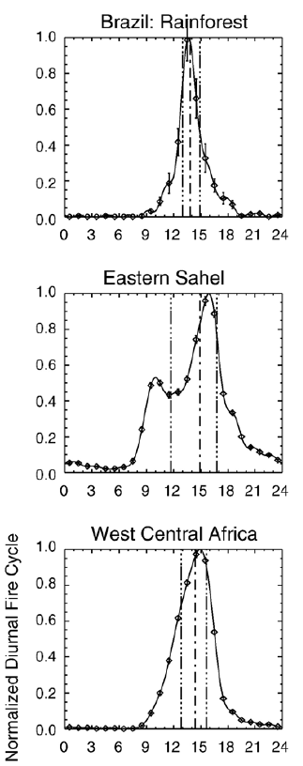
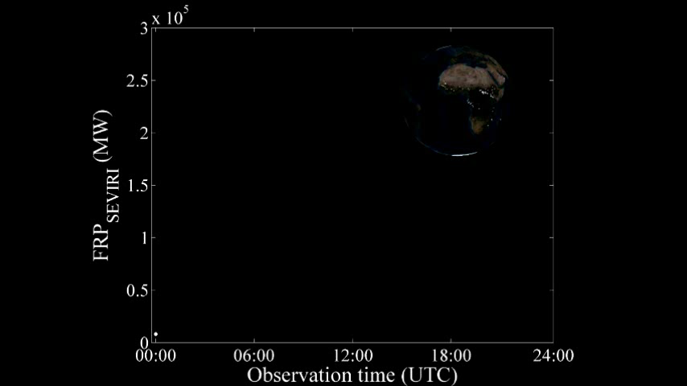
SEVIRI - Fire Diurnal Cycle
Fire Diurnal Cycles

Slide 9
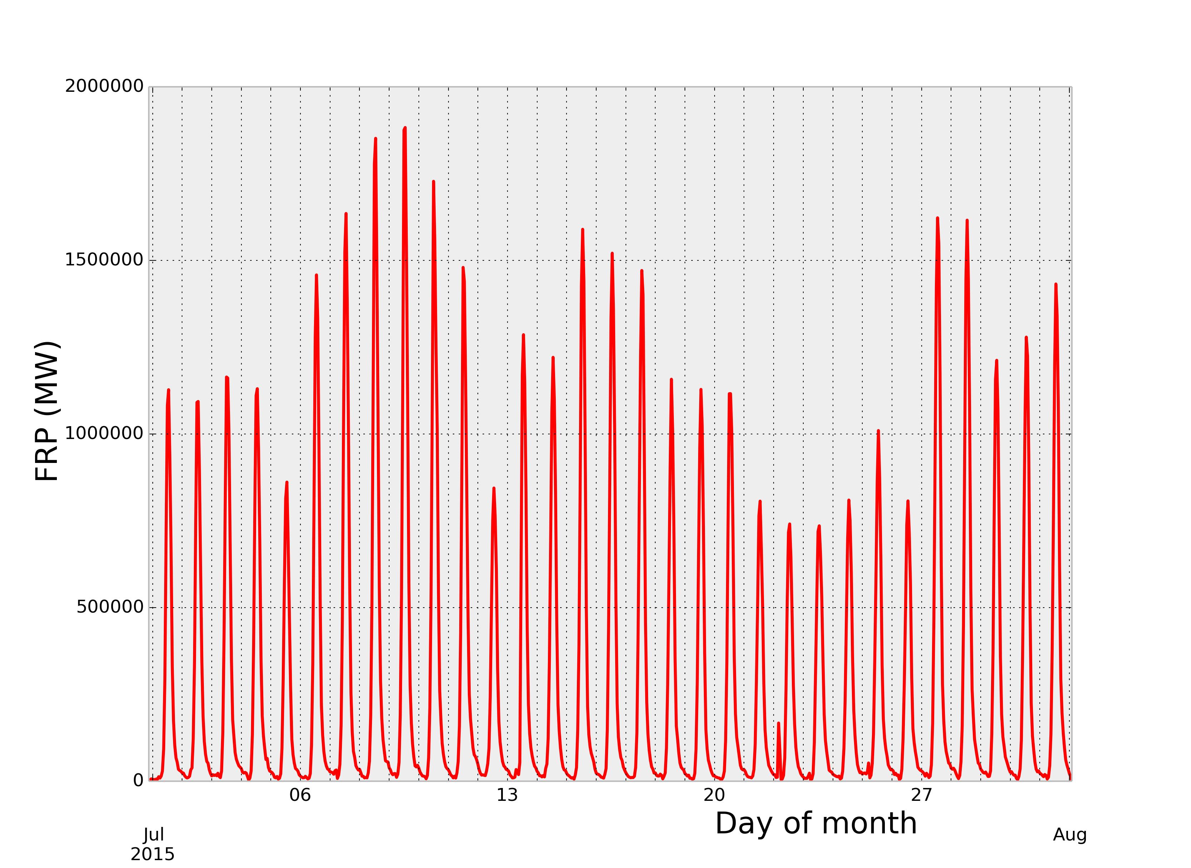
SEVIRI - Fire Diurnal Cycle

Slide 10
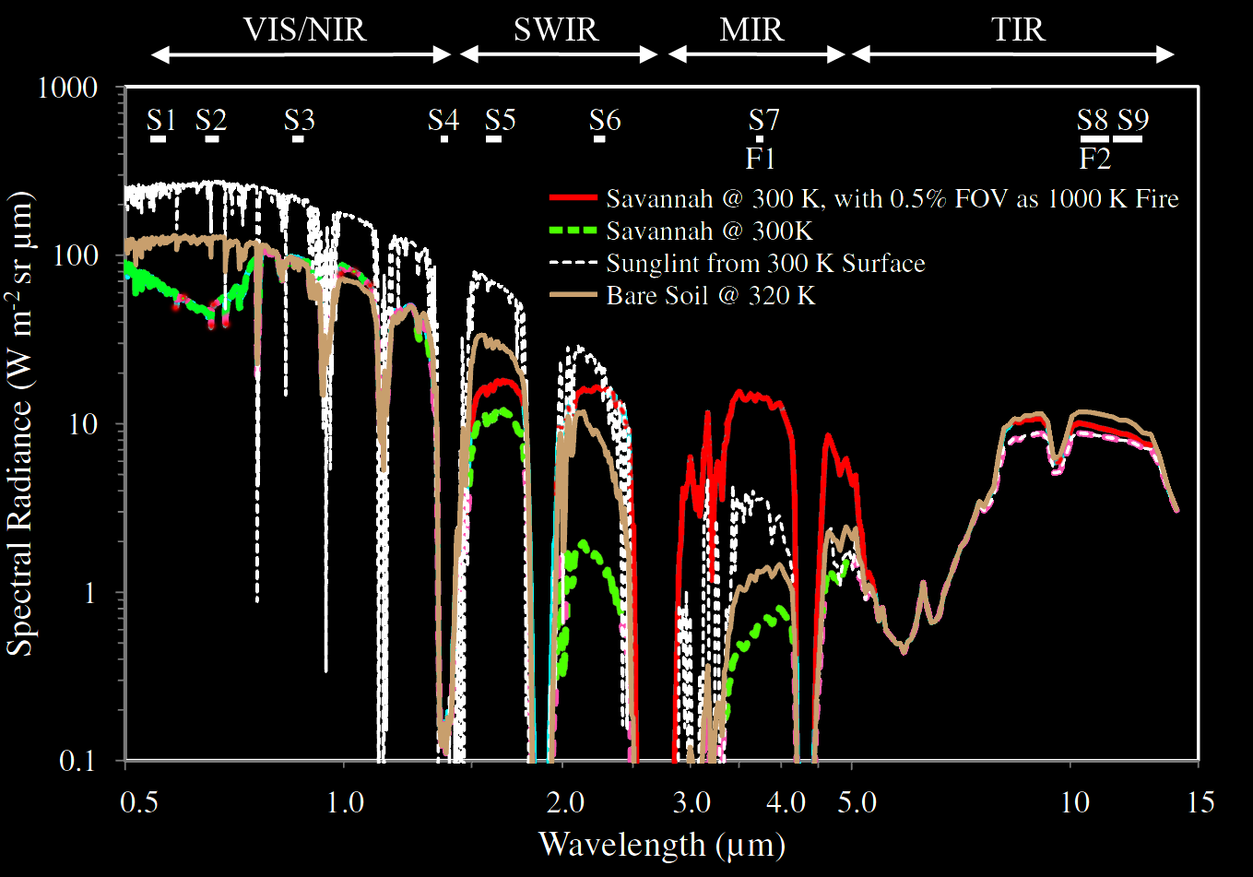
Radiative Transfer of Active Fire Detection

Slide 11
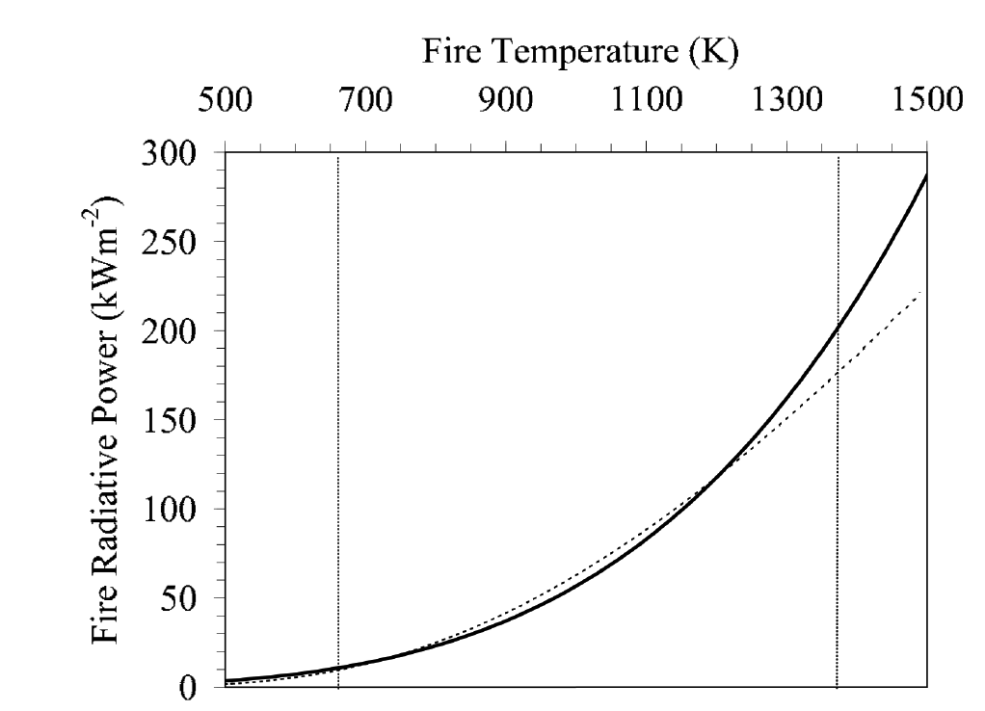
Fire Radiative Power Derivation
FRP (MW) corresponds to the ‘radiative strength’ of fire in a pixel, correlating to its rate of fuel combustion and smoke release.
Planck Function
MIR approach

Slide 12
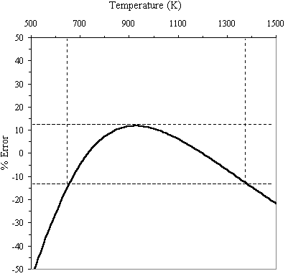
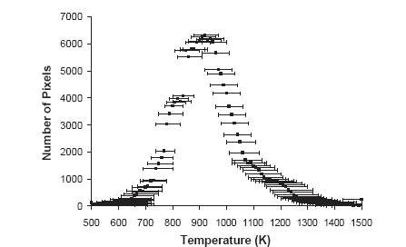
Fire Radiative Power Derivation
California Wildfire Temperatures
Fire Effective Temperature (K)
“Uncertainty” in FRP
Wooster et al, Remote Sens. Environ (2003)
Dennison et al. (2006) Remote Sens. Environ, 100.
Using MIR radiances, FRP can in theory be estimated to within ~ ±12.5% without knowledge of fire temperature (assuming in range 650 – 1375 K).
This temperature range covers vast majority of wildfire temperatures.

Slide 13
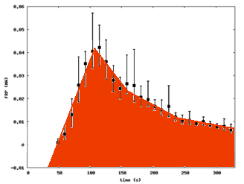
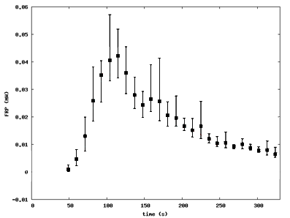
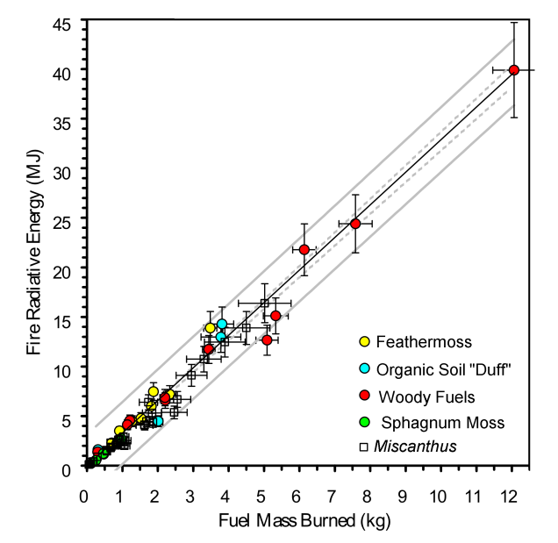
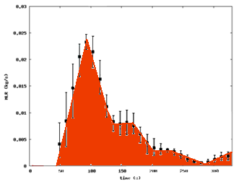
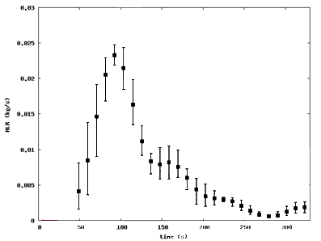
Relationship between Thermal Energy Emitted and Fuel Biomass Burned
Fire Radiative
Power (MW)
Fire Radiative Energy Emitted vs. Fuel Mass Burned
Fire Radiative
Energy (MJ)
FRP (MW)
Burnt Biomass
= Energy x CF
Combustion Factor (CF) ~ constant
Fuel Consumption
Rate (kg.s⁻¹)
Fuel Mass
Burned (kg)
Mass loss rate (kg/s)
Time (secs)
Notes:
The left hand graphs show timeseries of fire energy emission rate (called FRP – fire radiative power) and fuel consumption rate. Integrating under the curves gives total Fire Radiative Energy and Total fuel mass burned. This can then be plotted on the rhs scatterplot as one point. Do this for lots of different lab fires of different sized and different fuels – and you find strong linear relationship.
Thus by measuring the energy emitted we can estimate fuel consumption (which is related to the emissions of smoke as stated earlier)

Slide 14
Biomass Burning Emissions Calculation
Emissions of Species_{x} (g)
=
Fuel Load Per Unit Area (kg m⁻²) ×
Combustion Completeness (%) ×
Emissions Factor (g kg⁻¹)
Burned Area (m²) ×
Crutzen, P.J., L.E. Heidt, J.P. Krasnec, W.H. Pollock and W. Seiler, 1979: Biomass burning as a source of atmospheric gases CO, H₂ , N₂O, NO, CH₃Cl and COS. Nature, 282, 253-256.
Seiler, W. and P.J. Crutzen, 1980: Estimates of gross and net fluxes of carbon between the biosphere and the atmosphere from biomass burning. Climatic Change, 2, 207-247

Slide 15
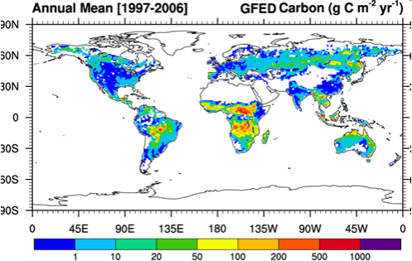
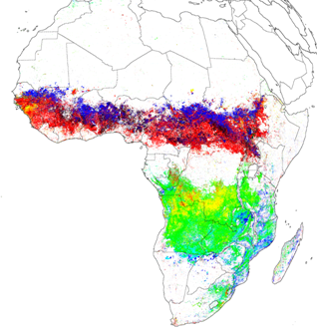
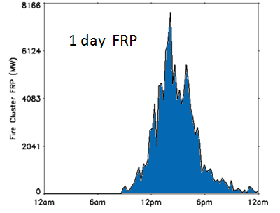
Biomass Burning Emissions Calculation
E_{i} = BA x FL x CC x EF_{i}
E_{i} = FRE x CF x EF_{i}
E_{i} = emission of species i [kg)]
“key uncertainties” (Reid et al. 2009)
(dynamic) veg. model
Global Fire Emissions
Database (GFED)
burnt biomass
land cover map
sat. obs.
Daily FRP
(single fire)
believed
~ constant
Geostationary FRE
(Roberts and Wooster, 2008)
E_{i} = emission of species i [kg(species i)] BA = burnt area [m²]
CC = combustion completeness [kg(burnt fuel) / kg (available fuel)]
EF_{i} = emission factor for species i [kg(species i) / kg(biomass)] FL = fuel load [kg(biomass) / m²]
FRP = fire radiative power [MW] FRE = Fire Radiative Energy [MJ] = ∫ FRP(t) dt
CF = combustion factor [kg(biomass) / MJ (FRE)]
Notes:
Possible drop this one?
This shows the eqn normally used for fire smoke emission calculations, vs that used when we take the fire enegery emissinon approach
Top line is burned area x fuel load x combustion completeness (i.e. how much of the available fuel actually burns)
Bottom line is simpler – Fire Radiaitve Enegry x the “Conversion Factor” defined via the lab experiments.
Both are then mutlitpied by the “EF” – the emissions factor that converts burned biomass into an amount of smoke

Slide 16
Summery
FRP-PIXEL: Operational product on LS ASAF ~10 year;
FRP relate to fuel consumption and smoke release rate;
FRP-PIXEL has genuine full diurnal cycle.

Slide 17
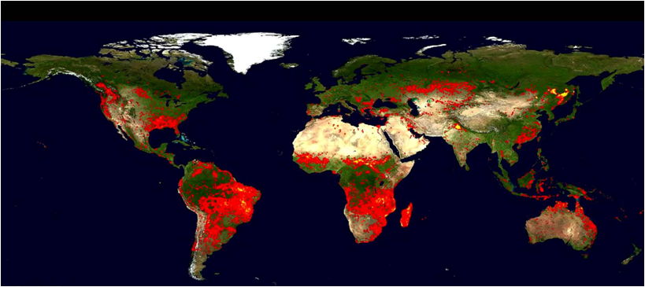
Global Fires from MODIS
1 km resolution – very sensitive to fires - but ONLY 4 passes per day.
Global database – useful for evaluation of other products.

Slide 18
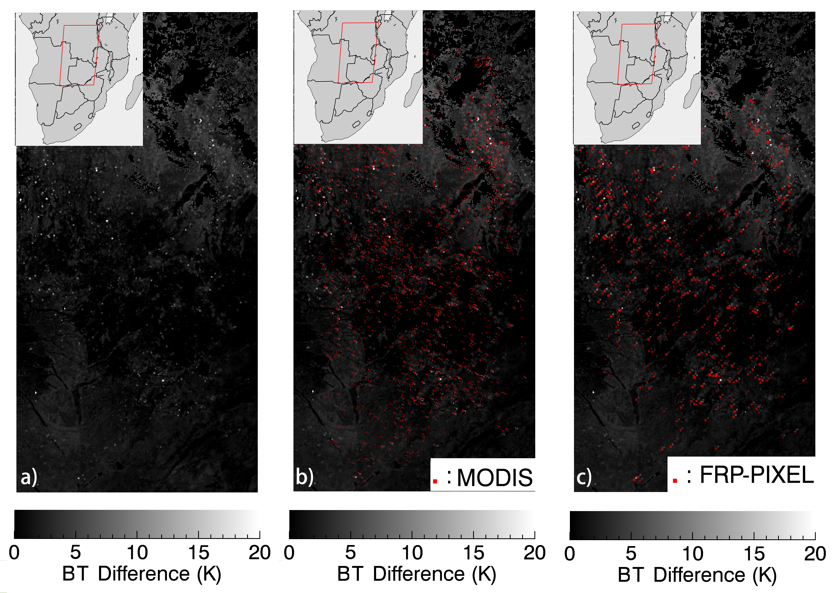
Diurnal cycles
Active Fire Pixel Comparison: FRP-PIXEL & MODIS
Error of omission: 67%
Error of commission: 8%

Slide 19
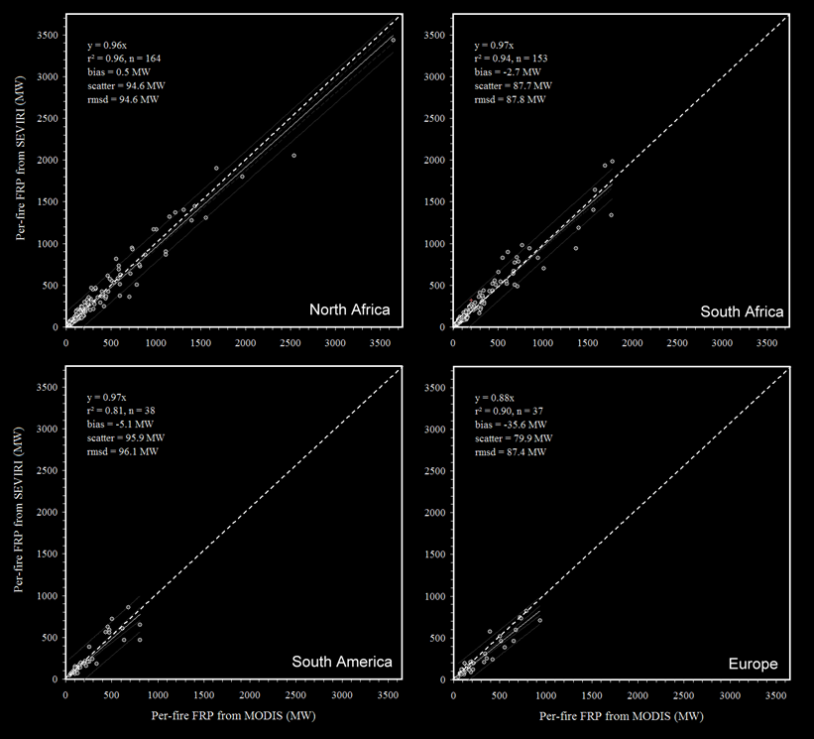
Fire Pixel “Cluster” FRP Comparison
(FRP-PIXEL vs. MODIS )
Slopes: 0.88-0.97
r²: 0.81-0.96
Scatter: 79.9-95.9
RMSD : 87.4-96.1
Conclusion
When SEVIRI and MODIS detect the same fires, the retrieved FRP shows excellent agreement in all four LSA SAF regions.

Slide 20
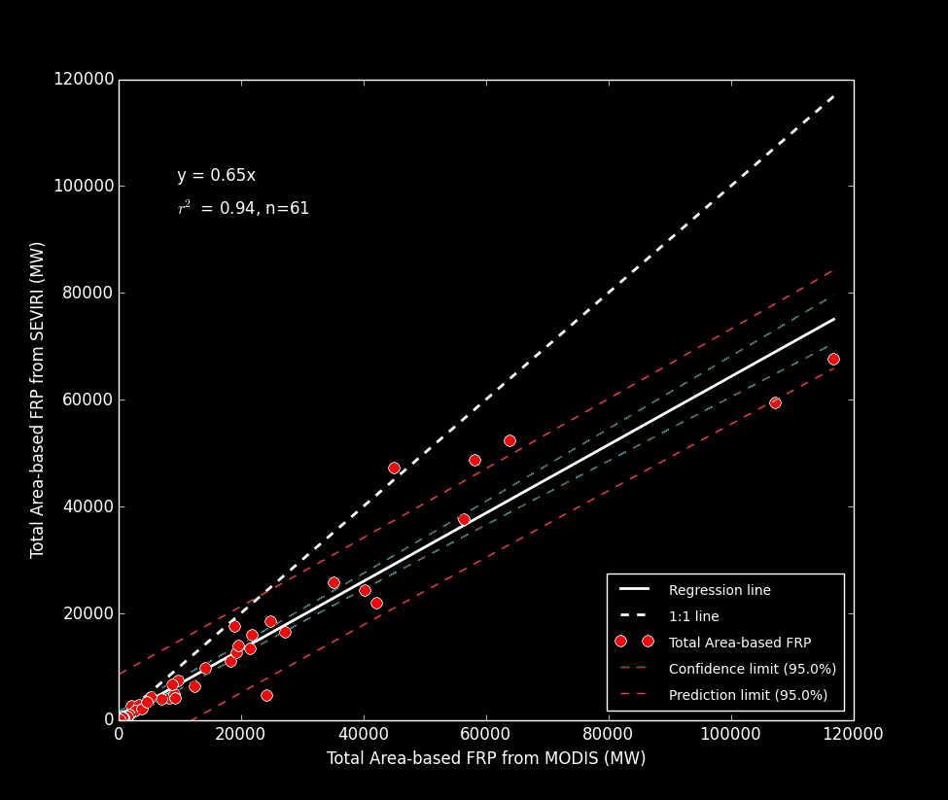
Regional Scale FRP Comparison
(FRP-PIXEL vs. MODIS )
Conclusion
Slope = 0.65
R² = 0.94
1:1
When SEVIRI and MODIS observe the same region, the FRP-PIXEL product tends to underestimate total regional-scale FRP, due to missing “small fire” which can be detected by MODIS.

Slide 21
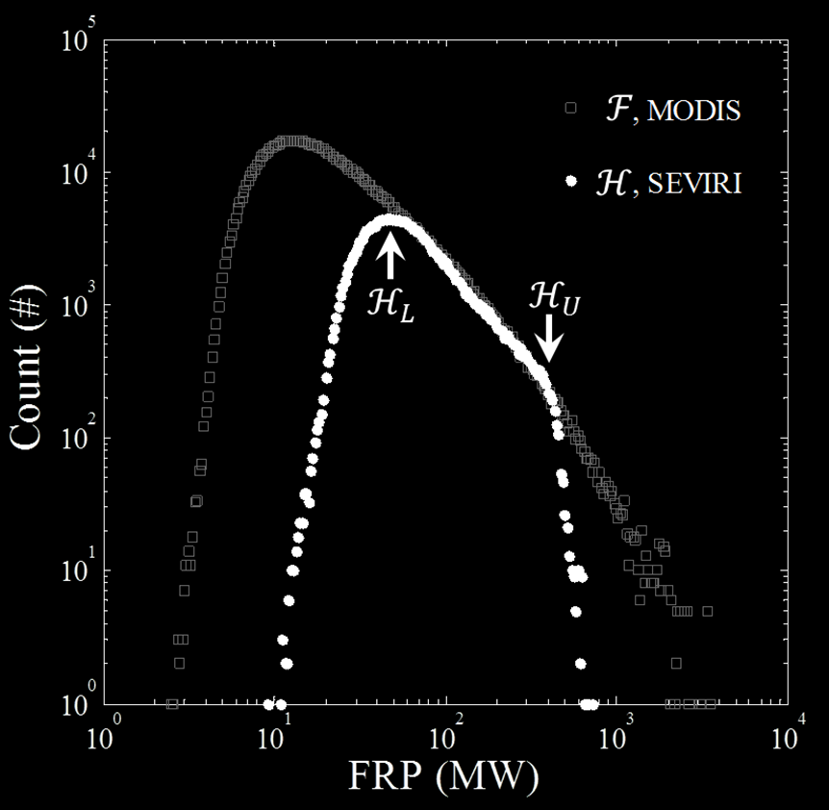
FRP Frequency Distribution
“Rollover” Thresholds
MODIS: ~10 MW
SEVIRI: ~ 40 MW

Slide 22
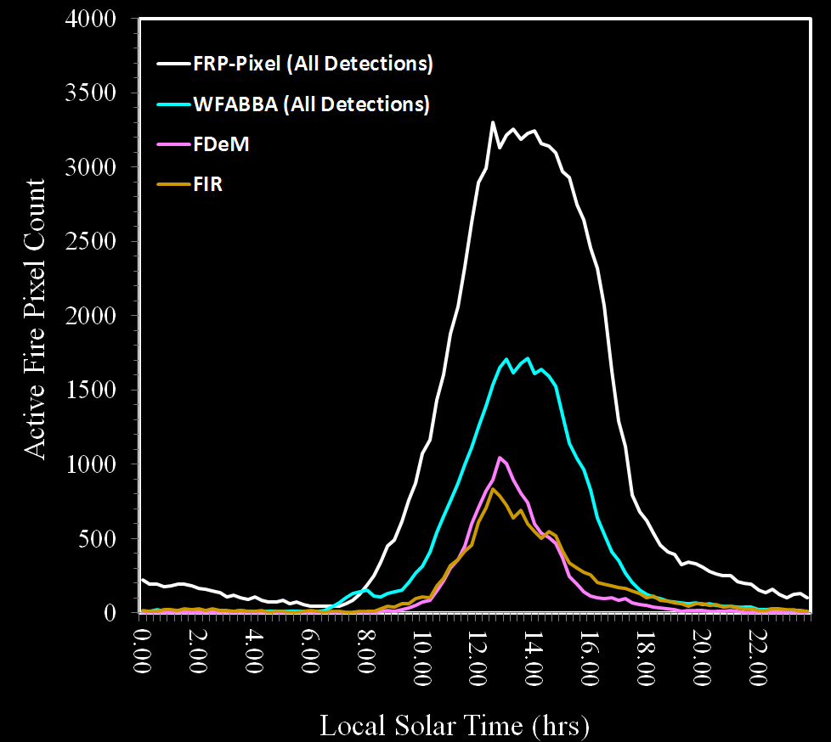
Fire Diurnal Cycle of SEVIRI Active Fire Products
Daily Active Fire Pixel Count
FRP-PIXEL : 89,781
WFABBA : 35,759
FDeM : 13,477
FIR : 14,645
All on 30 Aug 2014
Notes:
Global coverage, using Korean COMS for Asian area.

Slide 23
WFABBA filtered (201408)
FRP-Pixel: Comparison to Alternative SEVIRI Active Fire Products – 21 Aug 2014
FRP-Pixel
WFABBA
Active Fire Pixel Counts
False alarm from WFABBA show a random spatial pattern. No abrupt hot area in the map.
FRP-PIXEL : 1249
WFABBA : 686
FDeM : 346
FIR : 312
FDeM
FIR
All @ 13:15 UTC

Slide 24
Active Fire Detection Performance :
SEVIRI Fire Products vs. MODIS
1 Month Active Fire Error of Omission

Slide 25
Active Fire Detection Performance :
SEVIRI Fire Products vs. MODIS
1 Month Active Fire Error of Commission

Slide 26
Summery
FRP agree well between MODIS and SEVIRI on ‘per fire’ basis;
FRP-PIXEL is very sensitive detect much more fire than other fires product on SEVIRI;
FRP-PIXEL is the only product give FRP value.

Slide 27
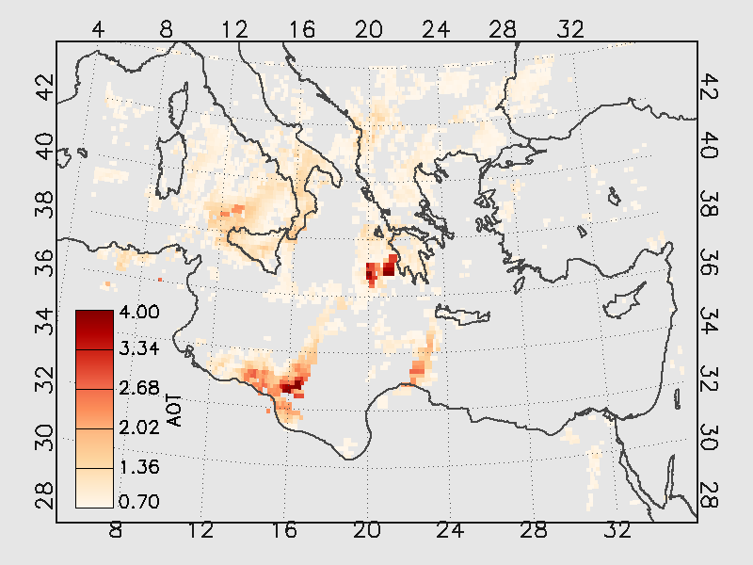
LSALSA
August 2007 Greek Fires
Fuel Consumption

Slide 28
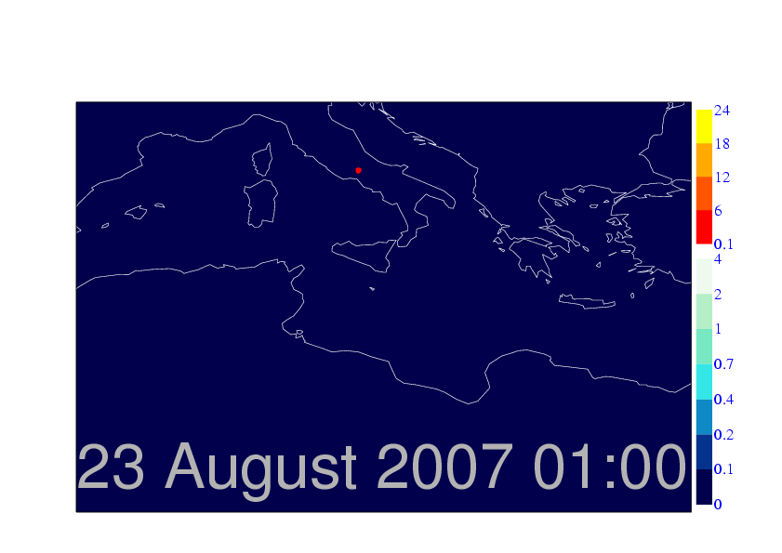
August 2007 Greek Fires
Aerosol Optical Depth
SEVIRI FRP (Observed)
Modelled Plume AOD
Aerosol Optical Depth (Modelled)
MODIS - 26th Aug (09:35 UTC)
Modeling performed under EU MACC Project
Courtesy by Morcrette, J., Jones, L, Benedetti, A. and Kaiser, J

Slide 29

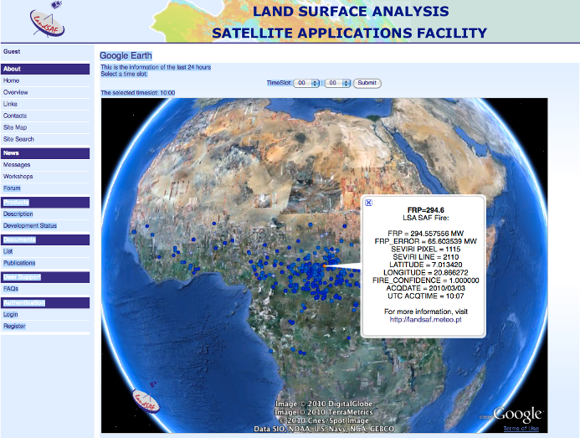
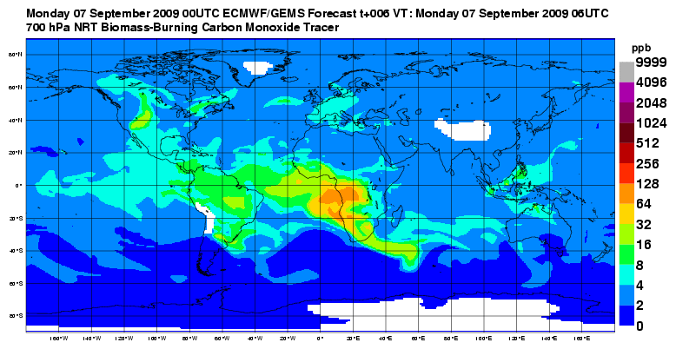
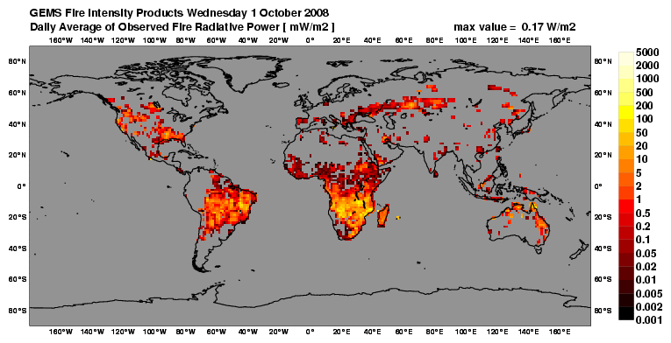


Global Fire Assimilation System (GFAS)
Operational deployment of FRP product via EUMETSAT LSA SAF: http://landsaf.meteo.pt/
Combined with MODIS FRP - then used to model fire chemical emissions in Copernicus Atmospheric Service.
https://atmosphere.copernicus.eu/
Observed Global FRP Areal Density
Modelled CO Biomass Burning Tracer

Slide 30
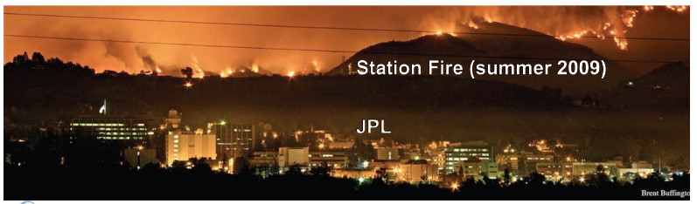
Carbon Monoxide from
Global Biomass Burning
NRT CO biomass burning tracer (ppb)
CO Concentration (ppb) @ 700 hPa
www.gmes-atmosphere.eu/
Notes:
Slide shows the concentration of carbon monoxide in the atmosphere that has been emitted by biomass burning (for one day)
You can see major sources of CO over Africa, South America and also a source in North America – which was caused by the huge “Station Fire” that burned in the hills surrounding LA and got close to NASA JPL.
These emissions can be quite rapidly transported thousands of km away from the actual source region – potentially affecting very large areas of the planet and hundreds of millions of citizens etc etc
Europe wants to operationalise information such as this – so we can monitor and forecast the “state of the atmosphere” (e.g. in terms of its concentration of different atmospheric gases and pollutants), in addition to normal weather monitoring and forecasting
Question is – how do we get information on emissions to the atmosphere in real time from all over the world?
Answer is to use observations from remote sensing satellites – but in regions of the electromagnetic spectrum outside those that we see with our eyes. In particular the infrared region.

Slide 31
Effective fuel-type dependent CF scaled to GFED3.1
Derivation of conversion factors (CF) from linearly regressing monthly GFED3.1 DM with GFAS1.0 FRE
CF_{W}: 0.368 g kJ⁻¹
Kaiser et al. (2012) Biogeosciences

Slide 32
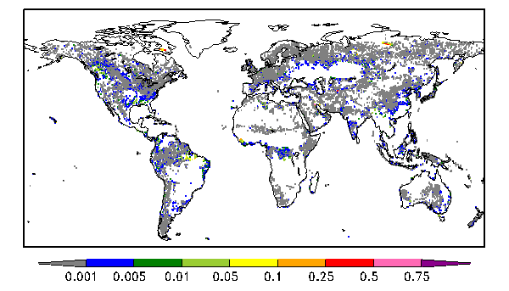
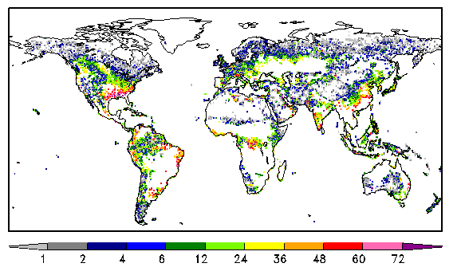
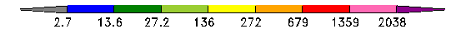
GFED3.1 Non-Detection Areas 2003-2009
Areas where GFAS1.0 shows Burning but GFED3.1 not
GFAS1.0
GFAS1.0
Frequent Fires in
Croplands or Savannah
FRE [kJ m⁻² year⁻¹]
N monthly fire observations [months]
33% of grid cells with GFAS1.0 fire observations not detected by GFED3.1:
- typically low fuel consumption (< 2.7 kJ m⁻² year⁻¹)
- repeated small fires in savanna, deforestation and agricultural areas
- contribute < 3% to global FRE
Only 0.1% of grid cells with GFED3.1 fire observations
not detected by GFAS1.0
EF
SA
DF
AG
Kaiser et al. (2012) Biogeosciences

Slide 33


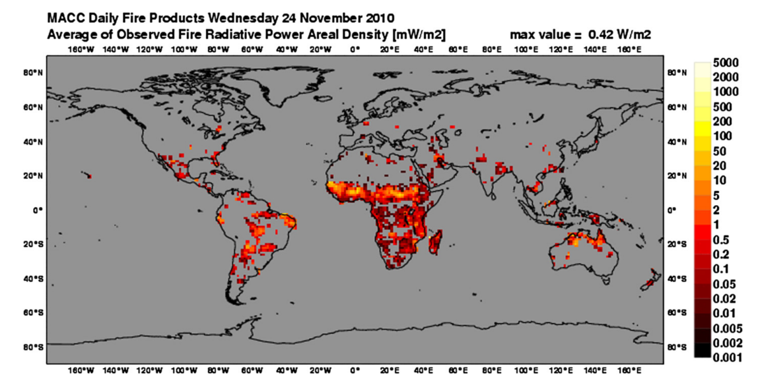

Operational Applications & Science Initiatives
Copernicus Atmosphere Monitoring Service
SALGEE Project
Advanced Fire Information System (afis.meraka.org.za)

Slide 34
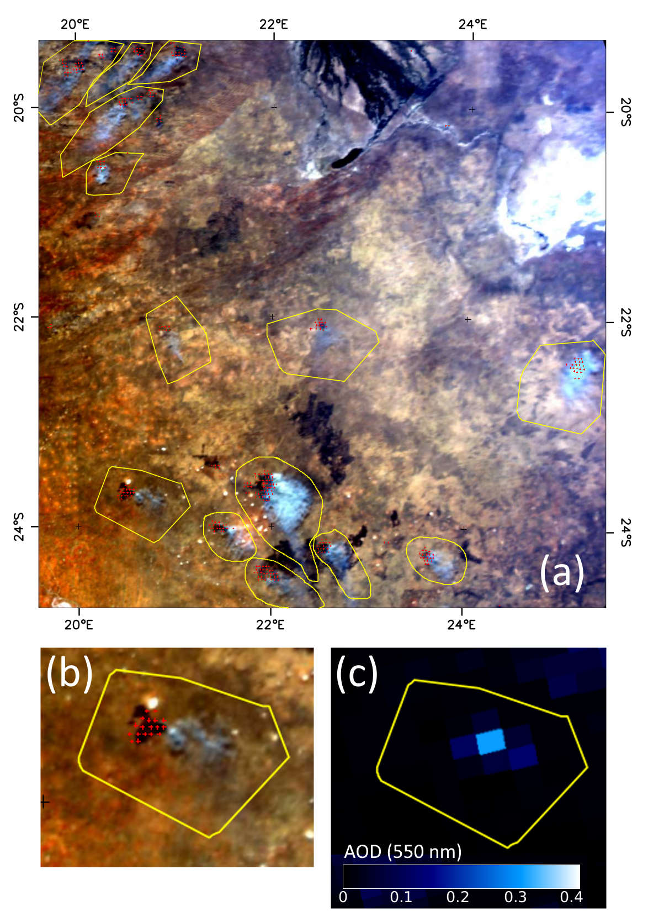

Future work: Fire <carbon> Emissions Product
Total Particular matter Emissions - Higher spatio-temporal resolution than all other emissions products. Now extending to total carbon emissions.
Based on factors linking FRE directly to atmospheric species.
AOD
Active Fires & Plume

Slide 35
Applications
Fuel consumption;
Aerosol optical depth;
Smoke emissions;
Air quality monitoring.

