Slide 1
H SAF Soil Moisture Data Services
Wolfgang Wagner
Department of Geodesy and Geoinformation (GEO) Vienna University of Technology (TU Wien) http://www.geo.tuwien.ac.at/

Slide 2
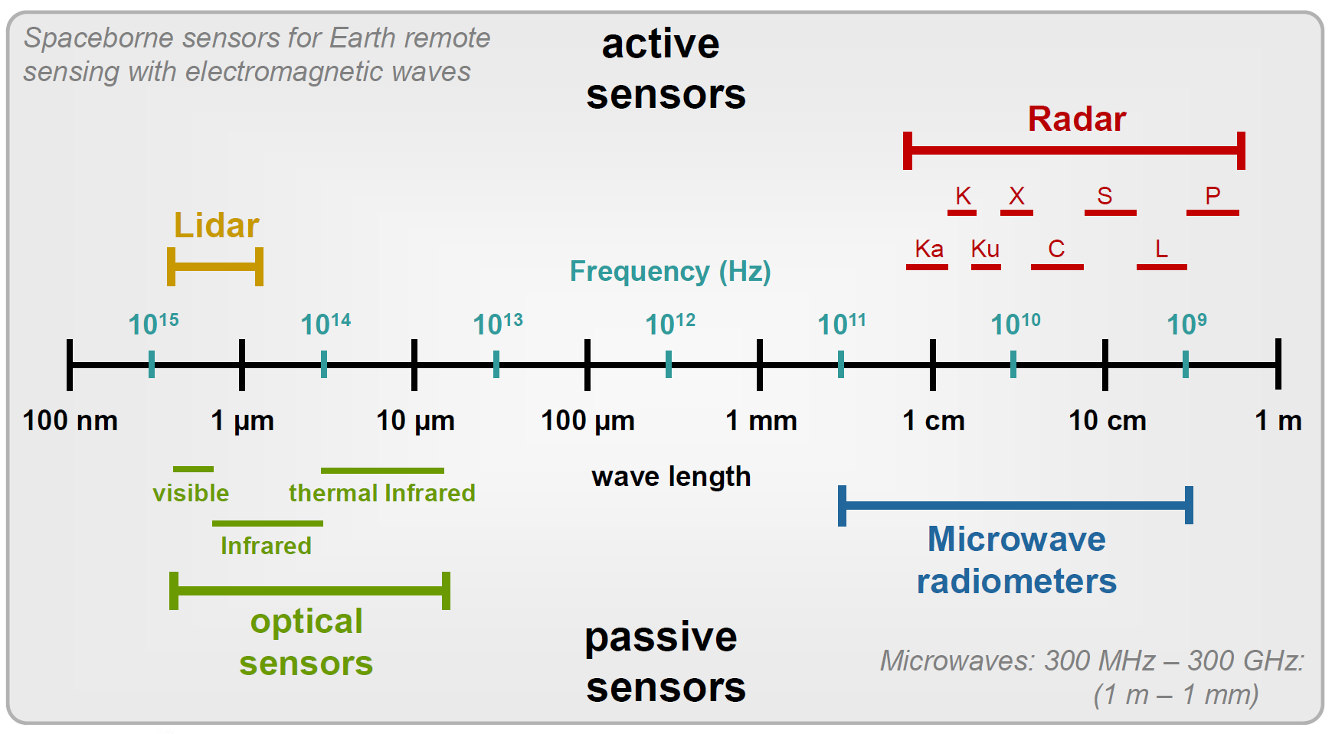
Active and Passive Microwave Remote Sensing
Passive microwave sensors record electromagnetic energy that is reflected or emitted from the surface of the Earth
Microwave radiometers
Active microwave sensors create their own electromagnetic energy and record the backscattered radiation
Altimeters
Scatterometers
SAR
https://earth.esa.int/documents/10174/642943/6-LTC2013-SAR-Moreira.pdf

Slide 3
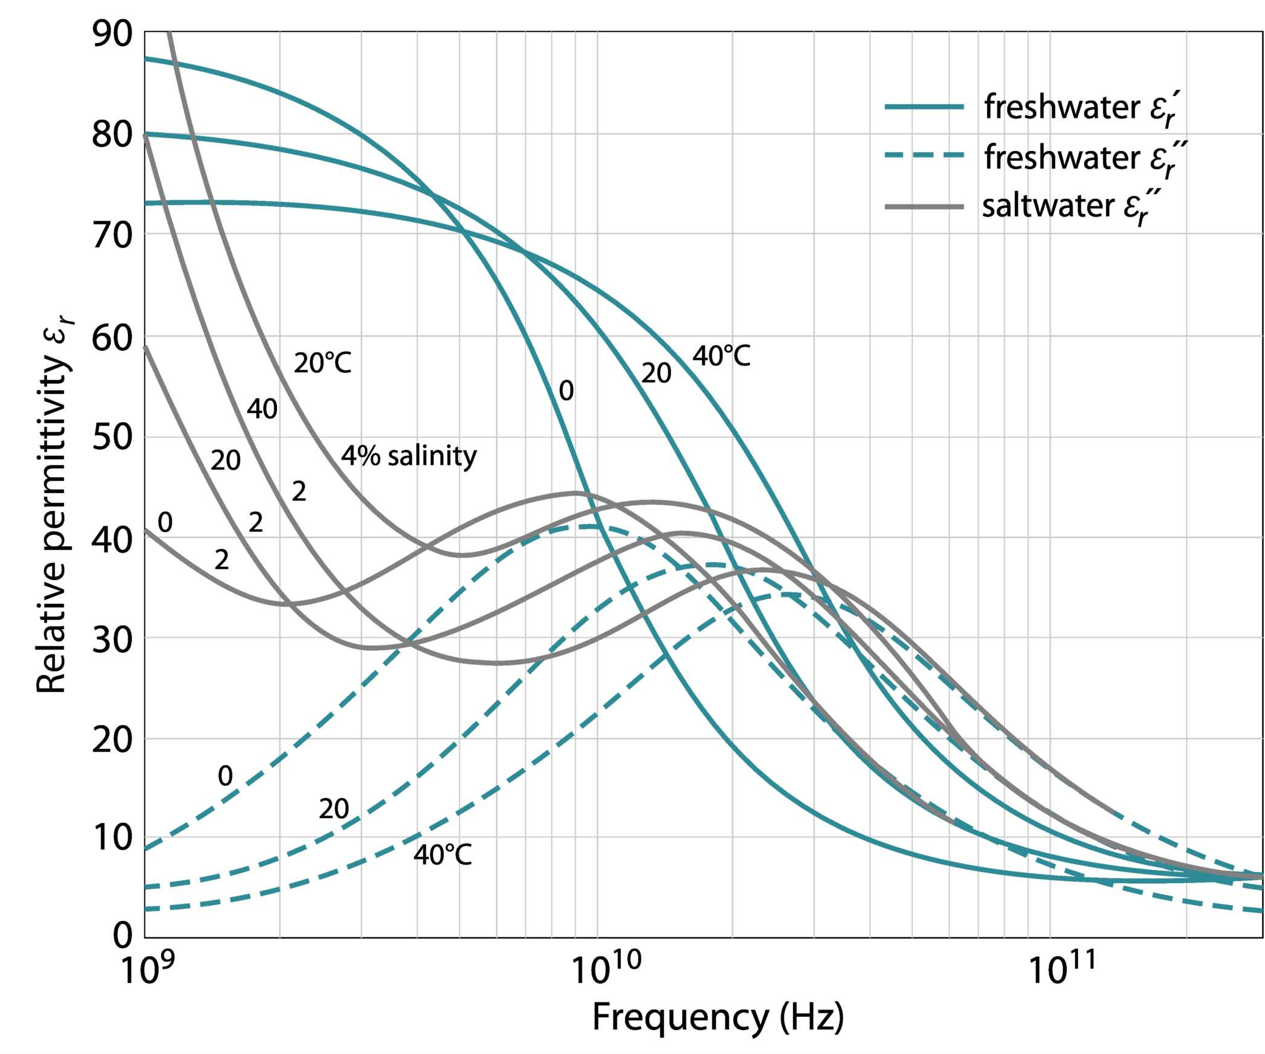
Measurement Capabilities
Microwave measurements are sensitive to
Geometric structure
Roughness
Dielectric properties
Water
High penetration into vegetation and soils
Longer wavelengths beneficial
Target quantities
Soil moisture
Vegetation water
Freeze/thawing
Surface water
Etc.
Dielectric properties of water at microwave frequencies
SMOS
SMAP
Graphic by Bartalis 2009
ASCAT
AMSR2

Slide 4
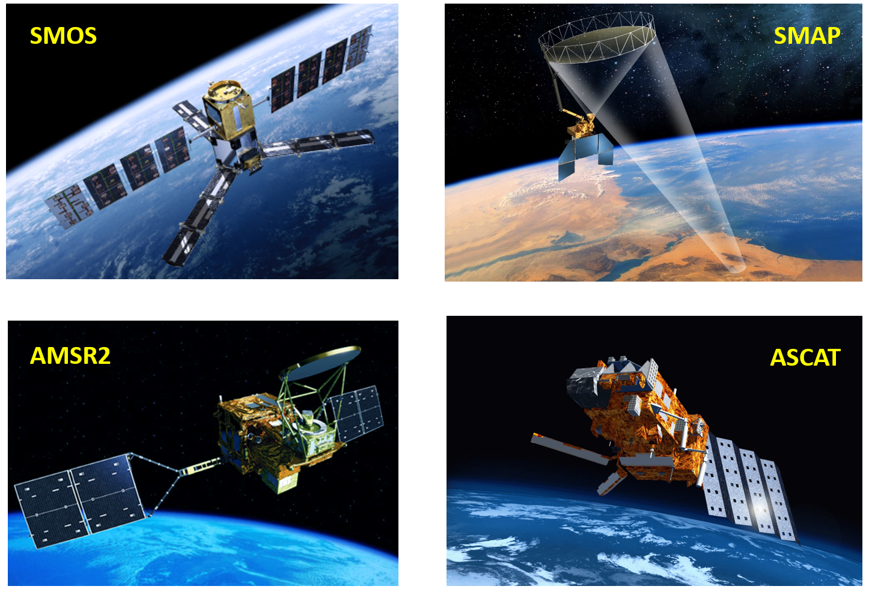
Global Soil Moisture Satellites & Sensors
Passive
λ = 21 cm
~36 km
Passive
& Active
λ = 21 cm
~40 km
Passive
λ = 4.3 cm
~60 km
Active
λ = 5.6 cm
~25 km

Slide 5
European C-Band Scatterometer Series
AMI Scatterometer
Frequency: 5.3 GHz
Polarisation: VV
Resolution: 50 km
Daily coverage: <40%
Satellites
ERS-1: 1991-2000
ERS-2: 1995-2011
METOP ASCAT
Frequency: 5.255 GHz
Polarisation: VV
Resolution: 25 km
Daily coverage: 82%
Satellites
METOP-A: 2006 ongoing
METOP-B: 2012 ongoing
METOP-C: 2018 ongoing
METOP-SG SCA
Frequency: 5.355 GHz
Polarisation: VV + VH + HH
Resolution: ~12.5 km
Daily coverage: ~88%
Satellites
METOP-SG-B1: 2022 METOP-SG-B2: 2030

Slide 6
Incidence Angle Dependency of ASCAT Backscatter
Original ASCAT Measurements
After Normalisation to 40° Incidence Angle

Slide 7
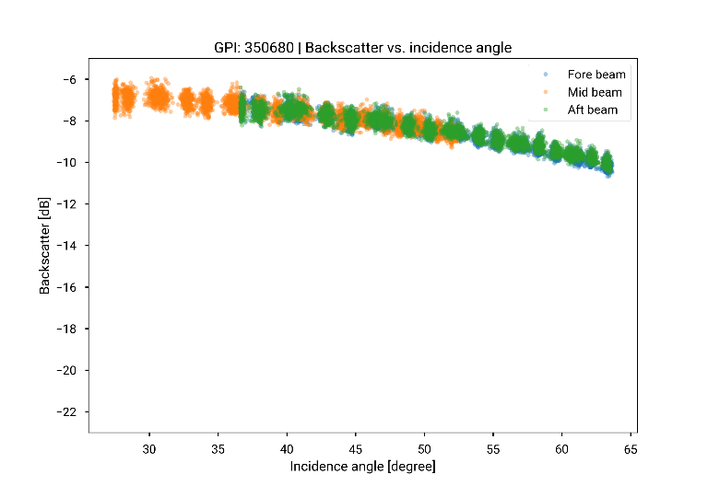
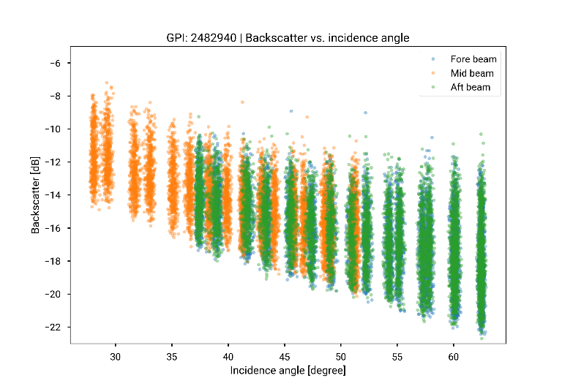
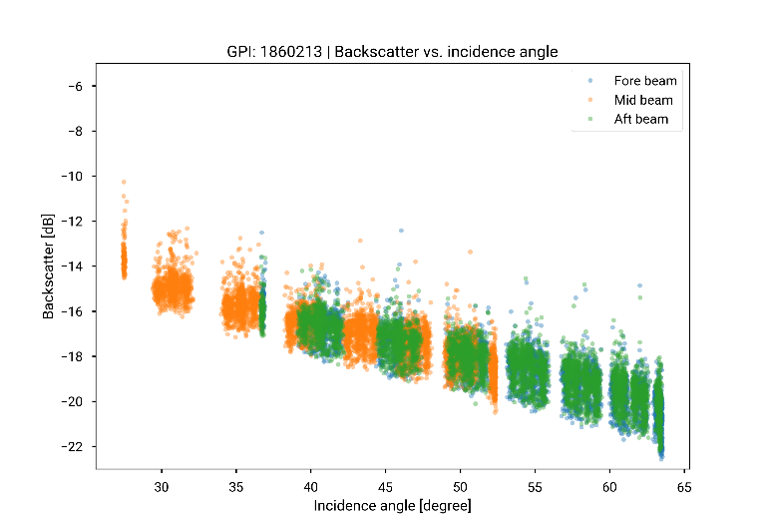
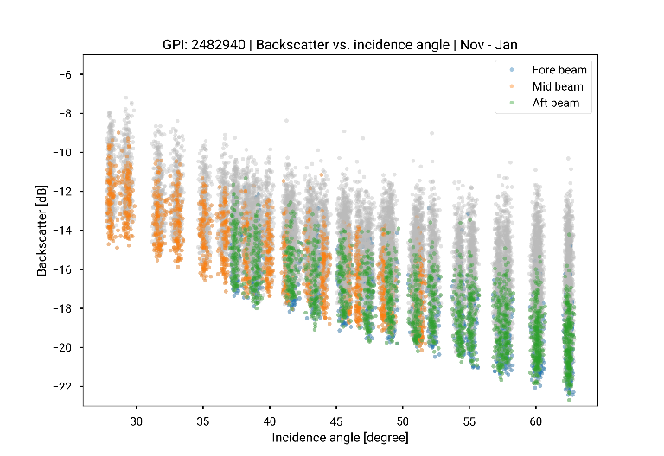
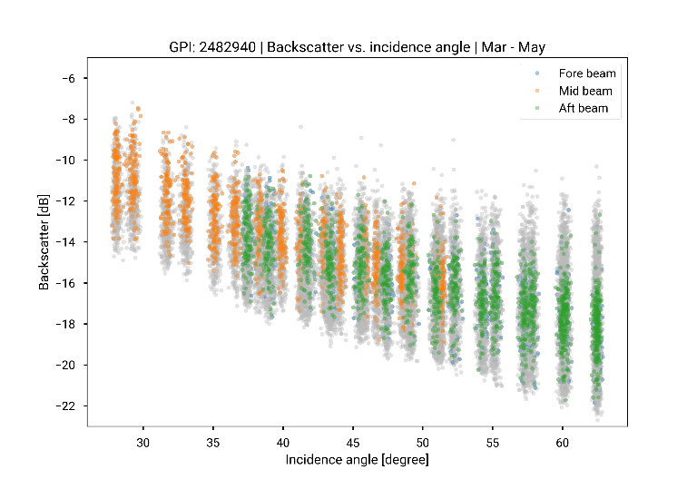
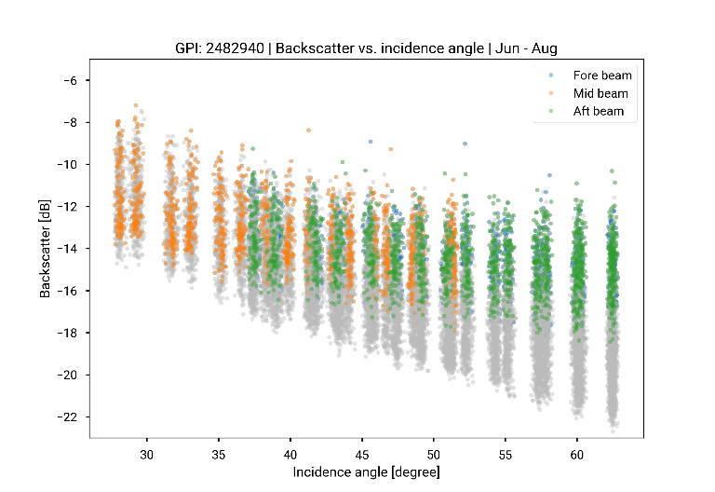
Changes in Backscatter with Land Cover and Season
Land cover
Season
Agriculture/Grassland
Bare Ground &
Low Vegetation
Tropical Forest
Winter
Spring
Summer

Slide 8
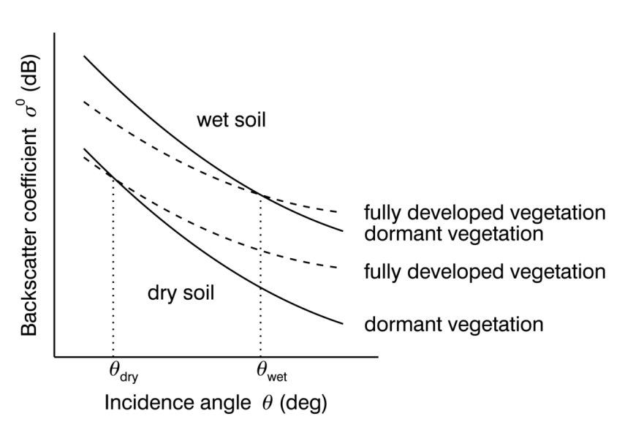
TU Wien Backscatter Model
Linear relationship between backscatter (in dB) and soil moisture
Seasonal vegetation effects cancel each other out at the "cross-over angles"
dependent on soil moisture
Functional behavior similar to “Water Cloud” model

Slide 9
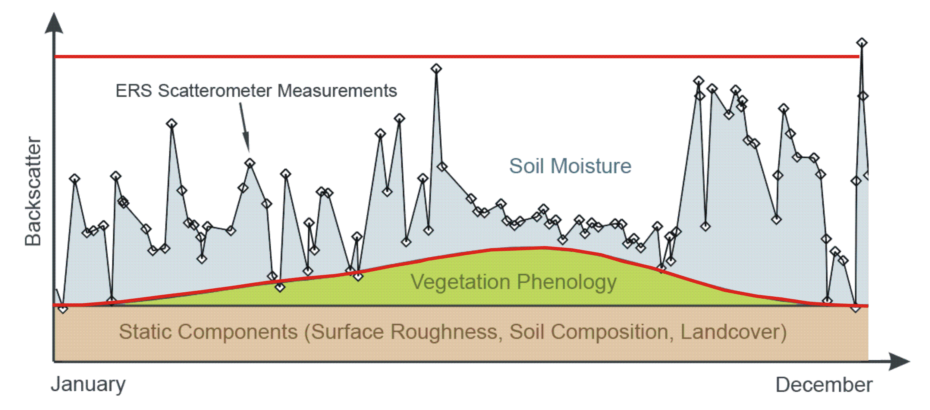
Change Detection
Calibration of model parameters $σ_{dry}^{0}$ and $σ_{wet}^{0}$ by analysing historic time series
Accounts indirectly for land cover and surface roughness
ASCAT Measurements

Slide 10
ASCAT Soil Moisture Data Services
Hydrology SAF
25 km ASCAT SSM in near-real-time and swath geometry
25 km ASCAT SSM data record time series
Disaggregated 1 km ASCAT SSM maps
Root zone soil moisture index based on ECMWF Land Data Assimilation System
Copernicus Global Land
Daily 25 km Soil Water Index (SWI) product based on H SAF soil moisture data
1 km Sentinel-1 SSM for Europe
1 km ASCAT/Sentinel-1 SWI data for Europe
Copernicus Climate Change Service
Climate data records (CDR) and Intermediate CDRS (ICDR) for
0.25° active microwave soil moisture
0.25° passive microwave soil moisture
0.25° merged active/passive microwave soil moisture

Slide 11
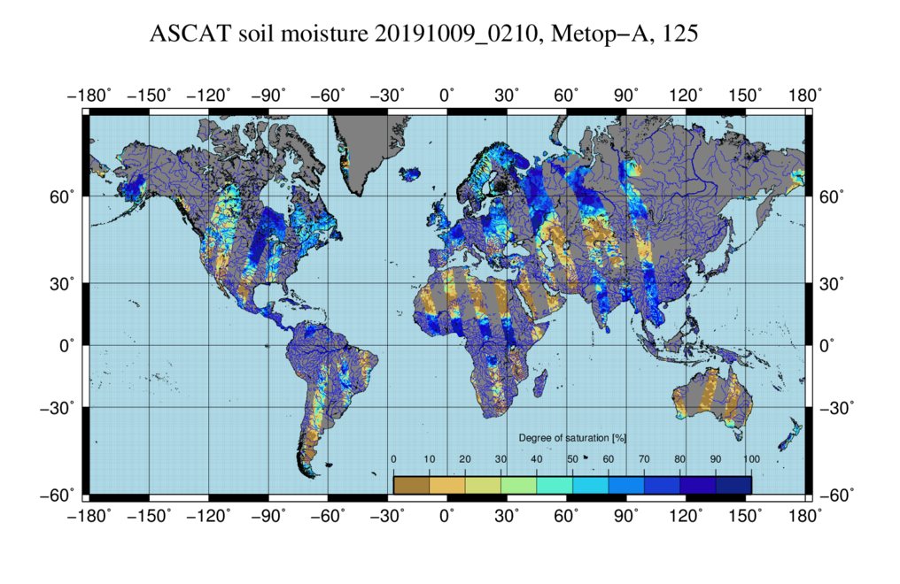
ASCAT Surface Soil Moisture
http://hsaf.meteoam.it/soil-moisture.php?tab=5

Slide 12
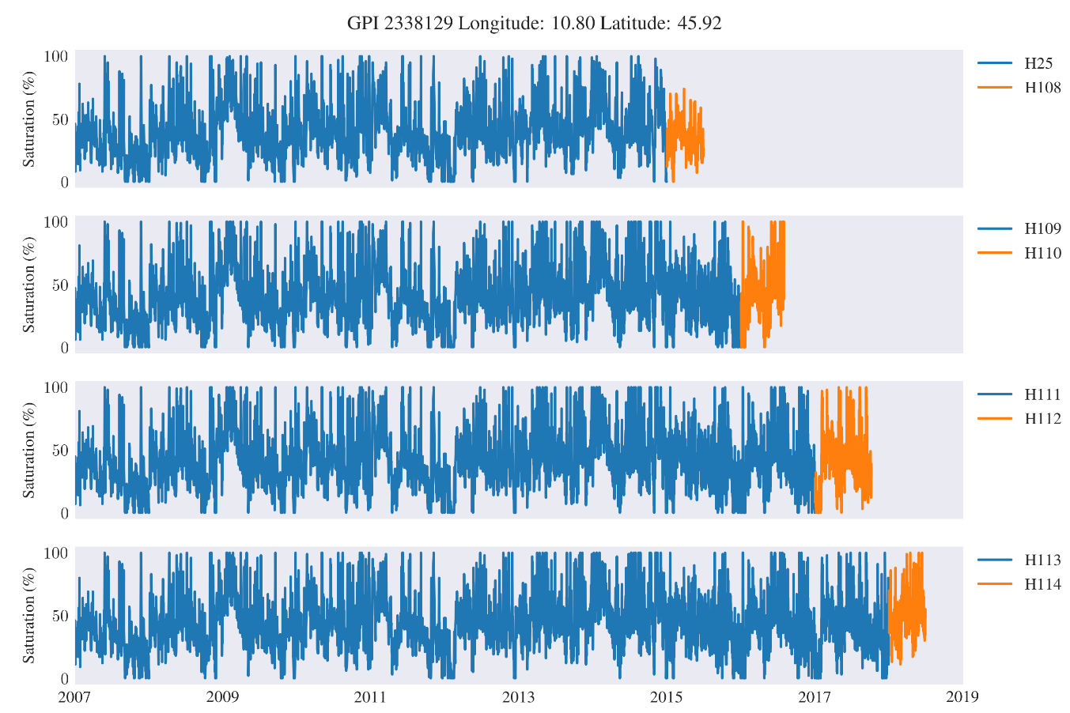
ASCAT Data Record Time Series
For grid point location see: https://www.geo.tuwien.ac.at/dgg/index.php

Slide 13
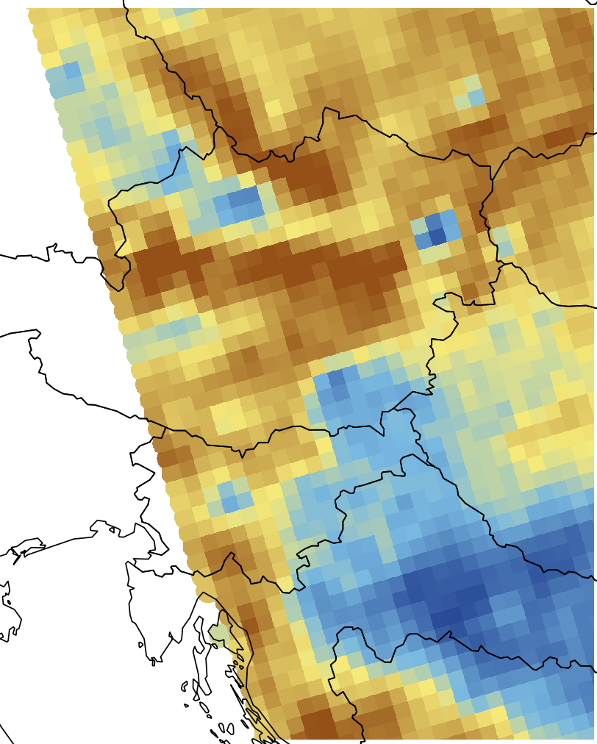
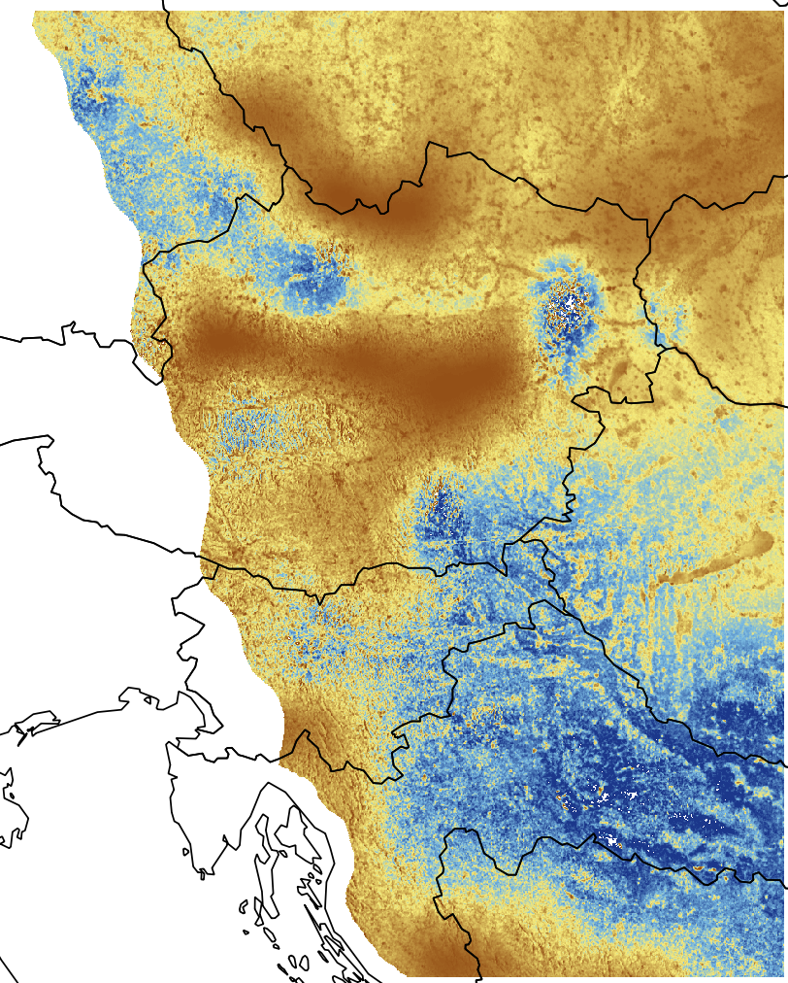
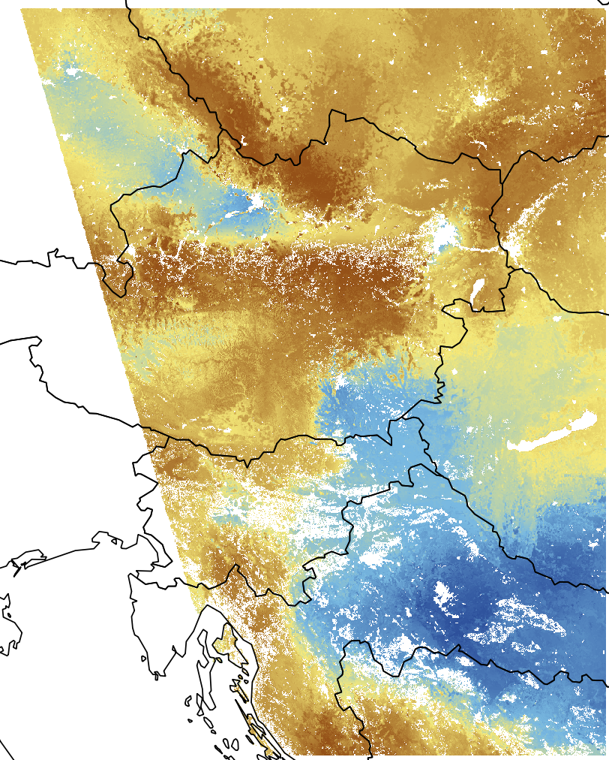
Disaggregating ASCAT SSM based on Sentinel-1
2018-03-21 19:09:00 METOP-B
H SAF H16
H SAF H08
New directional resampling approach

Slide 14
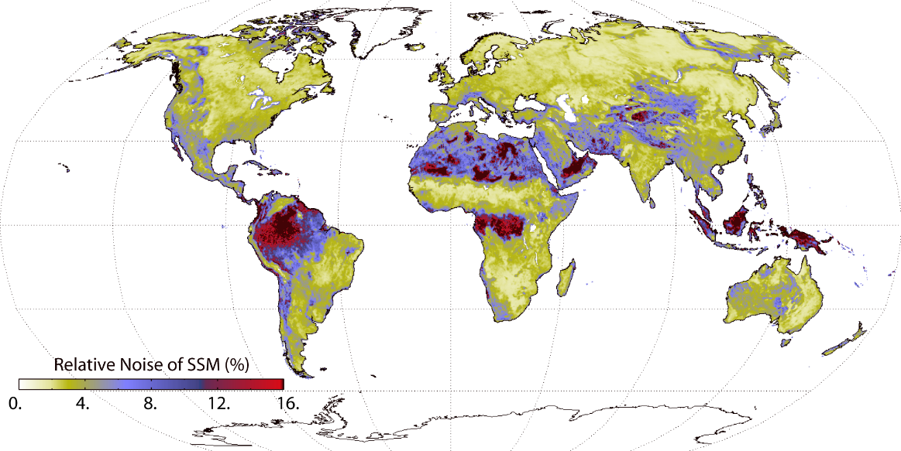
Where does the Retrieval Go Wrong?
Low signal-to-noise ratio (known from error propagation)
Vegetation
Mountainous regions
Urban areas
Where does the model fail?
Frozen ground
Snow cover
Water surfaces
Known issues
Changes in land cover (urban sprawl, deforestation, etc.)
Radio frequency interference
Sub-surface soil scattering

Slide 15
Conclusions
ASCAT surface soil moisture data
carry the same information as SMAP, SMOS and AMSR2 data and are competitive in terms of their accuracy
are fully operational
near-real-time
long-term data records
long-term prospects
are based on mature algorithms
very hard to improve them
Yet, due to their very nature, ASCAT surface soil moisture data are challenging to use! → See my next presentation
Acknowledgements
EUMETSAT: H-SAF CDOP2

