Slide 1



LST as a climatic index of drought monitoring and impact assessment
SALGEE
Julia Stoyanova
Contribution: Christo Georgiev, Plamen Neytchev, Andrey Kulishev
National Institute of Meteorology and Hydrology, Bulgaria
6th SALGEE Workshop, 14 – 17 October, Darmstadt, EUMETSAT HQ, Germany
‘MSG Land Surface Applications: Connection of climate and biosphere’

Slide 2
The aim
To explore the utility of skin temperature retrievals from infrared observations by the Meteosat geostationary satellite as a soil moisture indicator in a climatic context for the region of the Eastern Mediterranean (Bulgaria) (Stoyanova et al., 2019, Atmosphere, accepted)
Needs from advanced approaches that allow LST application as a biogeophysical drought indicator.
Applicability of LST product as a drought indicator
  Identifying the drought prone regions over Bulgaria.
  Illustrating the effect of drought on fire activity using satellite information
  Illustrating the effect of drought on crop yield production

Slide 3
Spectrum of drought
Drought is an event-driven extreme, which do not necessarily occur every year at a given location.
A drought is a complex phenomenon that can be defined from several perspectives.
Meteorological drought
usually defined as a significant negative
deviation from mean precipitation
Hydrological drought
a deficit in the supply of surface and sub-
surface water (run-off, water levels)
Agricultural drought
a combination of meteorological and
hydrological droughts resulting in reduced
supply of moisture levels for crops)
Ecological drought
reflected by ecosystem functioning
Socioeconomic drought
combination of the above droughts leading
to undesirable social and economic impacts
Therefore Drought is part of the natural climate variability and can be observed in all climate regimes. Unlike aridity, drought is a temporary abnormal phenomenon, usually characterized by lower than average water availability for the population or for the environment.

Slide 4
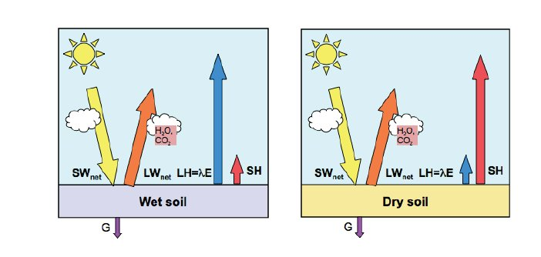
Land-atmosphere coupling
As a sort of land surface state, drought is a result of land-atmosphere coupling.
Coupling of energy-water cycles is the bases of ecosystem functioning that is resulting in transformation of solar energy into the energetic fluxes of latent heat, LE and sensible heat, H towards atmosphere, and in the soil, G;
  from the other side influences the vegetation functioning (intensity, efficiency).
Seneviratne et al. (2011)
wet climate regime
dry climate regime
Notes:
4

Slide 5

Biogeophysical cycles regulating fluxes of energy-water
Water
Energy
Evaporative cooling
Radiative budget
P
E
Rn
λE
H
SW_{in}
SW_{out}
E=60%P
λE=50-60%Rn
Variations of α: 0.1-0.2
Teuling et al (2010)

Slide 6
The role of soil moisture in propagation of Mediterranean drought:
Coupling of energy-water cycles at ‘Dry’- ‘Wet’ soil
Terrestrial drought in terms of biogeophysical cycling
meteorological processes that shape the land surface state
The role of soil moisture in propagation of Mediterranean drought: Coupling of energy-water cycles at ‘Dry’- ‘Wet’ soil is reflected by the proportion between LE and H.
A better description, understanding and modelling of soil moisture and associated land-atmosphere interaction would improve the predictability at both daily and sub seasonal scale.

Slide 7
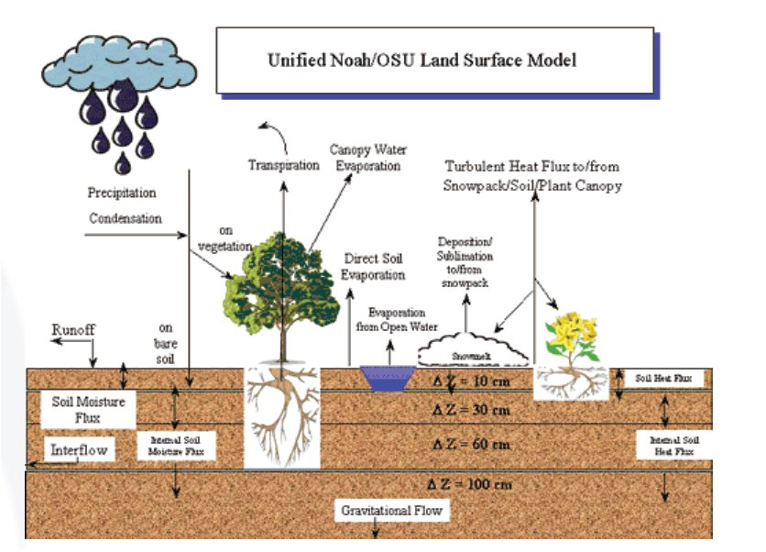
  Why LST is a key biogeophysical variable in land surface processes?
Land Surface Temperature (LST) is one of the key variables in the physics of land-surface processes on regional/global scales; As a functional parameter in main biogeophysical processes of energy-water-carbon balances it combines the effects of all surface-atmosphere interactions.
Surface skin temperature knowledge on regional and global scales are of importance for Global Circulation Models, for estimation and parametrization of surface fluxes (e.g. Brutsaert et al, 1993), to monitor drought, and estimate soil moisture (e.g. Feldhake et al., 1996), and water budget components (Park et al., 2005), fire risk (e.g. Stoyanova and Georgiev, 2010), and many others.

Slide 8
2. Approach
Selected drought indicators linked to the coupling between the energy and water cycles (and thus considered as biogeophysical indexes)
  Soil Moisture Availability (SMA) to vegetation land cover (source: meteorological modeling)
  Skin temperature retrieval based on IR satellite information from Meteosat Second Generation.
Numerical comparative analyses of satellite information from Meteosat and numerical modeling of SMA (as a reference)
Test scheme: The consistency in the behavior of the two indexes is evaluated by a stochastic graphical analysis using two approaches:
    quantitative site-scale comparison and
    spatial-temporal variability

Slide 9
Dataset: Long-term records, March-October (2007-2018)
LSASAF LST
  0900 UTC and 1200 UTC time slots (±30 min to avoid the limitations of cloudy pixels) are inferred at MSG pixel resolution.
  only values in the 1400 grid points of the ECMWF global NWP model IFS version that cover the region of Bulgaria are used.
SMAI (referred to the root zone depth horizons)
  produced operationally at NIMH since 2010 as a post-processing of the SVAT_bg
  inputs from meteorological measurements at 36 synoptic stations of the NIMH operational network
  SMAI is calculated at 20 cm, 50 cm, 100 cm, and the mean between 05-100 cm soil layers.
  used as a reference to identify dry anomalies
GDAL_grid library is used
  to interpolate soil moisture in the mesoregions and producing maps
  for georeferenced gridded LST datasets for the region of Bulgaria to produce and visualized maps.

Slide 10
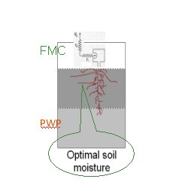
The Soil Moisture Availability (SMA) concept
Relation between soil media and atmosphere
Physical interpretation of SMAI
dry wet
For characterizing of coupling SM-atmosphere, the Soil Moisture Availability (SMA) to the vegetation cover is used.
SMA is a measure of both: SM dynamics and vegetation functioning, which in turn is reflected by LS state indicators: Ts, LE, H, E, etc.
Multiple equilibrium states in the soil-vegetation-atmosphere system are characterized by different levels of SMA, which is limited within the FMC and PWP moistening.
CTM
Limited SMA
At non-limiting SM conditions, the evapotranspiration from the plant community is not restricted.
At limiting SM conditions, the evapotranspiration from the plant community is restricted and controlled by soil.
SMA being the main determinant of plant systems development, at the same time might serve
as information source for “warnings” for environmental constrains.

Slide 11
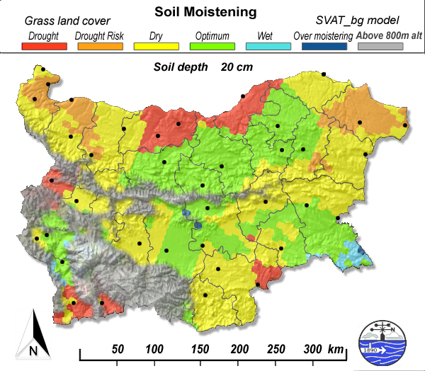
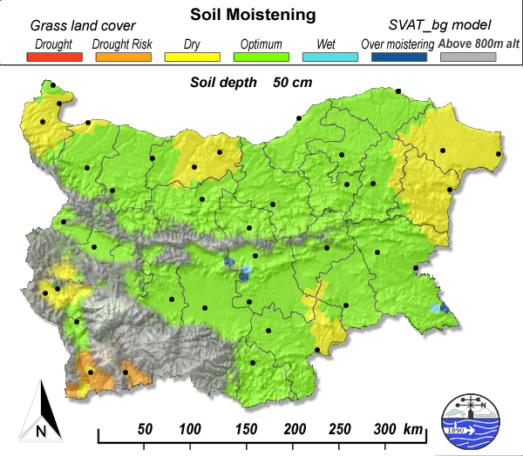
The Soil Moisture Availability Index (SMAI)
Drought identification by Soil Moisture Availability Index (SMAI)
SMAI is designed as a 6-level threshold scheme to account for moistening conditions. SMA is expressed by digital values ranging from 0 to 5, which are correspondingly color-coded, Table 1:
Table 1. Categories of dry/wet classes by the SMAI
Category | SMAI values | SMAI color-coding
Drought | 0 | Red
Drought risk | 1 | Orange
Dry | 2 | Yellow
Optimum | 3 | Green
Wet | 4 | Light blue
Over-moistening | 5 | Dark blue
Figure 1. Example of color coded maps of SMAI over Bulgaria for: (a) 0-20 cm soil layer; (b) 0-50 cm soil layer.
(Stoyanova & Georgiev, 2013)

Slide 12
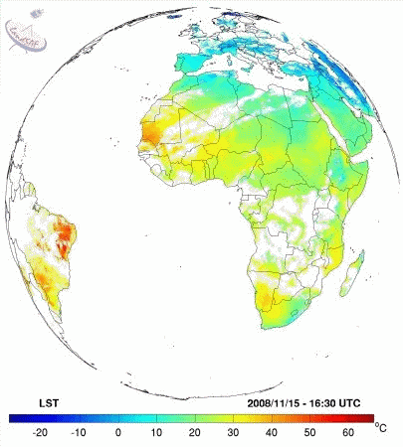
The LSASAF LST product
MSG LST can refer to an average effective LST, which is the radiative skin temperature over land derived from clear-sky thermal IR radiation.
Operational since Jan 2005. The algorithm uses a number of Input parameters derived from SAF satellite products and NWP data.
Inputs: Land Sea Mask + LandCover (GLC2000)
FVC ← LSA SAF
Cloud Mask ← NWC SAF (SEVIRI + ECMWF)
TCWV ← ECMWF
Tb (SEVIRI 10.8 & 12.0 μm)
Clear Sky Algorithm
IR 10.8μm and 12.0μm
general split window channels
Non-Clear
Pixel NOT Processed
MSG - Projection
15-min Frequency
LST & Quality Control
https://landsaf.ipma.pt/en/products/land-surface-temperature/lst/

Slide 13
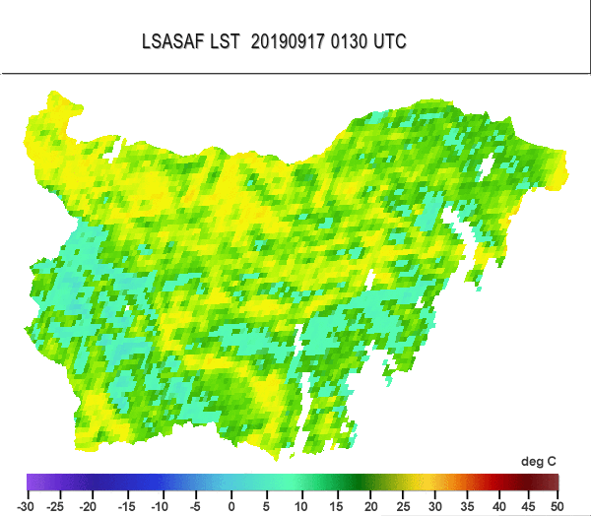
LSA SAF Land Surface Temperature (LST) the physical temperature of the Earth’s surface
Space variability of LST is modulated by surface properties like vegetation density and soil moisture.
As a functional parameter in main biogeophysical processes of energy-water-carbon balances LST combines the effects of all surface-atmosphere interactions.
    Available both in near real time and off-line:
EUMETCast
LSA_SAF_Archive
FTP
The LSA SAF products are operationally disseminated in HDF5 format:
  For qualitative analyses, products are used in image format.
  Digital values can be inferred at MSG pixel resolution.
Being related to the energetic and water cycles, LST derived by satellite data, can be used as a key parameter in drought analysis.
Notes:
13

Slide 14
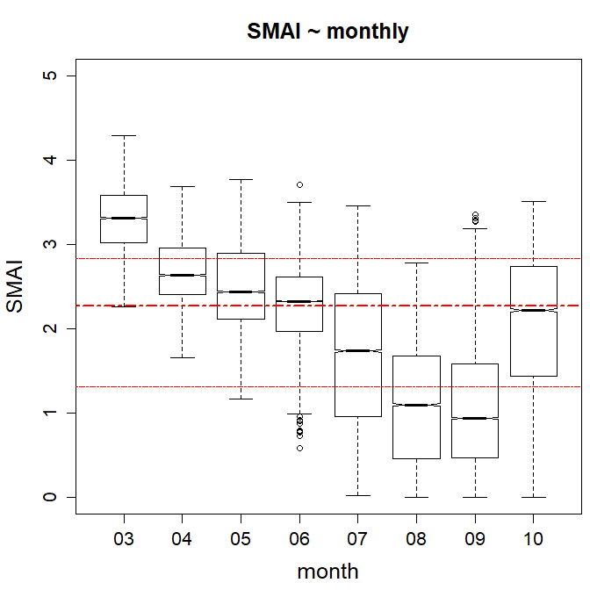
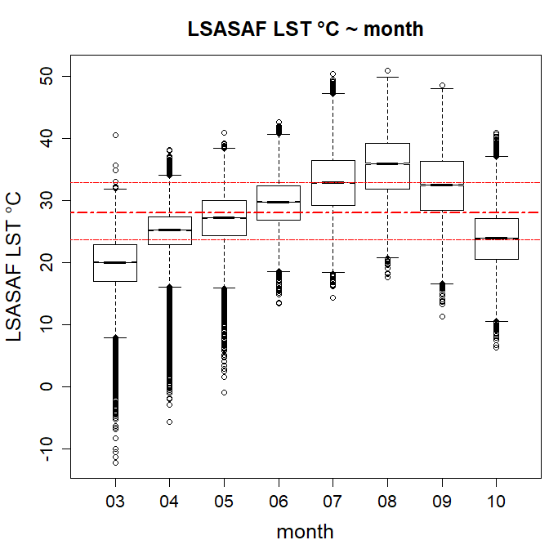
Results
LSASAF LST sensitivity as a soil moisture indicator /climatic context/
Temporal variability of biogeophysical indexes
seasonal course of SMAI and LST for the region of Bulgaria
Figure 2. Boxplots of monthly mean values (2007-2018) for the region of Bulgaria during the growing season (March-October) of: (a) SMAI; (b) LSASAF LST 0900 UTC °C.

Slide 15
1) Temporal variability of biogeophysical indexes seasonal course of SMAI and LST for the region of Bulgaria (monthly mean, 2007-2018)
Figure 2. Boxplots of monthly mean values (2007-2018) for the region of Bulgaria during the growing season (March-October) of: (a) SMAI; (b) LSASAF LST 0900 UTC °C.
Mean SMAI and LST have opposed seasonal trends
initial higher SMAI (optimum moistening) in spring (March) - steadily depleted in parallel to increasing insolation and vegetation development - becomes significantly depleted in July (between dry and risk of drought stages of SMAI scale) - reaches a minimum in August/September (risk of drought and drought) - starts to increase in autumn
Accordingly, LST starts from lowest mean annual values in March and steadily increases with a maximum in August (mean value of about 35 °C).

Slide 16
2) Spatial variability of biogeophysical indexes in ‘dry’ and ‘wet’ conditions
Qualitative analyses
Spatial variability of the two biogeophysical parameters are strongly related to the distribution of energy-water cycles across the climate gradient of Bulgaria, thus their evolution is performed for a variety of environmental conditions.
SMAI and LST experimental evolutions
Years/months with dominant sensible heat fluxes are selected: in this case a high energetic loading but limited precipitation leads to depleted SMA and drought occurrence with different levels of severity. Such years/months are classified as ‘dry’ periods.
Years/months with dominant latent heat fluxes are selected: in this case even at a high energetic loading precipitation is above norms, soil becomes saturated (and even over-moistened), and evapotranspiration is undisturbed. Such years/months are classified as ‘wet’ periods.

Slide 17
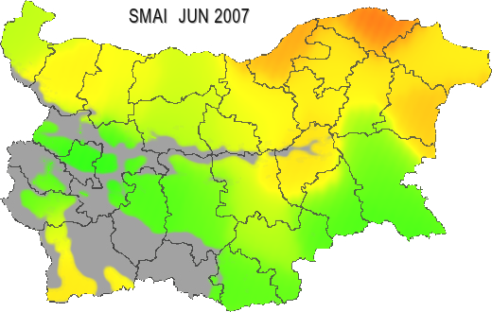
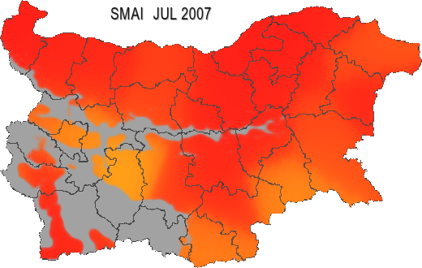
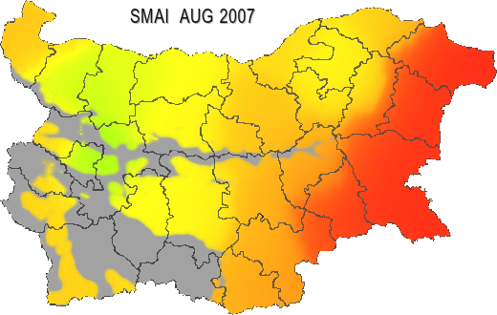
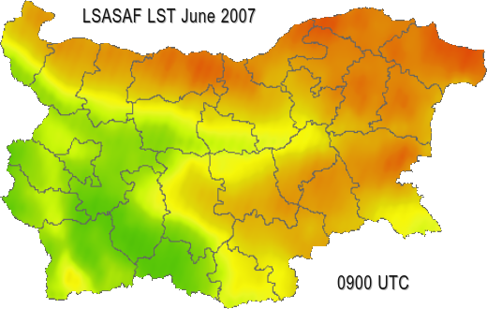
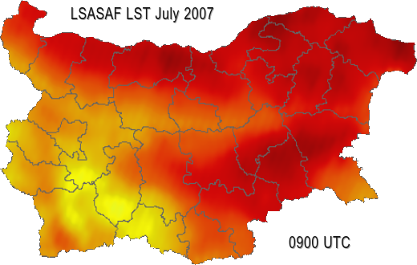
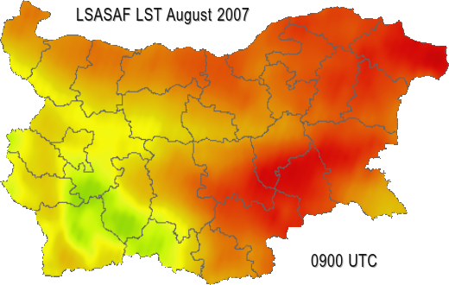
SMAI and LST during dry conditions
Example: 2007 deficient precipitations from April up to the beginning of August, below monthly norms.
(a)
(b)
(c)
(d)
(e)
(f)
Figure 3. Spatial distribution of monthly mean SMAI (50 cm soil layer) over Bulgaria in 2007 for:
(a) June; (b) July; (c) August, and of LSASAF LST for: (d) June; (e) July; (f) August.

Slide 18


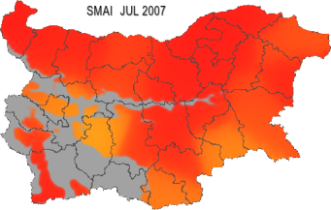



SMAI and LST during dry conditions
Example: 2007 deficient precipitations from April up to the beginning of August, below monthly norms
(a)
(d)
Qualitative comparison
A good agreement between the spatial distributions of the two indexes:
The lower the SMAI (i.e. increased drought severity) the higher LST.
Accumulated terrestrial drought leads to increased land surface temperature, as in July 2007.
For the regions with low SMAI indicating dry conditions, LST values according to the MSG-based satellite product are high.
(b)
(e)
(c)
(f)
Figure 3. Spatial distribution of monthly mean SMAI (50 cm soil layer) over Bulgaria in 2007 for: (a) June; (b) July; (c) August, and of LSASAF LST for: (d) June; (e) July; (f) August.

Slide 19
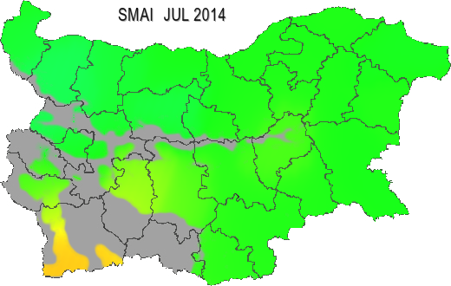
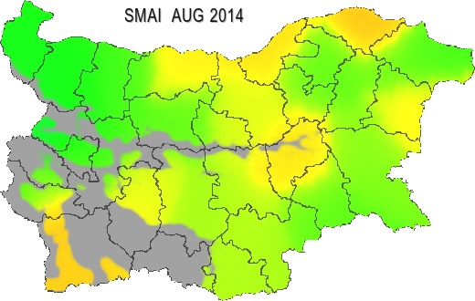
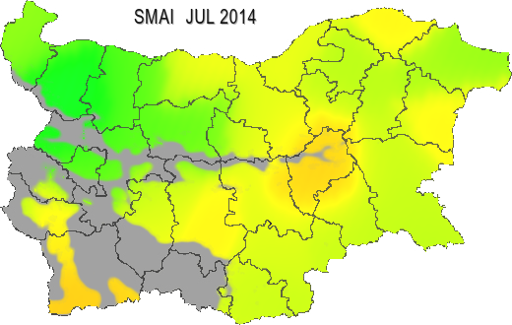
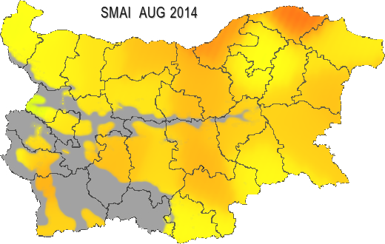
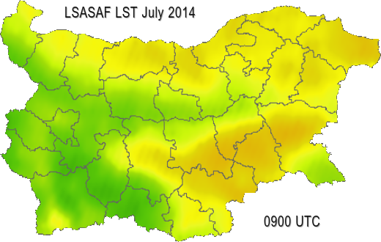
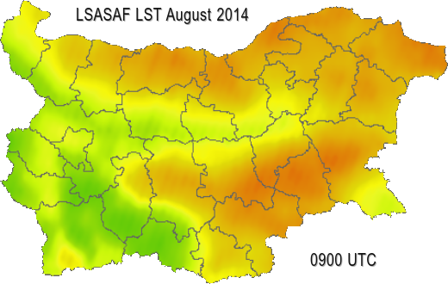
SMAI and LST during wet conditions
Example: 2014, for all months (March-October) and for almost all parts
precipitation is above climatic monthly norms
July
SMAI
August
(a)
(b)
50 cm soil depth
(c)
(d)
20 cm soil depth
(e)
LSASAF LST
(f)
Figure 4. Spatial distribution of monthly mean SMAI (50 cm soil layer) over Bulgaria in 2014 for: (a) July; (b) August, and of SMAI (20 cm soil layer) for: (c) July and (d) August; as well as LSASAF LST for: (e) July; (f) August.

Slide 20
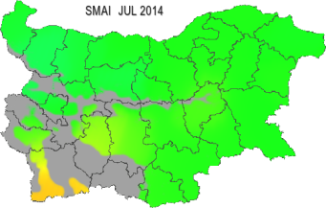


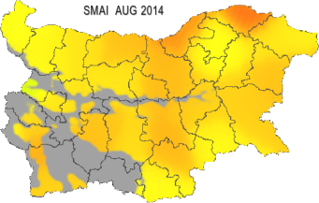


SMAI and LST during wet conditions
Example: 2014, for all months (March-October) and for almost all parts precipitation is above climatic monthly norms
July
SMAI
August
(a)
(b)
Qualitative comparison
The LST spatial variability is more closely related to SMAI distribution for 20 cm soil depth than SMA for 50 cm soil depth:
Spatial distribution of SMAI for the 50 cm soil layer indicates optimum soil moisture availability from March to July with a slight decrease in August
Spatial variability of SMAI at 20 cm depth (Fig. 4 c,d) corresponds much better to that of the LST distribution (Figure 4 e,f)
  regions with increasing drought correspond to higher LST values.
50 cm soil depth
(d)
(c)
20 cm soil depth
LSASAF LST
(e)
(f)
Figure 4. Spatial distribution of monthly mean SMAI (50 cm soil layer) over Bulgaria in 2014 for: (a) July; (b) August, and of SMAI (20 cm soil layer) for: (c) July and (d) August; as well as LSASAF LST for: (e) July; (f) August.

Slide 21
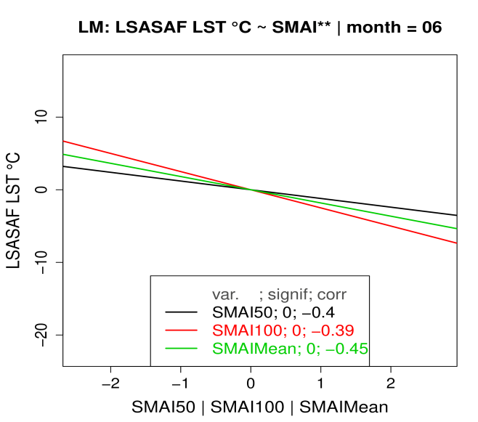
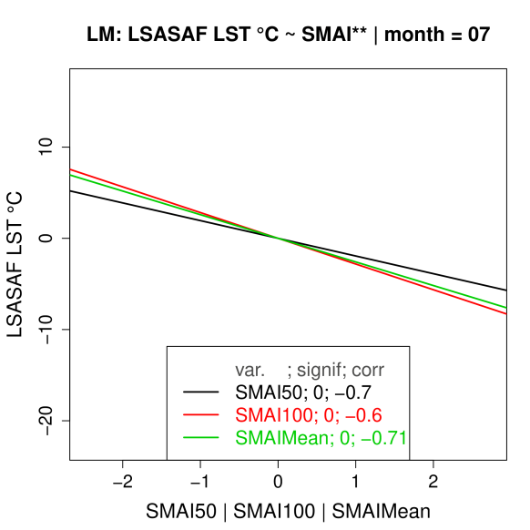
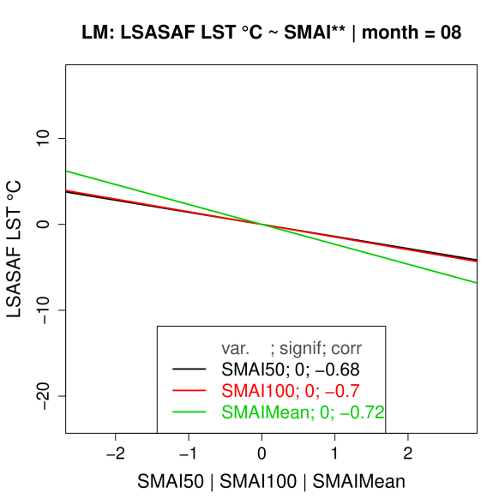
3) SMA anomalies versus LST anomalies
Results
utility of LSASAF LST to characterize spatio-temporal variability of dry land surface state anomalies
Quantitative analyses
(a)
(b)
(c)
Figure 5. Negative linear regression models of the relationship between LSASAF LST anomalies and SMAI (for 50 cm, black; 100 cm, red; Mean, green) for: (a) June, (b) July, (c) August, over Bulgaria. Monthly mean (2007-2018) are used to calculate the anomalies.

Slide 22
3) SMA anomalies versus LST anomalies
Quantitative analyses
(a)
(b)
(c)
Figure 5. Negative linear regression models of the relationship between LSASAF LST anomalies and SMAI (for 50 cm, black; 100 cm, red; Mean, green) for: (a) June, (b) July, (c) August over Bulgaria.
Monthly mean (2007-2018) are used to calculate the anomalies.
Linear regression models fit the SMA-LST anomalies relations
  The correlation is minimum in June (Fig. 5a), r = -0.45 (full vegetation cover, maximum precipitation, high values of SMA, and an undisturbed evaporative cooling effect).
  A strong negative relationship between higher warm anomalies of LST and stronger dry anomalies of SMAI, occurs in the summer months: for July and August (periods with the most limited rain quantities, a decrease of SMA, mean LST increases significantly, above 45 °C), r = -0.70 (Fig. 5 b,c).
LSA SAF LST product can be used as a tool for drought assessment in the critical period of July – August when most frequently severe dry anomalies occur over South Eastern Europe.

Slide 23
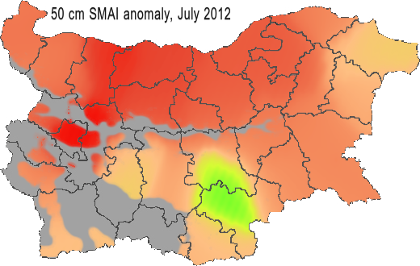
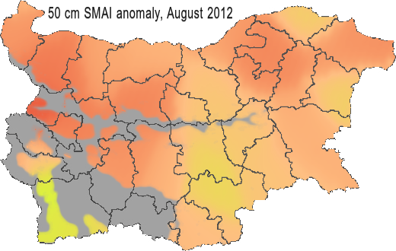
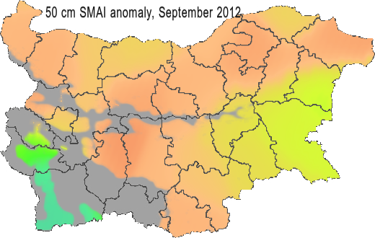
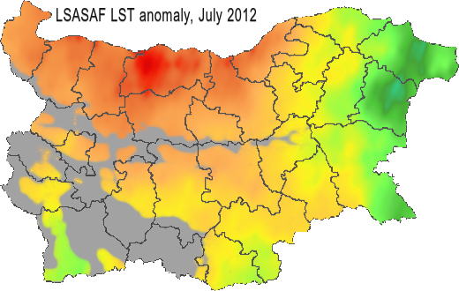
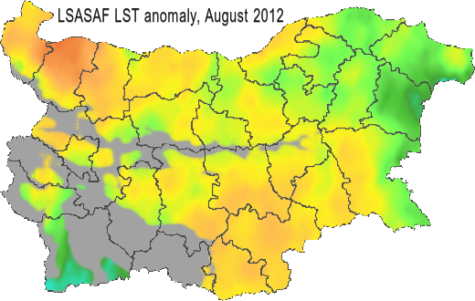
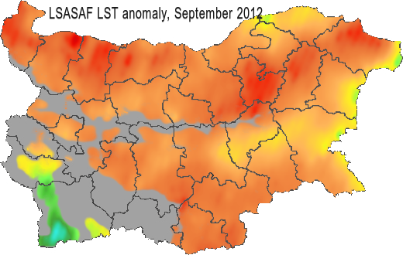
4) Spatial distribution of SMA - LST anomalies
Qualitative analyses
(a)
(b)
(c)
(d)
(e)
(f)
Figure 6. Monthly mean anomalies distribution over Bulgaria, 2012 of SMAI (50 cm soil layer) for: (a) July; (b) August; (c) September, and of LSASAF LST 0900 UTC for: (d) July; (e) August; (f) September. Anomalies are calculated for (2007-2018) period.

Slide 24


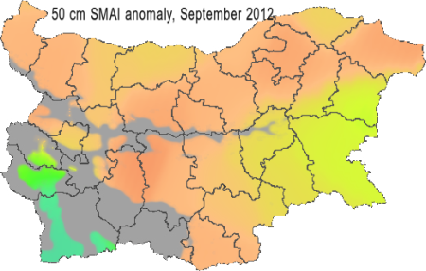
4) Spatial distribution of SMA - LST anomalies
(a)
(d)
Qualitative analyses
July
A very good coincidence in the spatial distributions of ‘dry (in red)’ SMA conditions and ‘hot (in red)’ land surface regions:
locations with the indicated dry negative SMAI anomalies (Fig. 6 a,b,c) correspond to regions with positive LST anomalies (Fig. 6 d,e,f) for the same period.
Some existing mismatches: due to highly inhomogeneous land cover, the complicated nature of their biogeophysical relations.
(b)
(e)
August
(c)
(f)
September
Figure 6. Monthly mean anomalies distribution over Bulgaria, 2012 of SMAI (50 cm soil layer) for: (a) July; (b) August; (c) September, and of LSASAF LST 0900 UTC for: (d) July; (e) August; (f) September. Anomalies are calculated for (2007-2018) period.

Slide 25
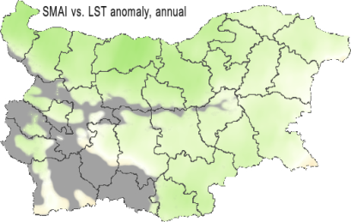
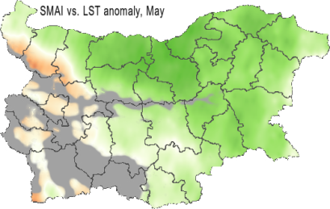
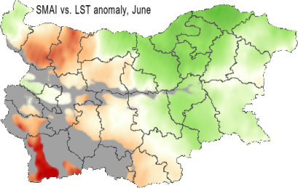
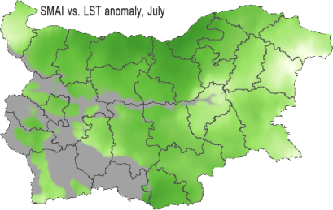
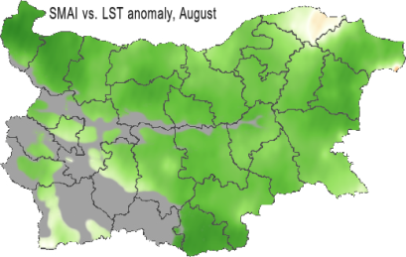
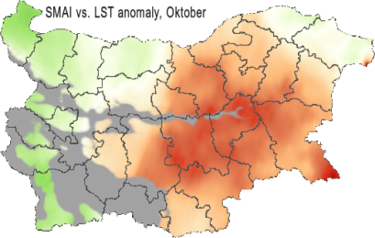
Results utility of LSASAF LST to characterize spatio-temporal variability of dry land surface state anomalies
5) Spatial variability of correlation between SMAI and LST anomalies
Quantitative analyses
(a)
(b)
(c)
(d)
(e)
(f)
Figure 7. Spatial distribution over Bulgaria of correlation between the monthly mean anomalies of root zone SMAI and LSASAF LST (MSG retrieval) for: (a) whole growing season; (b) May; (c) June; (d) July; (e) August; (f) October. Anomalies are calculated towards (2007-2018) period. Mountain regions above 800 m altitude are excluded with a mask.

Slide 26
Quantitative analyses
5) Spatial variability of correlation between SMAI and LST anomalies
On a mean annual bases (a) the increasing dry anomalies are related to increase of land surface temperature anomalies. The color map indicates correlations above moderate, r = -0.45 on mean annual bases.
A strong correlation between the anomalies of the two indexes in July and August (d), (e) (coefficients mostly around --0.8, maximum -0.84).
The behavior of LST closely corresponds to the drought severity as indicated by SMAI for the whole country, the lower SMAI, the higher LST.
(a)
(b)
(c)
(d)
(e)
(f)
Figure 7. Spatial distribution over Bulgaria of correlation between the monthly mean anomalies of root zone SMAI and LSASAF LST (MSG retrieval) for: (a) whole growing season; (b) May; (c) June; (d) July; (e) August; (f) October. Anomalies are calculated towards (2007-2018) period. Mountain regions above 800 m altitude are excluded with a mask.

Slide 27
Needs from advanced understanding and approaches that allow
LST application for drought monitoring and
drought impact assessment
Identifying the most drought prone regions
Effect of drought on fire activity
  Drought assessment and crop yield prediction
  Forest disease

Slide 28

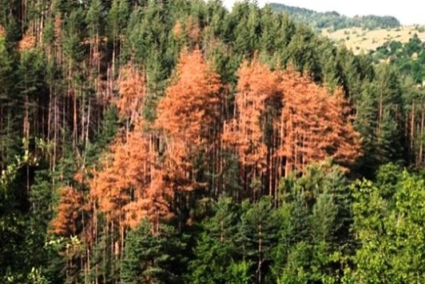

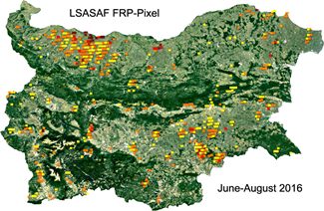

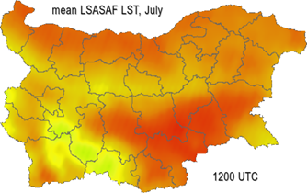
Applicability of LSASAF LST product as a drought index
using advanced approaches
1. Identifying the most drought prone regions
2. Effect of drought on fire activity
  3. Drought assessment and crop yield prediction
4. Forest disease
map of monthly mean SMAI
fire activity
LST is a functional parameter in main biogeophysical processes of energy-water-carbon cycles
Photo of affected by disease forest is provided by State Forest Agency, Bulgaria
map of monthly mean LST
map of monthly mean LST
Talk on 15 Oct 2019
6th Salgee workshop

Slide 29

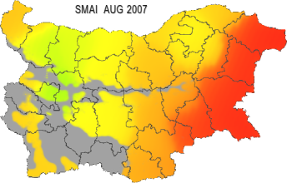


Spatial-temporal variability of land surface dry anomalies
1. Identifying the most drought prone regions
A climatic perspective means that a drought needs to be understood in terms of time and space statistics. A knowledge of the causes of a drought cannot provide an a priori description of the specific sequence of dry and wet days or any other similar daily details about a drought. Such day-to-day changes in precipitation, temperature, wind, and so forth are defined as weather, not climate.
Soil moisture availability index (SMAI) and LST
Category | SMAI color-coding
Drought | Red
Drought risk | Orange
Dry | Yellow
Optimum | Green
Wet | light blue
Overmoistening | dark blue
Color-coded maps for each one of SMAI and LST indexes (monthly means, 2007-2018) are developed to depict the consistency in spatial-temporal variability between the two indexes.
Qualitative comparison of the color maps reveals a good agreement between the spatial distributions of the two indexes:
The lower SMAI (i.e. increased drought severity) the higher LST.
Spatial distribution of monthly mean SMAI over Bulgaria in 2007 for: (a) June; (b) July; (c) August, and of LSASAF LST for: (d) June; (e) July; (f) August. (2007-2018) mean values are used.

Slide 30
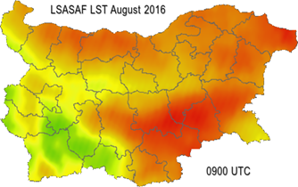
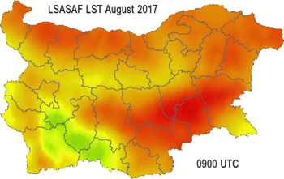
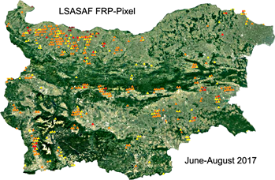
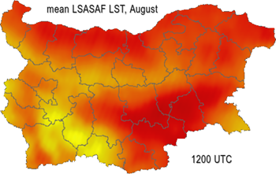
2. Sensitivity comparative analyses of drought related fire activity
(a)
(b)
Fires in Mediterranean are mainly caused by human activities related to agricultural practices.
Identification of regions most vulnerable to biomass burning is of importance regarding some prevention activities.
MSG LST product very well indicates the most sensitive areas to wild fires:
  Large number of fire detections in the northwestern, southwestern and southeastern parts of Bulgaria correspond to areas of highest LST.
(c)
(d)
(e)
(f)
Figure 8. Land surface state and probable fire occurrence: Monthly mean LSASAF LST 0900 UTC for: (a) August 2016; (b) August 2017. Accumulated thermal anomalies detections by LSA SAF FRP-Pixel product for: (c) June-August 2016; (d) June-August 2017. Monthly mean (2007-2018) LSASAF LST 1200 UTC values for: (e) July; (f) August.

Slide 31


  3. Drought assessment and crop yield prediction
Background: Conceptual scheme of the functional coupling between
Biogeophysical & Biogeochemical cycles
1. Scaling of knowledge: from laboratory experiments to environmental conditions
Presented in:
Stoyanova et al., 4th SALGEE Workshop
‘MSG Land Surface Applications: Drought and
Environmental Response’, 1-3 September 2015, Matera, Italy
leaf
plant
stand
landscape
controlled microclimate / biogeophysical cycle
thermodynamic description of soil-vegetation-atmosphere interface/biophysical processes at natural environment
2. Cybernetic insight in ecosystem functioning
Wiener’s cybernetics (1948) and the mathematical communication theory of Shannon (1948).
3. Thermodynamic model of ecosystems Ecosystems as open thermodynamic systems
                Entropy production in canopy leaves
(Florov, 1983; 1988; 2002)
4. Functional coupling between Biogeophysical & Biogeochemical cycles: Biogeophysical cycle is the signature of functioning of the ecosystems as open thermodynamic systems through mass- and energy- exchange at the specific site environment (soil, climate, topography, etc.). It is the cause for the intensity/efficiency of biogeochemical processes at molecular level (as a consequence),
(Stoyanova, 1985; 1996; 1998; 2013a,b)
5. Biogeochemical nature of drought
Climatic bioenergetic resources (Φ) → Potential productivity (crop yield)
Yield ≡ Accumulated solar energy = f(Dissipated energy like heat, Φ )

Slide 32
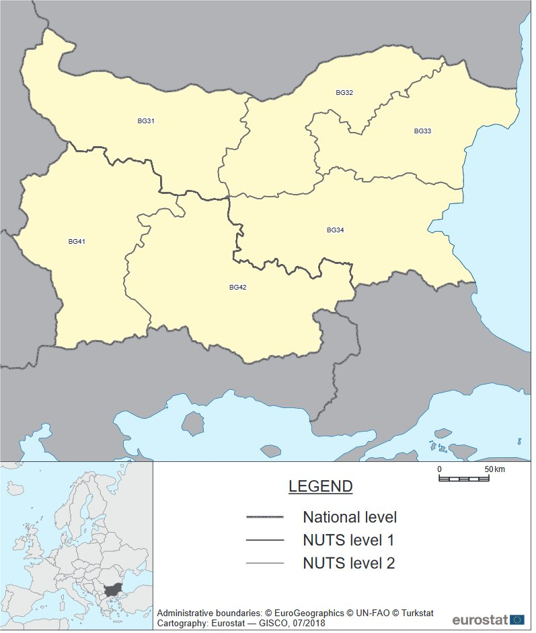
Dobrich
Kneza
Test sites: winter wheat field from the agrometeorological network of NIMH
  NUTS BG 33 (sample region Dobrich)
  NUTS BG 31 (sample region Kneza)

Slide 33
Climatic characteristics of site environment
(a)
(c)
(b)
  Dobrich region is characterized by higher SMA (Fig. 9c), while Kneza shows higher evapotranspiration (Fig. 9a) and higher land surface temperature (Fig. 9b)
  This trend is consistent for all years
  Implies more favorable conditions for crops growth in Dobrich.
Figure 9. Climatic environment at the two experimental sites Dobrich and Kneza for wheat yield formation of 2007-2018 : a) Accumulated evapotranspiration after LSA SAF ET at 1200 UTC; b) Accumulated land surface temperature after LSA SAF LST at 0900 UTC; c) SMA at 100 cm depth (based on SVAT output).

Slide 34
Modeling of ecosystem functioning
Quantification of ecosystem functioning by MSG
Entropy production in canopy leaves at different sites
Entropy production in canopy leaves using MSG information
Fig. 10. Entropy production (dissipation function, Ф) accumulated during wheat ecosystem functioning for 2007-2018.
Fig.11. Dissipated energy in wheat canopy at different climate environment approximated by simplified heat flux estimate using MSG data.
  Dobrich is characterized by lower dissipated energy, i.e. more energy is involved in growth substances (Fig. 10).
  This trend is consistent for all 12 years (from 2007 to 2018).
(LSASAF LST–T2m)
approximates heat flux exchange wheat canopy-atmosphere
used as a proxy of energetic climatic resources, Ф.

Slide 35
Modeling of ecosystem functioning
Quantification of ecosystem functioning by MSG
Entropy production & Yield prediction
Entropy production & Yield prediction
Fig. 13. Analytical description of mean wheat yield vs. entropy production in canopy derived by satellite information.
There is a high correlation between dissipated energy as a complex bioenergetic climatic indicator defined by (LSASAF LST –T2m) and wheat yield production.
Fig. 12. Relations between climate recourses, Ф and wheat yield
  Analytical description of functional relation between yield and dissipated energy allows to forecast yield.

Slide 36
Comparison of entropy production derived by modeling vs. alternatively derived using MSG information
(a)
(b)
Fig. 14. Scatterplots of dissipated energy Ф during wheat yield formation quantified by modeling vs. MSG data application: a) Dobrich; b) Kneza

Slide 37

Acknowledgements: This study is partially funded by EUMETSAT, the European Organisation for the Exploitation of Meteorological Satellites in the frame of SALGEE Project 2019.
State Forest Agency of Bulgaria and Ministry of inner Affairs have provided information for actual forest fires / grass fires and their characteristics for the test years 2016 and 2017.
For the purposes of this study, the new O1280 version of ECMWF model is introduced for use at NIMH, Bulgaria.
Data for yield production are from NIMH agrometeorological network.

