Slide 1
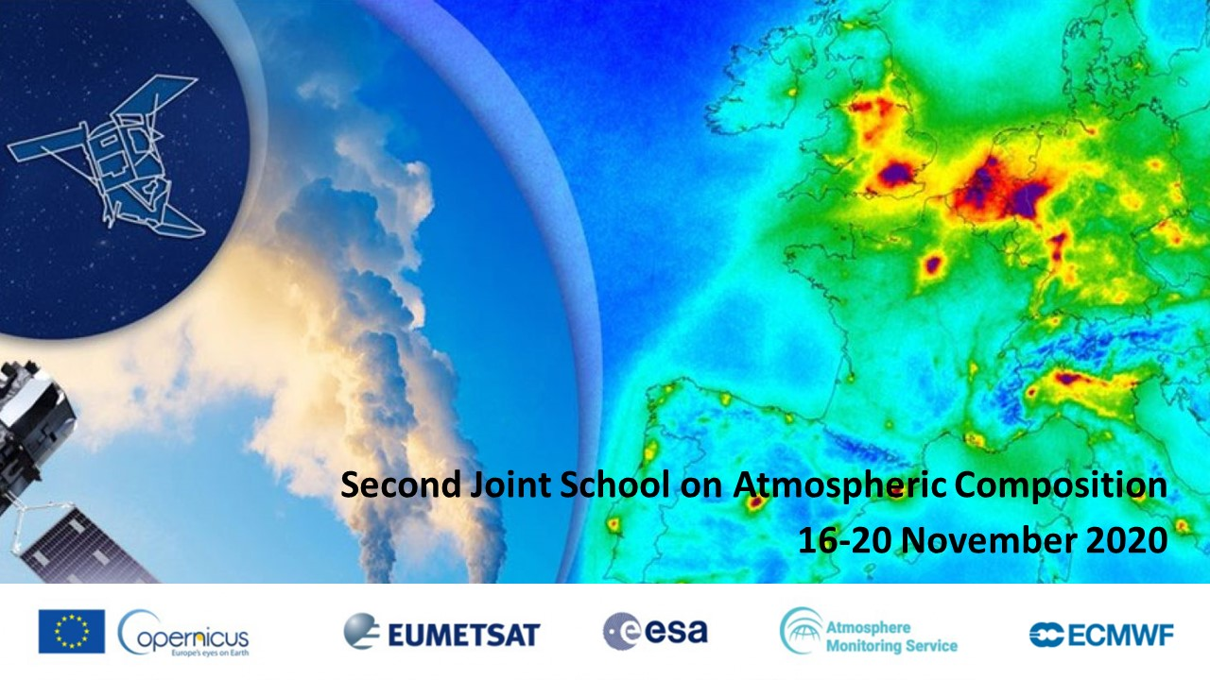
Data Assimilation for Atmospheric Composition: Applications and Challenges / Antje Inness & Jérôme Barré (ECMWF)

Slide 2
Outline
Part-I
Copernicus Atmosphere Monitoring Service
Data assimilation methodology for atmospheric composition
Some issues when assimilating satellite data
Reanalysis
Part-II (Jérôme Barré):
Data assimilation approaches: variational and ensemble
The operational emissions inversions needs and challenges
Co-emission
Chemistry-meteorology data assimilation coupling
Thanks for contributions from the ECMWF CAMS team

Slide 3
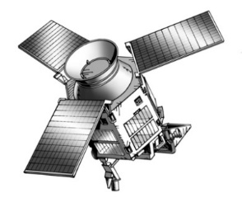
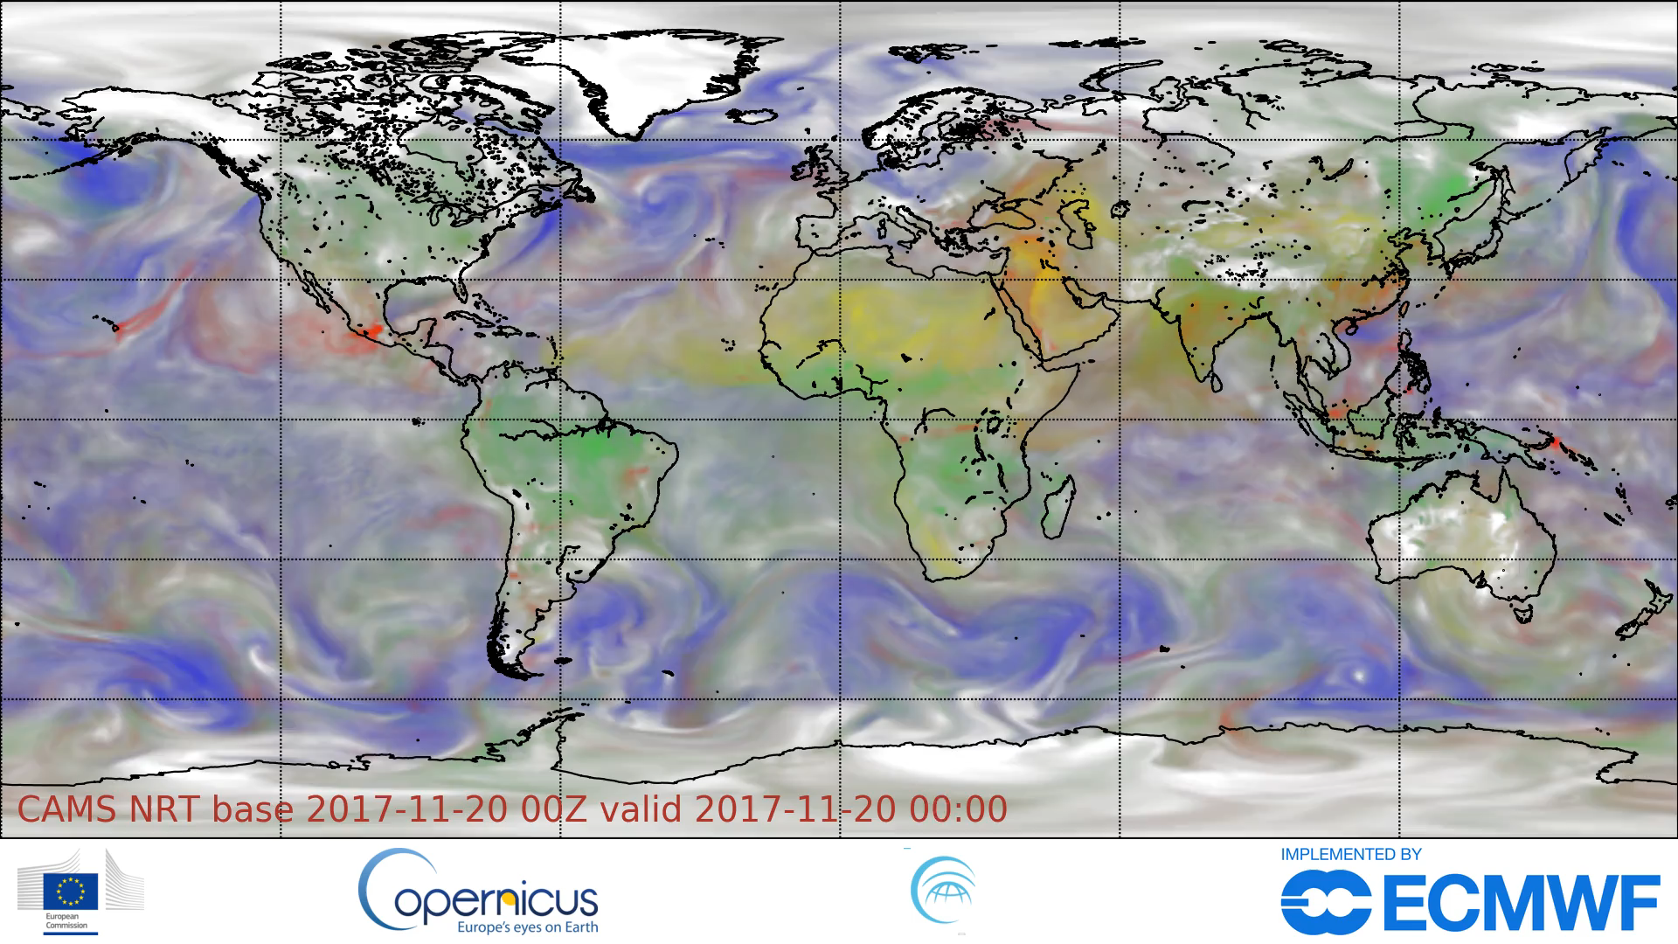

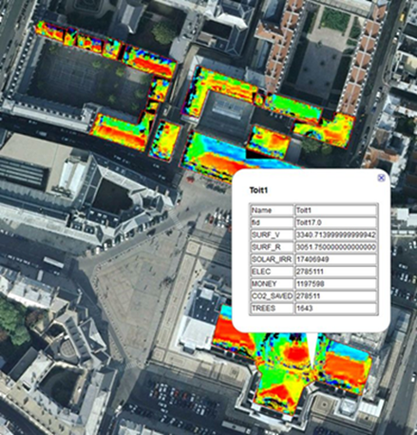
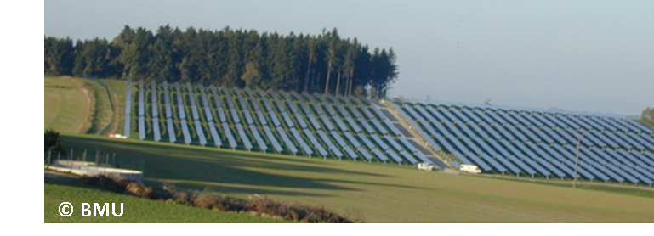
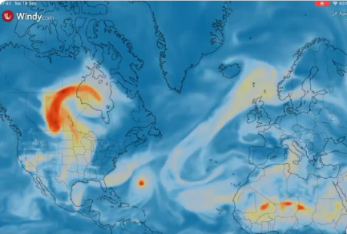
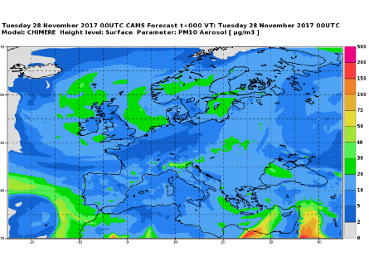
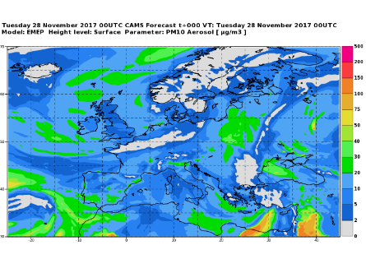
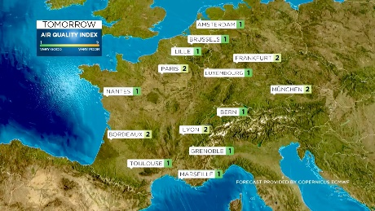
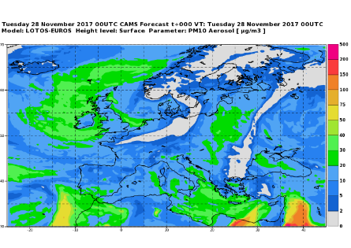
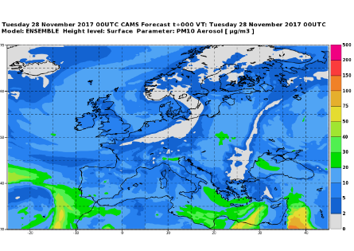
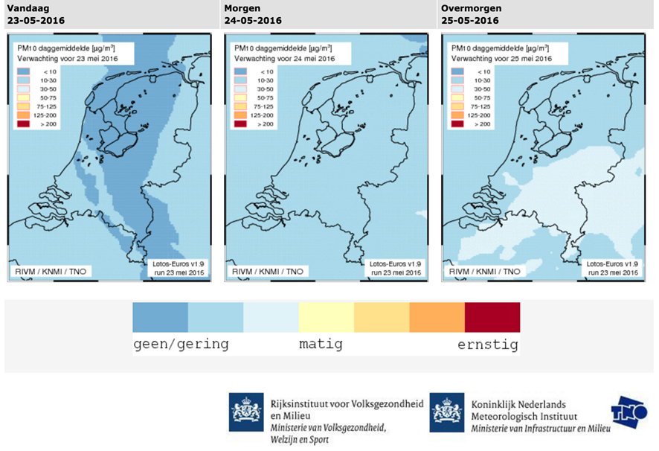

Copernicus Atmosphere Monitoring Service
Transforming satellite observations into user-driven services.
https://atmosphere.copernicus.eu/data

Slide 4
Data Assimilation Methodology

Slide 5
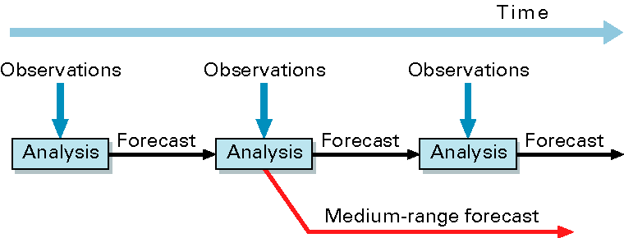
Variational Data assimilation
NWP definition: Combining data and model in an ‘optimal’ way to produce the best possible initial conditions for a numerical forecast
Optimal in a statistical sense: minimize error and/or maximize probability of the analysis being correct
CAMS uses ECMWF’s 4-dimensional variational data assimilation system or 4D-Var
For AQ other parameters than
  IC might be of interest
model state
Model trajectory from corrected initial state
y
x_{a}
Model trajectory from first guess x_{b}
x_{b}
3
6
9
12
15
time
Assimilation window

Slide 6
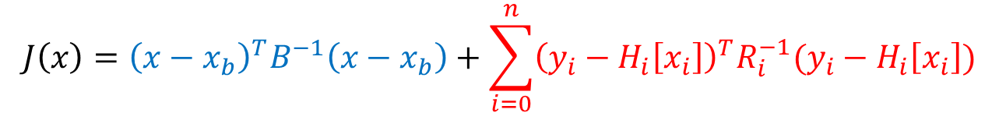
Cost function
Data assimilation for atmospheric composition is in principle no different from NWP data assimilation
Analysis: x that minimizes cost function
$$J\left(x\right)={\left(x−x_{b}\right)}^{T}B^{−1}\left(x−x_{b}\right)+\sum_{i=0}^{n}{{\left(y_{i}−H_{i}\left[x_{i}\right]\right)}^{T}R_{i}^{−1}(y_{i}−H_{i}\left[x_{i}\right])}$$
Methodology decribed in Part-II
J_{b}
J_{o}
Cost function
Background term
Observation term
x: control vector
x_{b}: model background (short forecast)
B: Background error covariance matrix
y: Observations
H[x]: Model equivalent of observations
R: Observation error covariance matrix
Strong constraint 4D-Var assumes perfect model over assimilation period
Weak constrained 4D-Var includes a model error term

Slide 7
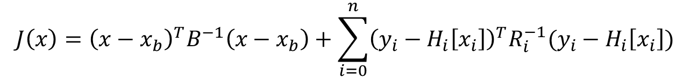
Data assimilation methodology
Data assimilation for atmospheric composition is in principle no different from NWP data assimilation
$$J\left(x\right)={\left(x−x_{b}\right)}^{T}B^{−1}\left(x−x_{b}\right)+\sum_{i=0}^{n}{{\left(y_{i}−H_{i}\left[x_{i}\right]\right)}^{T}R_{i}^{−1}(y_{i}−H_{i}\left[x_{i}\right])}$$
Control variables
NWP
vorticity divergence temperature surface pressure (logarithm) specific humidity
Atmospheric Composition
ozone carbon monoxide nitrogen dioxide formaldehyde sulphur dioxide
carbon dioxide methane
aerosol mixing ratio
IFS

Slide 8
Data assimilation methodology
Data assimilation for atmospheric composition is in principle no different from NWP data assimilation
$$J\left(x\right)={\left(x−x_{b}\right)}^{T}B^{−1}\left(x−x_{b}\right)+\sum_{i=0}^{n}{{\left(y_{i}−H_{i}\left[x_{i}\right]\right)}^{T}R_{i}^{−1}(y_{i}−H_{i}\left[x_{i}\right])}$$
Control variables
NWP
vorticity divergence temperature surface pressure (logarithm) specific humidity
Atmospheric Composition
ozone carbon monoxide nitrogen dioxide formaldehyde sulphur dioxide
carbon dioxide methane
aerosol mixing ratio
Chemical Module
TM5 (CB05)
54 species, 126 reactions
Photolysis, dry and wet deposition
IFS
Chemical module
GHG module
Aerosol module

Slide 9
Data assimilation methodology
Data assimilation for atmospheric composition is in principle no different from NWP data assimilation
$$J\left(x\right)={\left(x−x_{b}\right)}^{T}B^{−1}\left(x−x_{b}\right)+\sum_{i=0}^{n}{{\left(y_{i}−H_{i}\left[x_{i}\right]\right)}^{T}R_{i}^{−1}(y_{i}−H_{i}\left[x_{i}\right])}$$
Control variables
NWP
vorticity divergence temperature surface pressure (logarithm) specific humidity
Atmospheric Composition
ozone carbon monoxide nitrogen dioxide formaldehyde sulphur dioxide
carbon dioxide methane
aerosol mixing ratio
IFS
Greenhouse Gas Module
CHTESSEL
Photosynthesis & ecosystem respiration model
Diagnoses the gross primary production of CO2 by plants and release of CO2 by soil
CH4 comes from prescribed emissions and climatological loss
Chemical module
GHG module
Aerosol module

Slide 10
Data assimilation methodology
Data assimilation for atmospheric composition is in principle no different from NWP data assimilation
$$J\left(x\right)={\left(x−x_{b}\right)}^{T}B^{−1}\left(x−x_{b}\right)+\sum_{i=0}^{n}{{\left(y_{i}−H_{i}\left[x_{i}\right]\right)}^{T}R_{i}^{−1}(y_{i}−H_{i}\left[x_{i}\right])}$$
Control variables
NWP
vorticity divergence temperature surface pressure (logarithm) specific humidity
Atmospheric Composition
ozone carbon monoxide nitrogen dioxide formaldehyde sulphur dioxide
carbon dioxide methane
aerosol mixing ratio
IFS
Chemical module
Aerosol bin scheme
14 aerosol-related prognostic variables:
3 bins sea-salt, 3 bins dust, Black carbon, Organic matter, Sulphate,
2 bins Nitrate, Ammonium
Emissions, dry and wet deposition, sedimentation
GHG module
Aerosol module

Slide 11
Some issues when assimilating satellite data

Slide 12
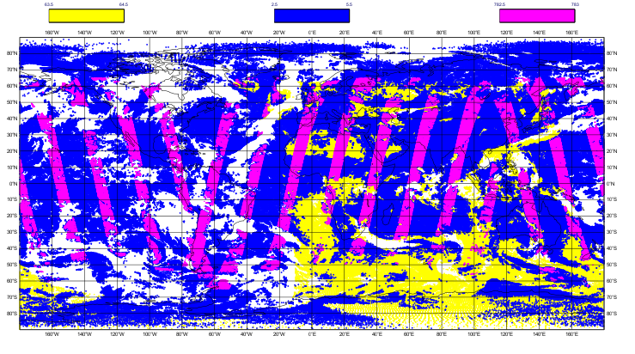
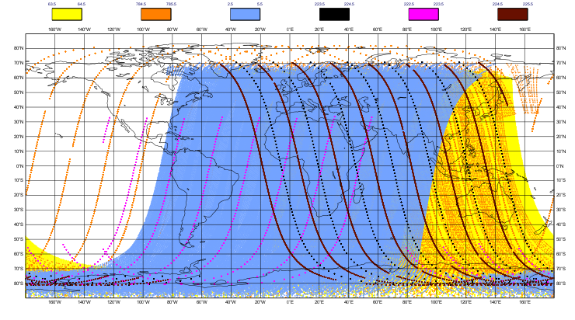
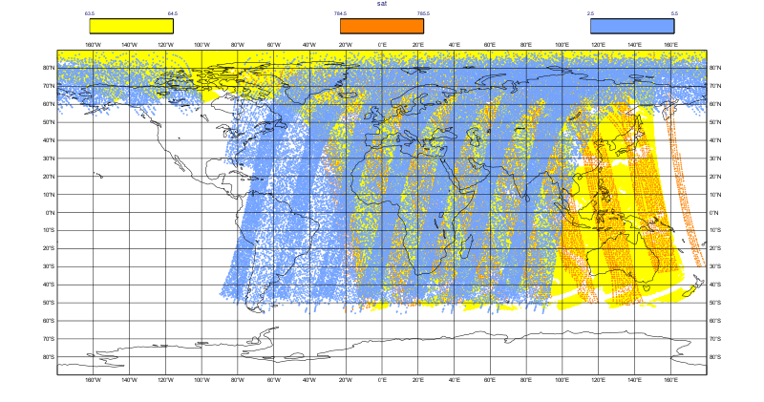
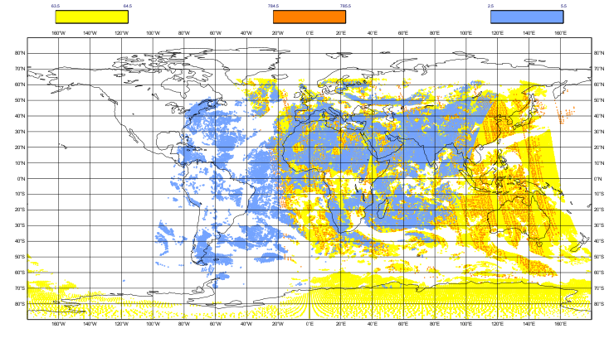
Example of coverage for reactive gases
CO: TROPOMI, MOPITT, IASI
O3: TROPOMI, GOME-2,OMI,SBUV,OMPS,MLS
12-hour
analysis cycle
Often limited to cloud free conditions
Global coverage in a few days (LEO) – fixed overpass time
NO2: TROPOMI, GOME-2,OMI
SO2: TROPOMI, GOME-2,OMI
Total or tropospheric columns
Fixed overpass times and daylight conditions only (UV-VIS) -> no daily maximum/cycle

Slide 13
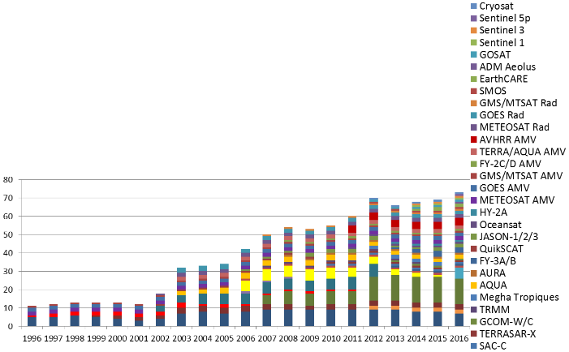
Biases and Bias correction
$$J\left(x\right)={\left(x−x_{b}\right)}^{T}B^{−1}\left(x−x_{b}\right)+\sum_{i=0}^{n}{{\left(y_{i}−H_{i}\left[x_{i}\right]\right)}^{T}R_{i}^{−1}(y_{i}−H_{i}\left[x_{i}\right])}$$
Background constraint
Observation constraint
4D-Var assumes that errors are unbiased and gaussian
Biases in the input [y – h(x)] can arise from:
  errors in the actual observations
  errors in the model background
  errors in the observation operator
Often no true reference in the real world
Need an adequate bias model to correct for this
  Correct observation biases before use
  Adaptive bias correction system (better for complex and changing observation system)

Slide 14
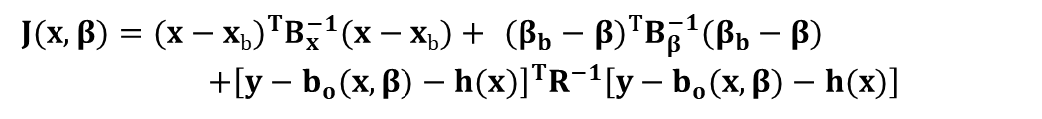
Variational bias correction scheme
The original problem:
$$J\left(x\right)={\left(x−x_{b}\right)}^{T}B^{−1}\left(x−x_{b}\right)+\sum_{i=0}^{n}{{\left(y_{i}−H_{i}\left[x_{i}\right]\right)}^{T}R_{i}^{−1}(y_{i}−H_{i}\left[x_{i}\right])}$$
Background constraint
Observation constraint
The modified problem:
J_{b}: background constraint for x
J_{β}: background constraint for bias β
$$J(x,β)=(x−xb)^{T}B_{x}^{−1}(x−xb)+ (β_{b}−β)^{T}B_{β}^{−1}(β_{b}−β) \\ +{\left[y−b_{o}(x,β)−h(x)\right]}^{T}R^{−1}\left[y−b_{o}(x,β)−h(x)\right]$$
J_{o}: bias-corrected observation constraint

Slide 15
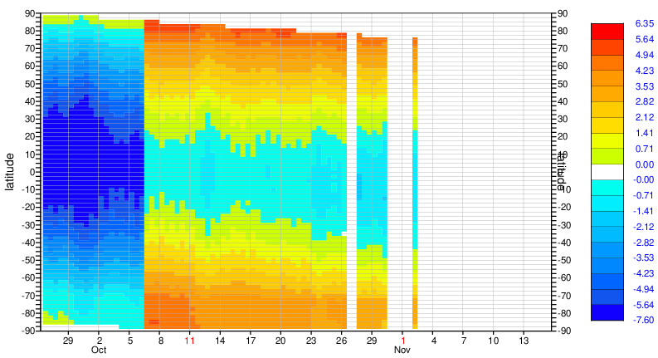
Examples of variational bias correction
Example 2:
NOAA-9 MSU channel 3 bias corrections (cosmic storm)
NOAA-9 MSU channel 3 bias corrections (cosmic storm)
Variational bias correction:
Spins up
Adjusts to changes in model or data
Removes biases
200 hPa temperature departures from radiosonde observations

Slide 16
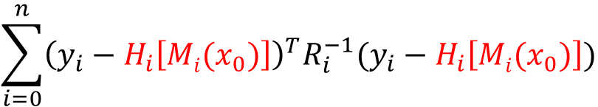
Observation operators
$$\sum_{i=0}^{n}{{\left(y_{i}−H_{i}\left[{Mi(x}_{0})\right]\right)}^{T}R_{i}^{−1}(y_{i}−H_{i}\left[{Mi(x}_{0})\right])}$$
Observation operator H maps model state at beginning of the assimilation window (t=0) to the observation time and location
Direct assimilation of radiance observations:
The observation operator must incorporate an additional step to compute radiances from the model state variables (radiative transfer model, e.g. RTTOV)
CAMS hopes to explore this in the future
Assimilation of retrievals:
Good characterization of retrieval is crucial:
Averaging kernels
A priori
Error estimates
Quality flags

Slide 17


Assimilating retrievals: Column retrieval
We can make use of the averaging kernel A in the observation operator
$\hat{y} ={ y}_{a}+A\left(y−y_{a}\right)+ε$
Retrieved value: true state smoothed by the averaging kernel 𝐀; y_{a}: apriori, ε: retrieval error
Without averaging kernels in observation operator
$$d=y−H(x_{m})=ya+A(y−ya)+ε−H(x_{m})$$
$$d=y−\hat{H}(x_{m})=ya+A(y−ya)+ε−(ya+A(H(x_{m})−ya))$$
With averaging kernels in observation operator
$$=A(y−H(x_{m}))+ε$$
We remove the influence of the a-priori profile if we use the averaging kernel to sample the model profile according to the assumptions made in the retrieval.
However, the a-priori error assumptions are still in there and we assume everything is linear within the bounds of the a-priori assumptions. (And we still need to know x_{a} and A in the observation operator calculations).

Slide 18
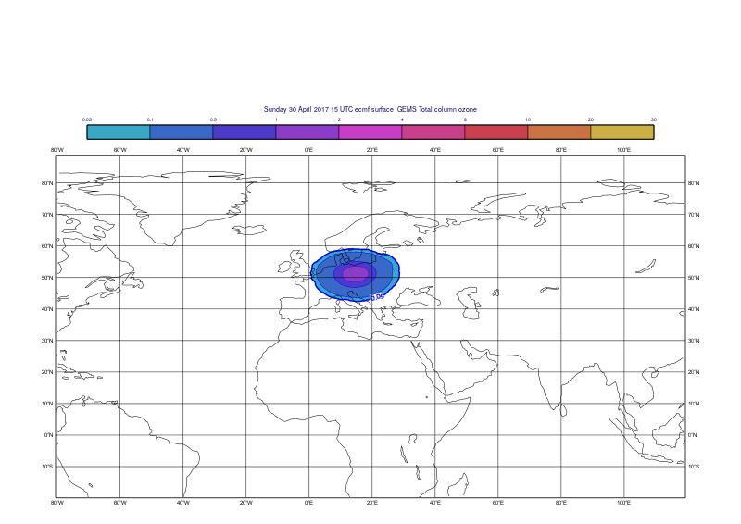
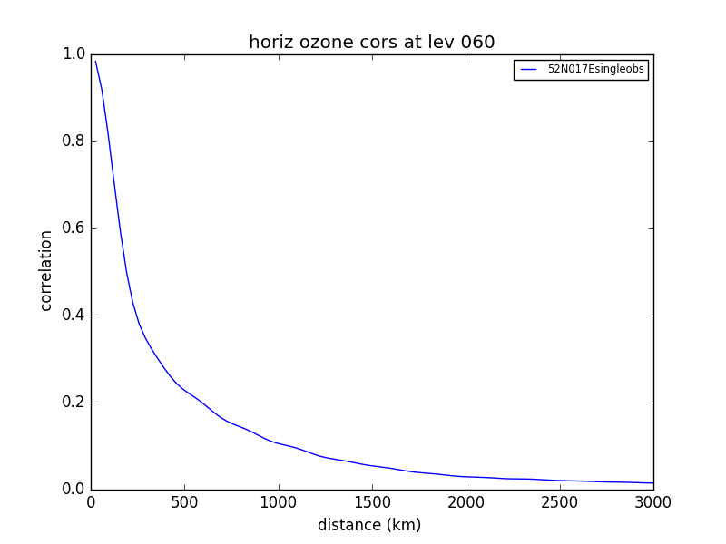
Limited information content
Increment from one TC ozone retrieval
Horizontal correlation from the B-matrix that spreads the information from the single observation in the horizontal
Increment created by a single ozone observation of 375 DU, 10 DU higher than background

Slide 19
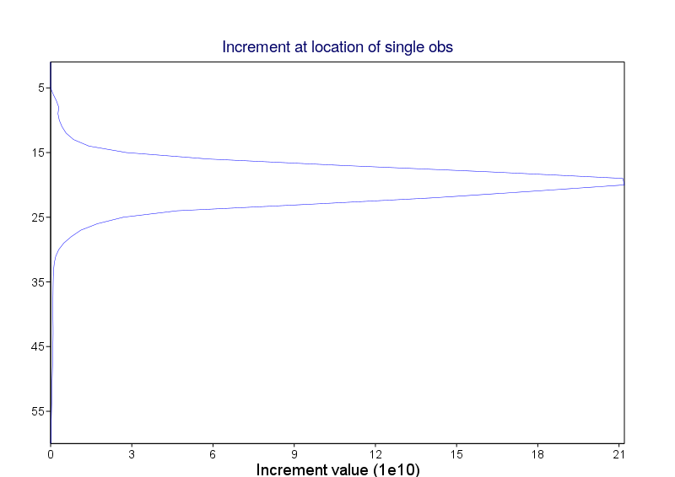
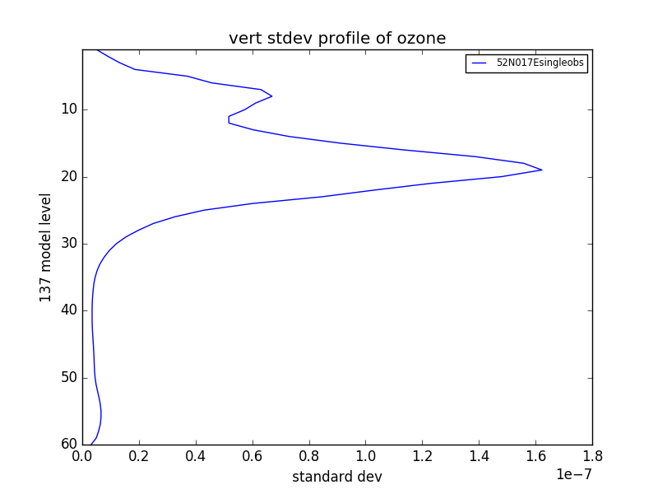
Increment from one ozone retrieval
Vertical profile of the increment at the observation location
Background matrix has a significant impact on the distribution of information
Increment created by a single ozone observation of 375 DU, 10 DU higher than background
Standard deviation from the background matrix at the observation location
Formulation of the B-matrix is very important for AC

Slide 20
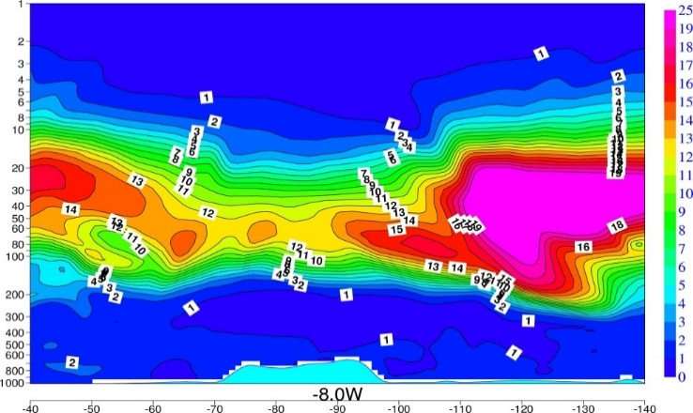
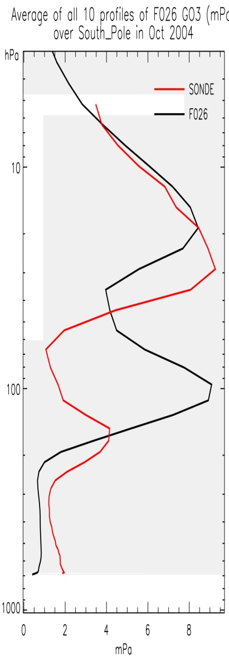
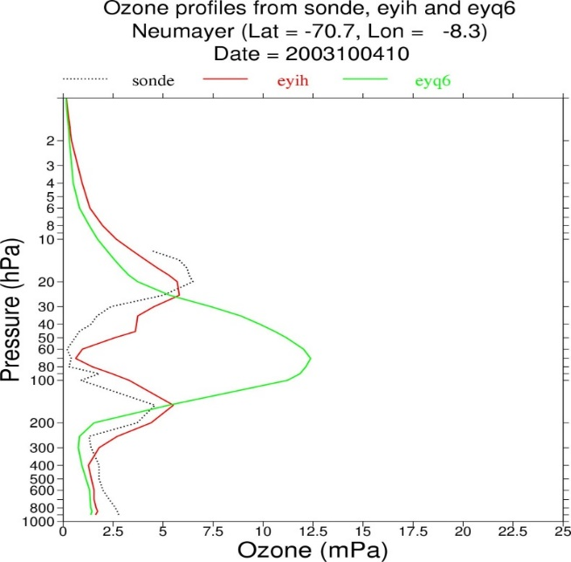
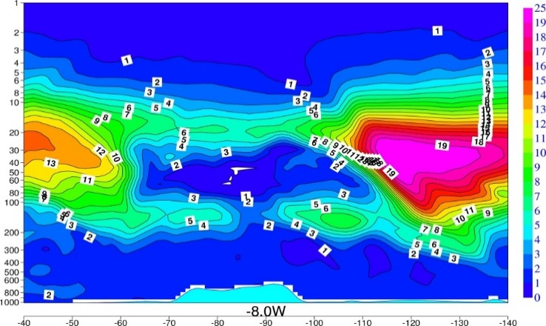
Importance of height-resolved data
Oct 2004
CTRL
ASSIM (MIPAS)
Assimilation with profile data
Assimilation with total column data
Ozone hole in CAMS reanalysis: Cross section along 8E over South Pole, 4 Oct 2003

Slide 21
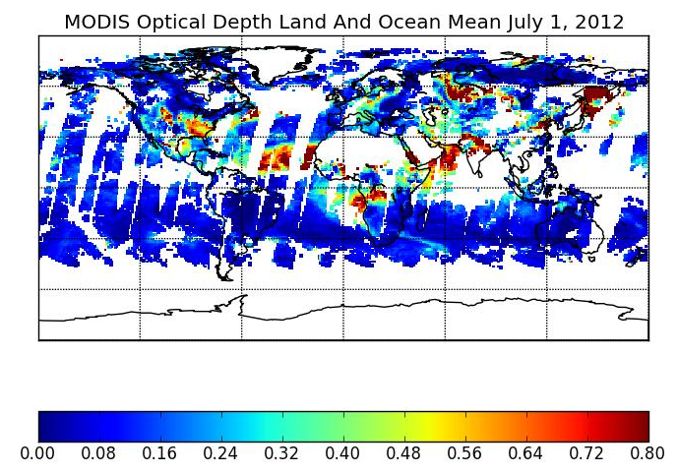
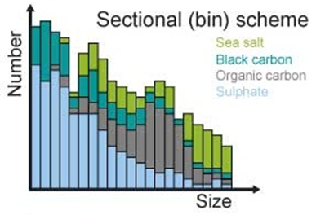
Added difficulty with AOD observations
Bin scheme model used with 12 bins (now 14)
AOD observations used in the assimilation
Challenge: How do we transfer the information from the total aerosol to the 14 different bins. B-matrix is not relevant in this case….

Slide 22
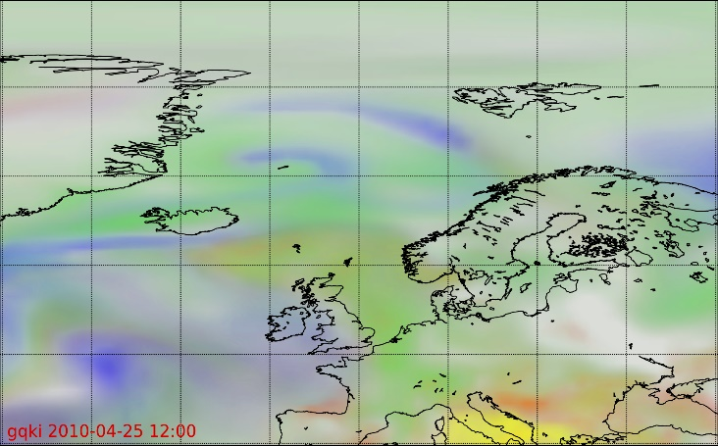
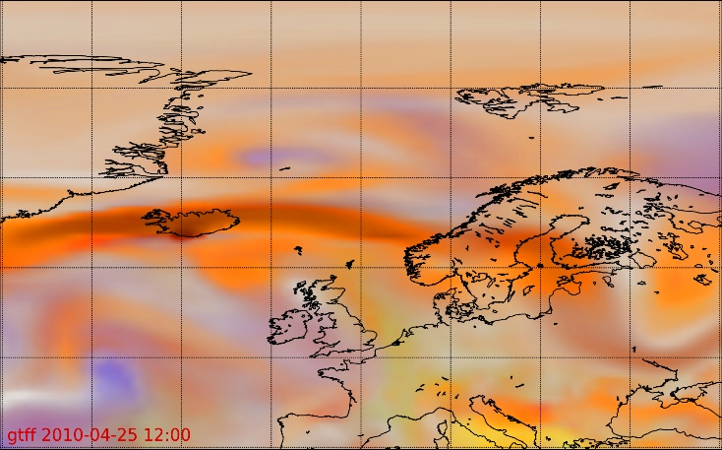
Added difficulty with AOD observations
Assimilating Aerosol Optical Depth (AOD) observations without having all required aerosol species realistically in place, results in wrong species assignment in analysis (plume of organic matter aerosol above).
Improving the model with estimated emissions of volcanic ash and sulphates (below) allows much better use of observations.
Sea-salt
Dust
Organic matter
Background sulphate
Volcanic ash
Volcanic sulphate
Eyjafjallajökull volcanic eruption

Slide 23
Reanalysis

Slide 24
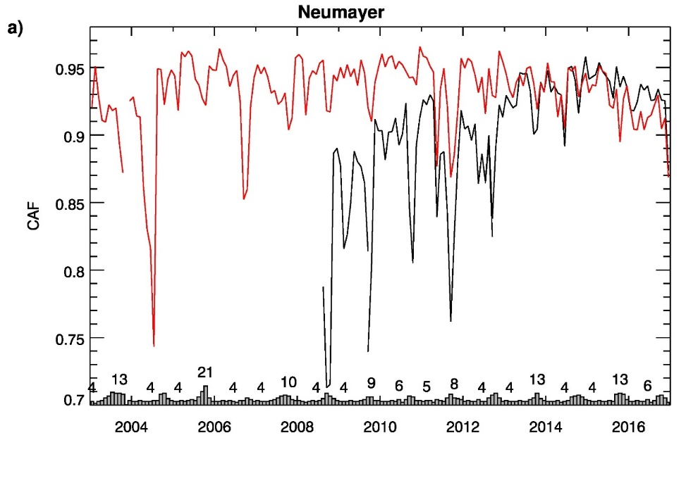
Near-real time model versus reanalysis
Ozone score
NRT global CAMS system (daily analyses and 5-day forecasts):
Evolves with time: Usually 2 model updates per year
Horizontal and vertical resolution can change
Observation usage changes
Emission data sets might change
good
Reanalysis (retrospective):
Consistent long term dataset produced with one model version
Consistent emissions
Consistent, reprocessed observations
Can be used for trend analysis
bad
CAMS Reanalysis
NRT CAMS analysis

Slide 25
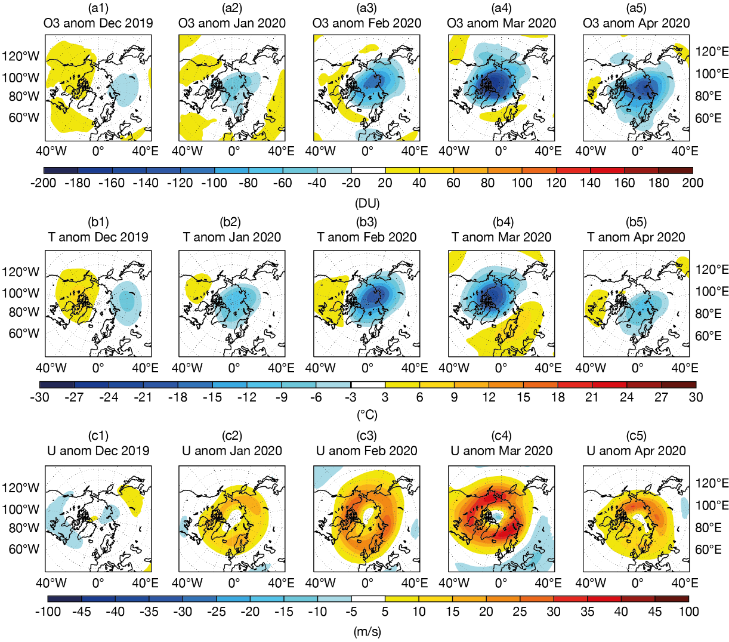
2019/2020 Arctic ‘ozone hole’
Up to 180 DU/140 DU (~40%/35%) below climatology in March/April
Ozone
column
Temperature at 50 hPa
Up to 18 K/21K below climatology in Feb/March
Anomalies against 2003-2019 climatology
Zonal wind at 50 hPa
Inness et al. (2020, accepted by JGR)

Slide 26
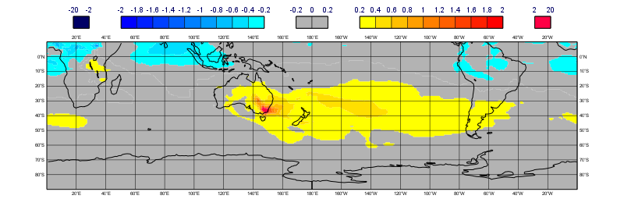
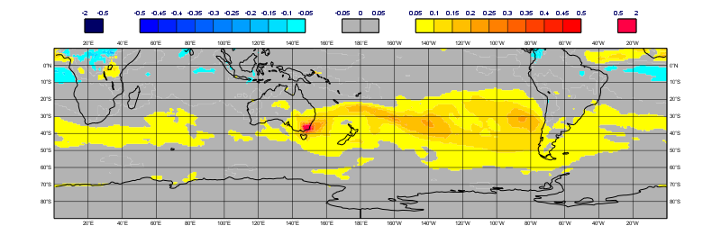
January 2020 anomalies of CO and AOD
Impact of Australian fires
CO anomaly
CO in 10¹⁸ molec cm⁻²
AOD is unitless
Anomalies calculated against the 2003-2019 January means from the CAMS reanalysis
AOD (550 nm) anomaly
CAMS reanalysis 2003-2019 data available from:
https://atmosphere.copernicus.eu/data

Slide 27
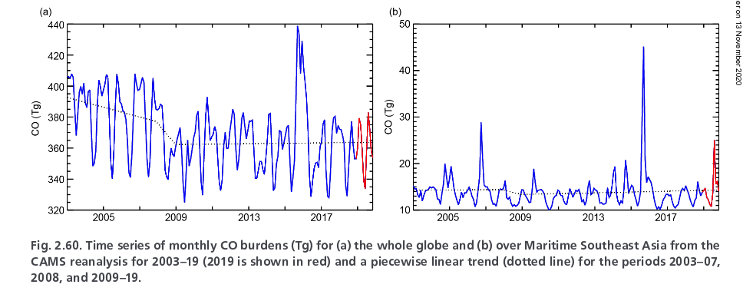
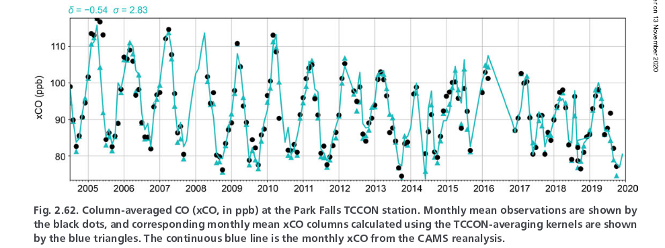
Study of trends
CO burdens
Globe
Maritime SE Asia
Comparison of xCO with TCCON at Parkfalls
Flemming et al. (2020), BAMS State of Climate 2019
TCCON data from:
https://tccondata.org/

Slide 28
Part 2
Jérôme Barré

