Slide 1
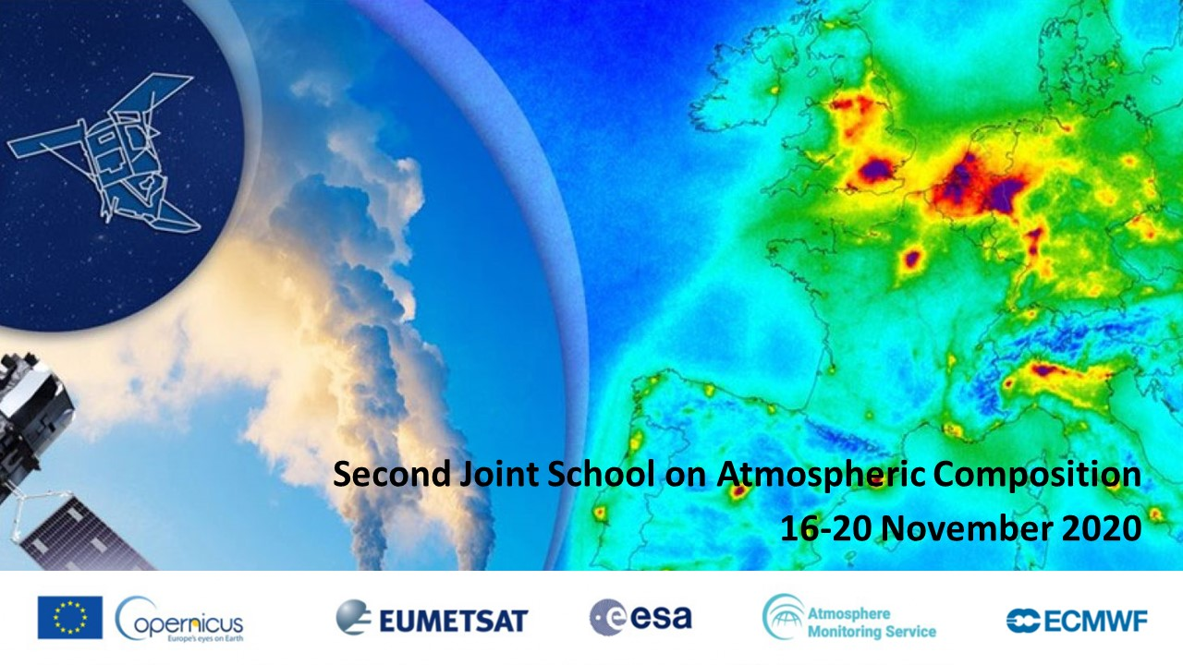
The added value of profiling observations from the ground based networks / Lucia Mona - CNR

Slide 2
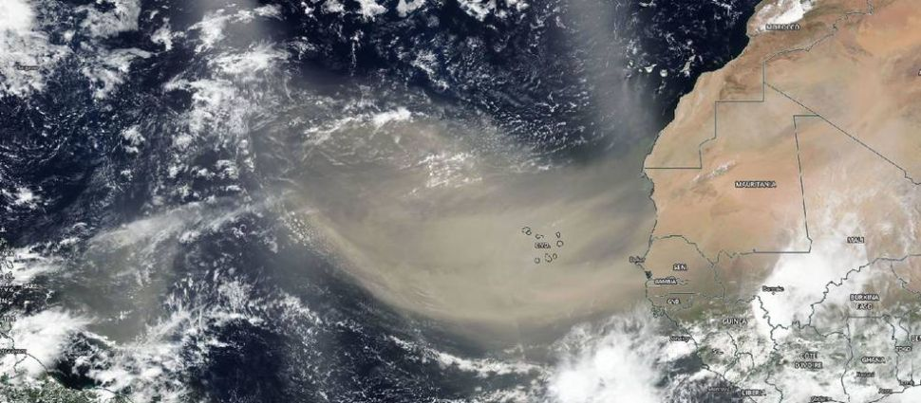
Profiling: why important?
A massive dust plume from the Sahara Desert reaches far out over the Atlantic Ocean, stretching across 2,000 miles, in this view from the NASA-NOAA Suomi NPP Earth-observing satellite on June 13, 2020. (Image credit: NASA Worldview)

Slide 3
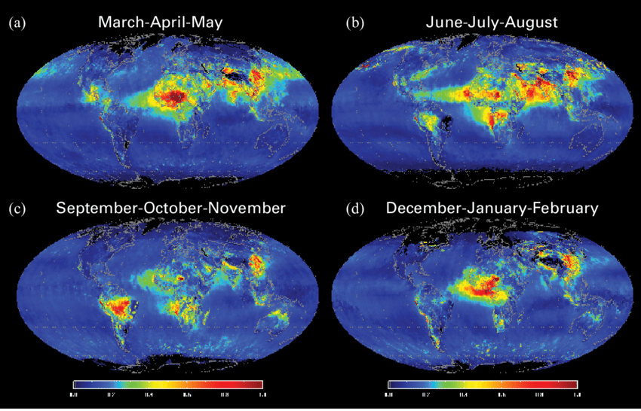
Profiling: why important?
Global distribution of MODIS aerosol optical depth at 0.55 μm showing aerosol hotspots
In 2005
Lau, et al. (2009). WMO Bull. 58.

Slide 4
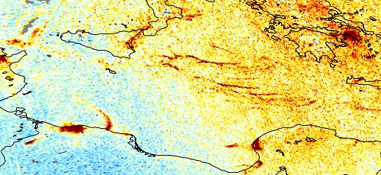
Profiling: why important?
Sentinel 5P TROPOMI measurements of NO2 3.5 x7 km² tracking pollution from individual ships

Slide 5
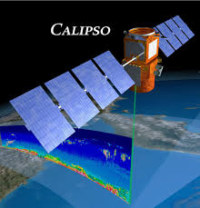
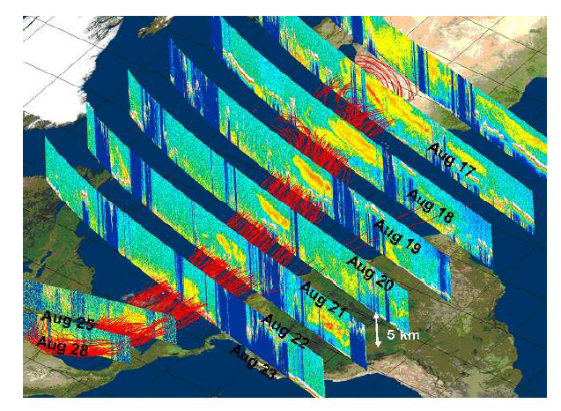
Profiling: why important?
….but a 3D world is there reported in a 2D space loosing the vertical information.
https://youtu.be/ygulQJoIe2Y
Unprecedented 3D observation of dust

Slide 6
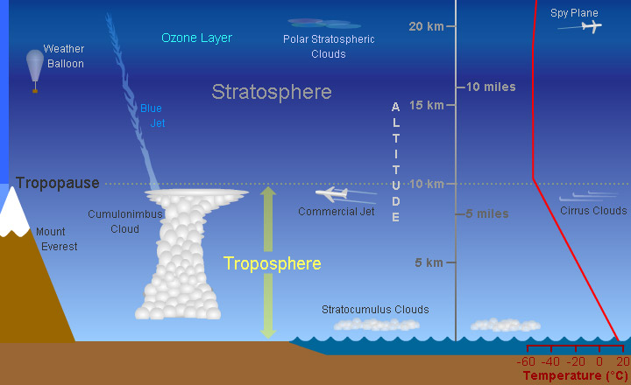
Profiling: why important?
From surface to UTLS different interactions, effects and impacts
Buondary Layer

Slide 7

Profiling: why important?
Aerosol
Strong impact on radiation budget for UTLS layers
Impact on aviation
Long range transport in the Free troposphere
Impact on radiation budget for lofted layers
Formation of clouds and precipitations in the Free troposphere
air quality & health in the PBL
impacts on agriculture and environment at the surface

Slide 8
Profiling: why important?
Ozone
Depletion ozone in Stratosphere
UV penetration
air quality and health

Slide 9
Profiling: why important?
Water vapour
Radiation budget
Cloud formation
Precipitation
Health

Slide 10
Profiling: why important?
Cloud
Radiation budget
Precipitation
Aerosol-cloud interactions

Slide 11

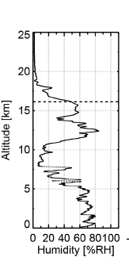
Profiling networks
Important for
spatial coverage
harmonization of procedures
access to data
fairness of the data
RIs fundamental for this

Slide 12
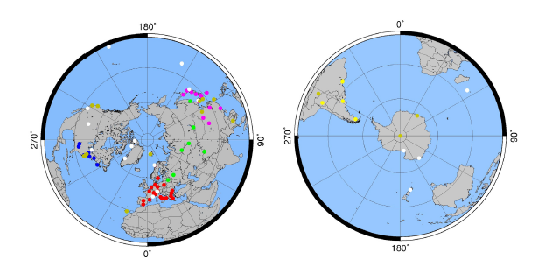
Profiling networks: aerosol lidar
GALION (GAW Aerosol LIdar Observational Network)
Network of regional networks
Cooperation and harmonization fostered
AD-NET ALINE CISLINET EARLINET MPLNET NDACC REALM
https://community.wmo.int/activity-areas/gaw

Slide 13
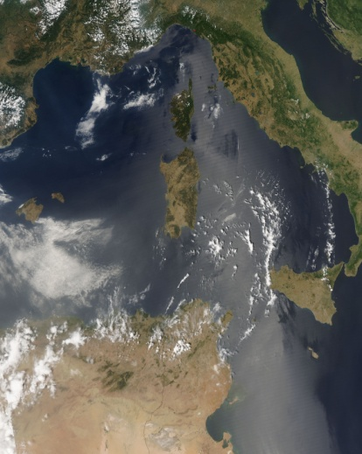
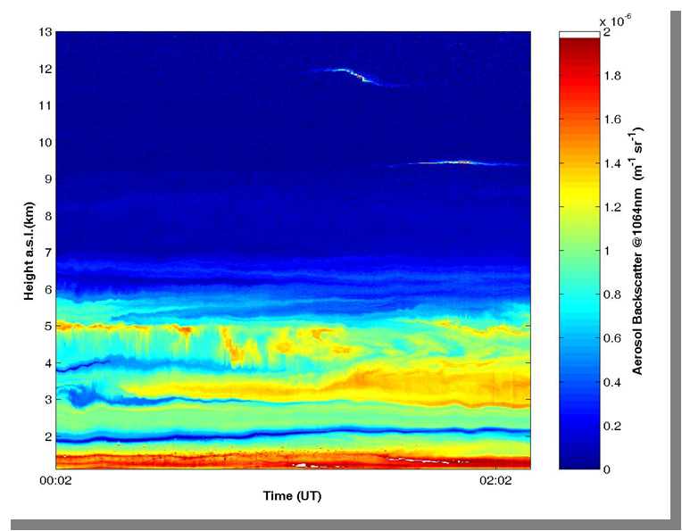
Example of aerosol lidar observation
Thin cirrus
Feeble aerosol layer
Intense layer of desert dust
Interface PBL- free troposphere
Aerosol lidar measurements @ 1064 nm CNR-Potenza-IT

Slide 14


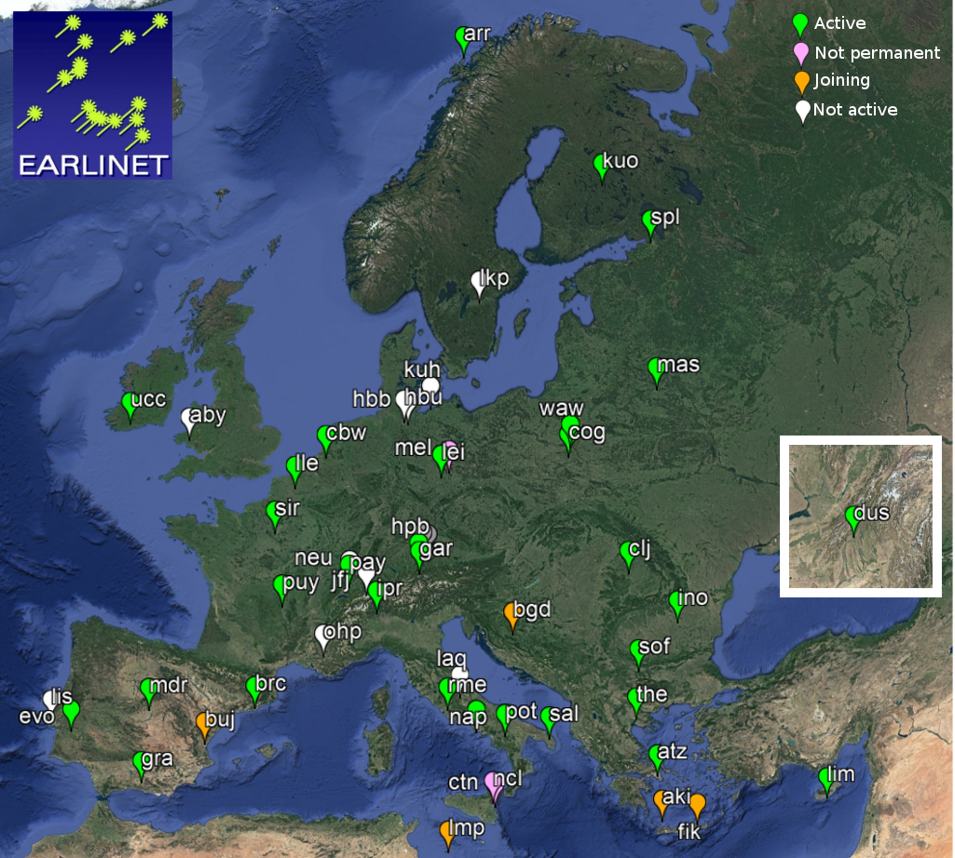
EARLINET
European Aerosol Research Lidar Network
31 lidar stations observing aerosol 4d distribution over Europe
Standardized quality assurance and control tests
Central harmonized processing available
Version controlled database
Netcdf files
https://actris.nilu.no & https://data.earlinet.org/

Slide 15

EARLINET
Standardized and harmonized procedures over largely different lidar systems
is
a reference for
harmonization at global level
and
more basic systems
Pappalardo et al., AMT 2014

Slide 16
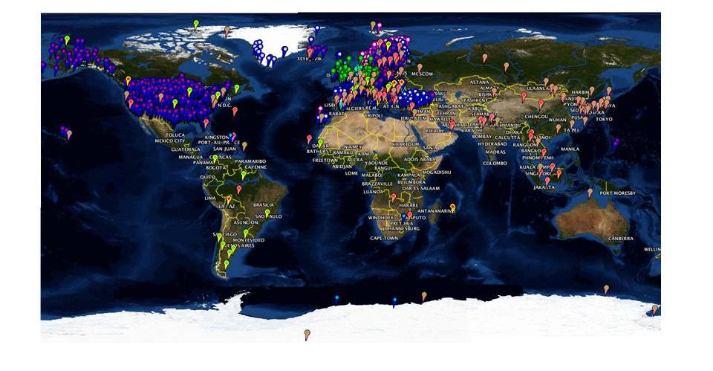
Ceilometer
Ceilometer are low power lidars built for providing cloud heights.
They are proved to be able to provide at soma extend also information on aerosol content 24h /7 d week
http://www.dwd.de/ceilomap

Slide 17
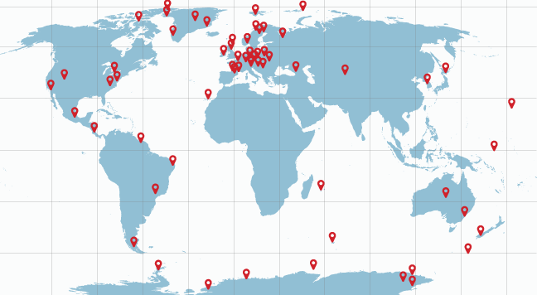
Profiling networks: ozone & water vapor lidar
NDACC : Network for the Detection of Atmospheric Composition Change --
De Maziere et al. , ACP 2018
ftp.cpc.ncep.noaa.gov/ndacc

Slide 18
NDACC
Key elements
Stratosphere measurements
Different instruments (lidar, microwave, radiometers, FTIR)
Harmonized procedures
Long term measurements

Slide 19
NDACC Europe/ACTRIS
European component of NDACC within ACTRIS RI
Structured around a Topical center and DC node
https://actris.nilu.no

Slide 20
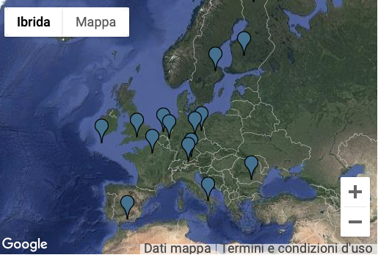
Profiling networks: clouds
Cloudnet
vertical profiles of cloud properties at high temporal and spatial resolution.
Instruments:
Radar; microwave radiometer, ceilometer, doppler
https://actris.nilu.no

Slide 21
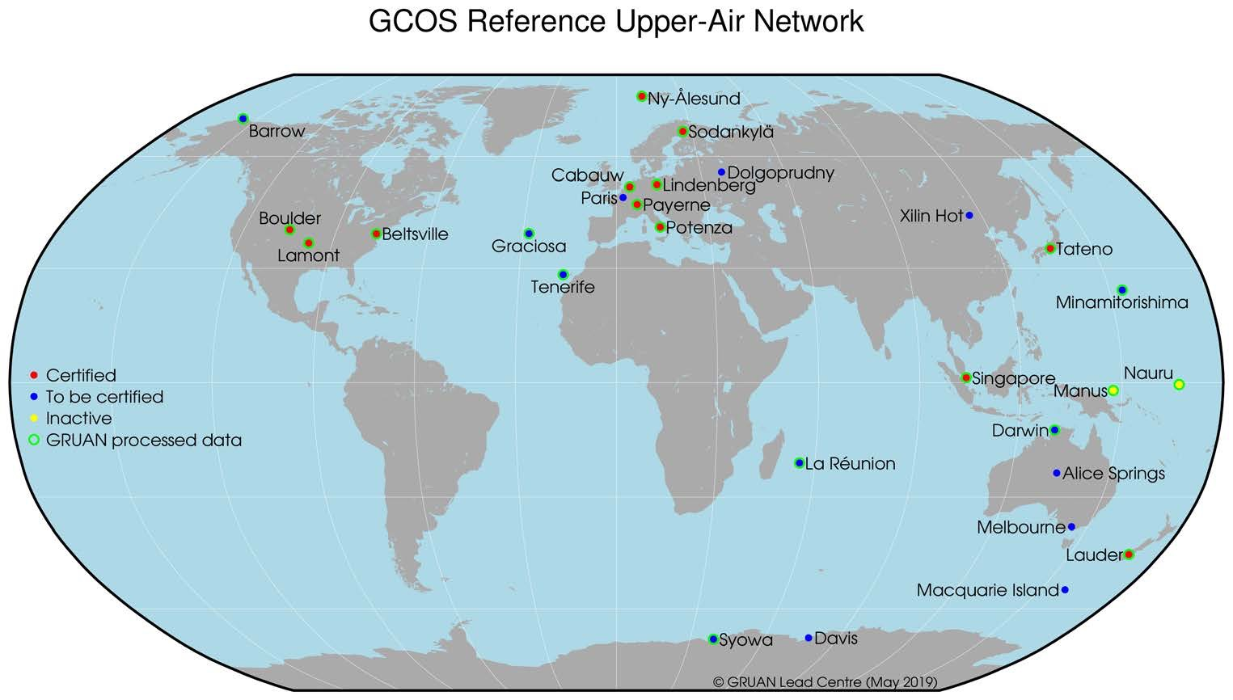

Profiling networks: Temperature & Humidity

Slide 22
GRUAN
Long term view to observations of upper air essential climate variables
Focus on priority 1 variables to start: Water vapor and temperature (starting to bring in other variables)
Reference observation means:
o quantified uncertainties
o traceable
o well documented
o verify in redundant observations

Slide 23
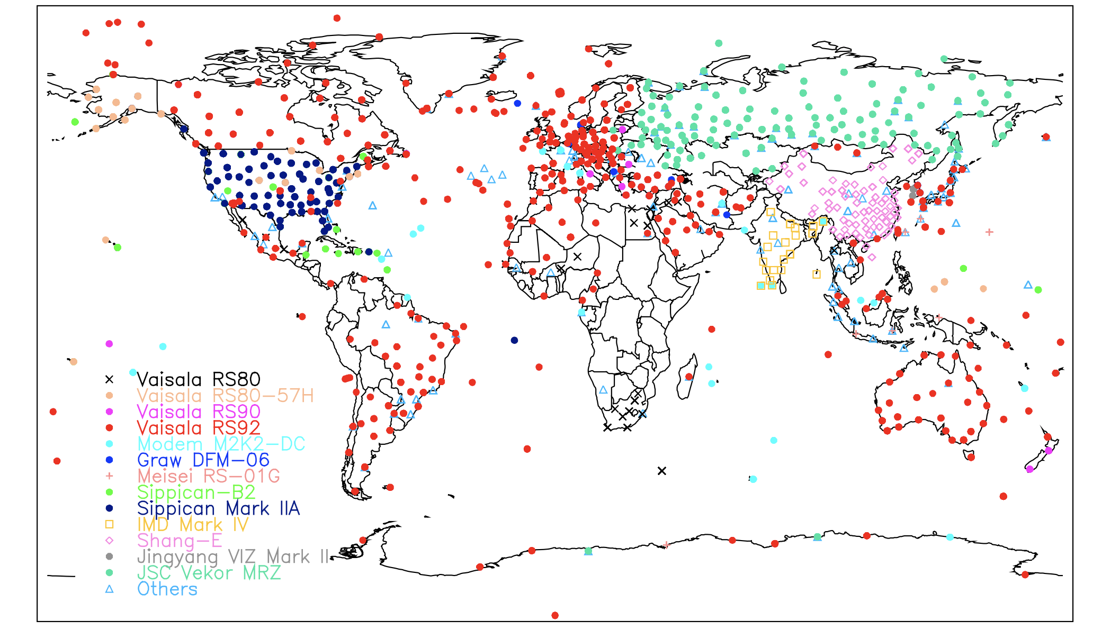
Profiling networks
IGRA: Integrated Global Radiosounding Archive
Global baseline observations, no uncertainty

Slide 24
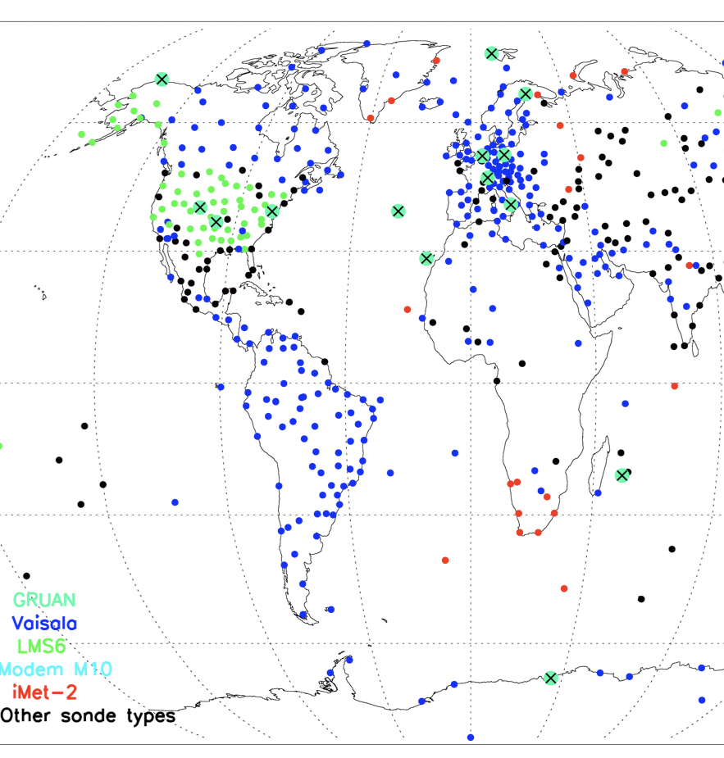
GRUAN & IGRA
Homogenized temperature, humidity and wind sub-daily profiles since 1-1-1978 for 600 radiosounding stations globally taken from IGRA.
Global distribution of GRUAN Reference stations (green large dots) and the subset of IGRA stations homogenized using the RHARM (Radiosounding HARMonization ) approach (small dots).
Madonna, F. et al., ESSD Disc., under review, 2020.

Slide 25

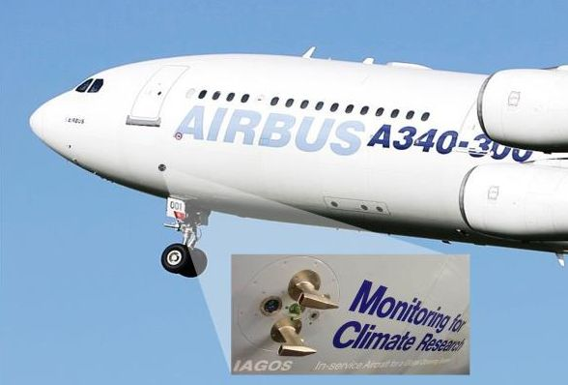
Profiling networks: aircraft
IAGOS : In-Service Aircraft for a Global Observing System
IAGOS-CARIBIC: one aircraft for campaigns observes approximately 100 trace gases and aerosol parameters
IAGOS-CORE: continuous data on trace gases, aerosol and cloud particles from a growing fleet of aircraft operated globally.
Typical measurements: ozone, carbon monoxide, humidity and cloud particles.
http://www.iagos-data.fr/portal.html
Notes:
Profiles over city provided

Slide 26
Why profiling for satellite and models?
As input about distribution on the vertical dimension for simulations/understanding/boundaries
Calibration/validation of satellite data products and algorithms
Evaluation and verification of model capability of reproducing vertical dimension
Assimilation into model for improving forecast in 4d space
MAIN AIM: improving the capacity of observing and modelling the vertical distribution of key components of the atmosphere

Slide 27
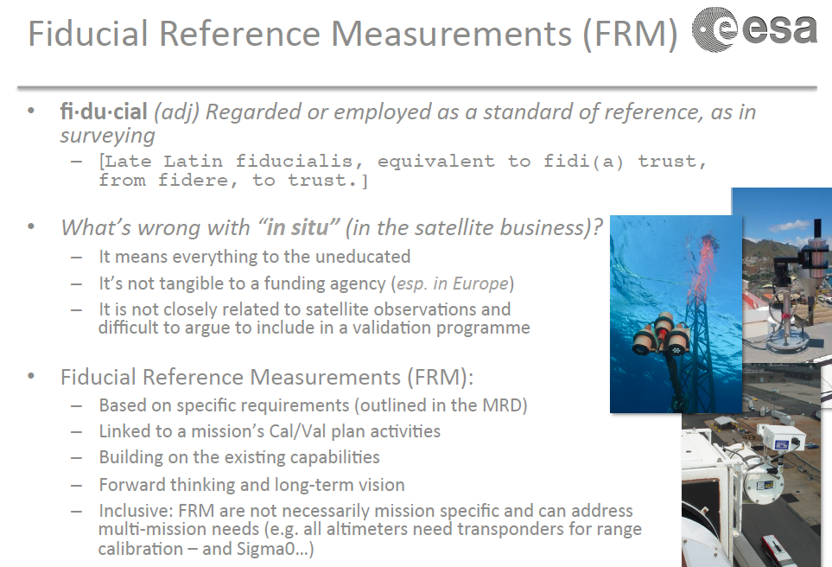
Profiling for satellite and models

Slide 28
Satellite validation/synergy
CALIPSO is providing since June 2006 4d observations of aerosol and clouds in the vertical at 532nm and 1064 nm
Backscatter and extinction profiles
Depolarization profiles
Classification in aerosol vs clouds
Aerosol types
ACTRIS/EARLINET the natural GB tool for calibration validation integration and synergy

Slide 29
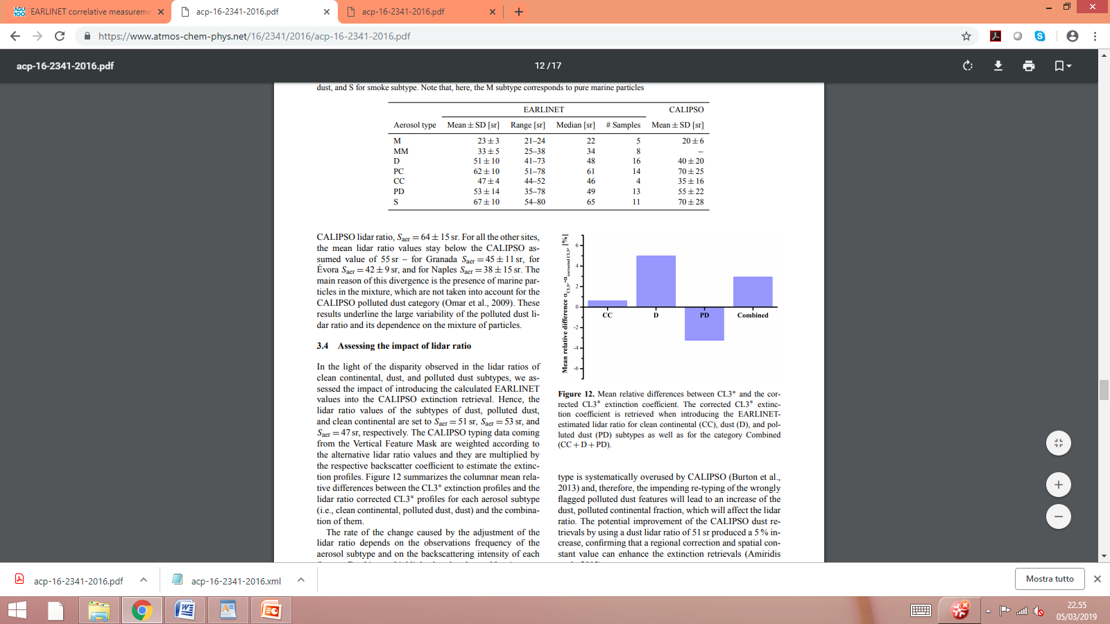
Satellite validation/synergy
Comparison in terms of Level 1 raw lidar data
No relevant issues
Validation of aerosol optical properties profiles
some issues in properly layering and typing the atmospheric aerosols
Climatological comparison on continental scale
Some solutions were proposed to in terms of lidar ratio assumptions which were considered by the CALIPSO team for the new version release of CALIPSO data
Pappalardo et al., 2010
Pappalardo et al., 2010; Wandinger et al.,2010
Papagiannopoulus et al, ACP,2016

Slide 30
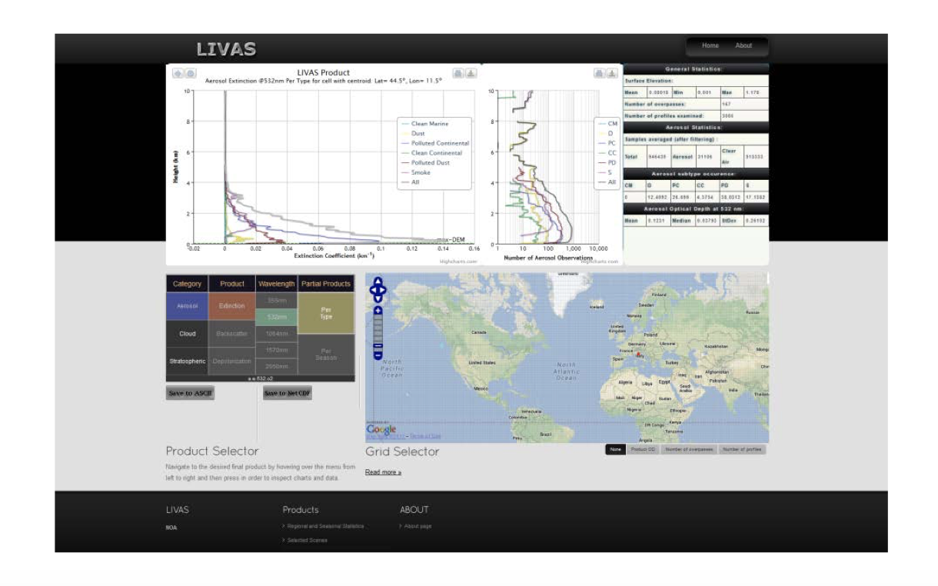
Satellite synergy
LIVAS
LIdar climatology of Vertical Aerosol Structure for space-based lidar simulation studies
Integrates CALIPSO observations, with added values of ACTRIS/EARLINET knowledge about aerosol characterization + aerosol models, improving CALIPSO assumptions
Amiridis et al., ACP 2015

Slide 31
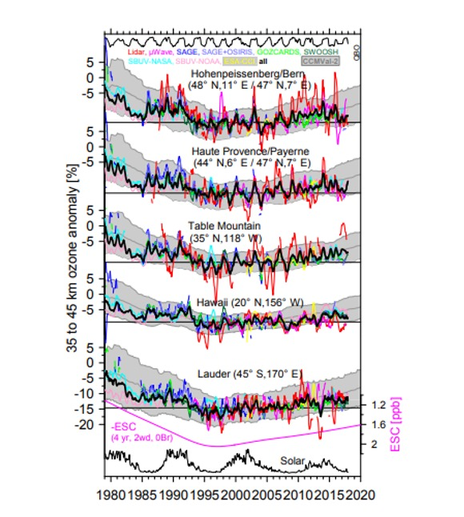
Satellite validation
NDACC data as reference for improving consistency among multiple satellite data records.
Upper-stratospheric ozone time series from
  SAGE (Stratospheric Aerosol and Gas Experiment), OSIRIS (Optical Spectrograph and InfraRed Imager System), ESA-CCI)
  SWOOSH (The Stratospheric Water and OzOne Satellite Homogenized)
  GOZCAR
Success of the Montreal protocol in reversing the ozone depletion tendency observed till 2000 at all sites.
De Maziere et al., 2018

Slide 32
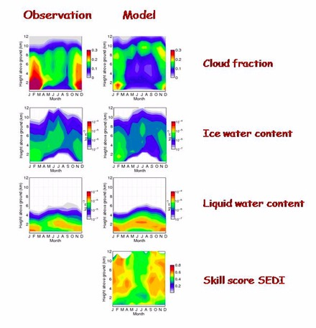
Model verification
ACTRIS/Cloudnet provides NRT evaluation of weather forecast about
Cloud fraction, ice and liquid water content,
&
Cloud fraction SEDI score (Symmetric extremal dependence index) to assess the general performance of a forecast system and its ability to predict extreme (rare) events.
Comparison datasets reported in terms of climatologies (Means, distribution, skill scores). Illingworth et al., 2007

Slide 33
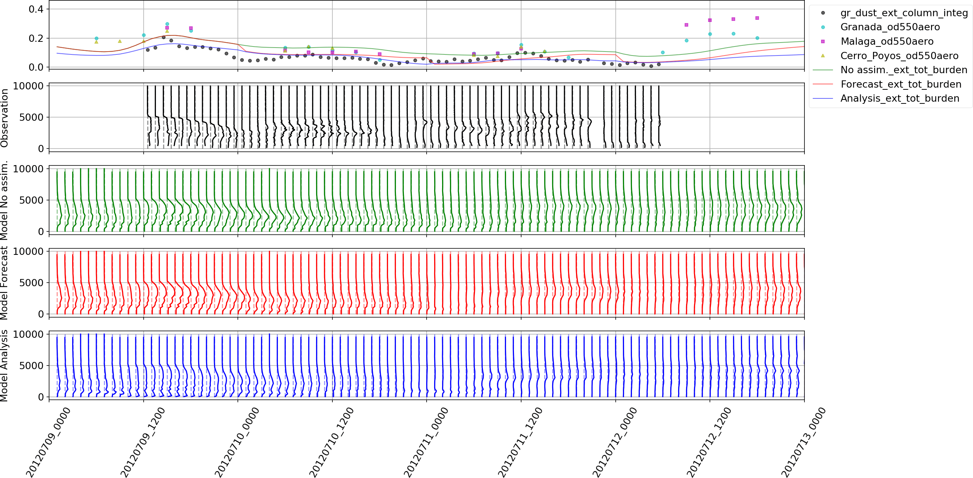
Model assimiliation
Assimilation of ACTRIS/EARLINET desert dust backscatter profiles in the BSC dust model simulations from the chemical weather prediction system NMMB-MONARCH .
Lidar Observations
No assimilation
Forecast initialized from an analyses
Model analysis
The assimilation of measured lidar profiles helps in correcting inconsistencies between observed and simulated dust plumes.
Sicard et al AMT 2014; Bienotolgou et al., AMT 2015

Slide 34
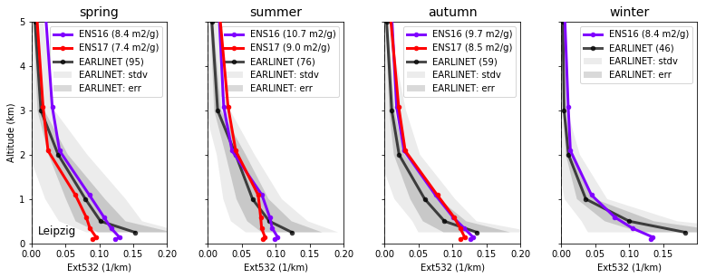

Climatological model evaluation
Comparison of aerosol extinction profiles in terms of climatological seasonal averages. The Copernicus ENSEMBLE air quality forecast ensemble means for 2016 and 2017 are reported together with ACTRIS/EARLINET averaged.

Slide 35
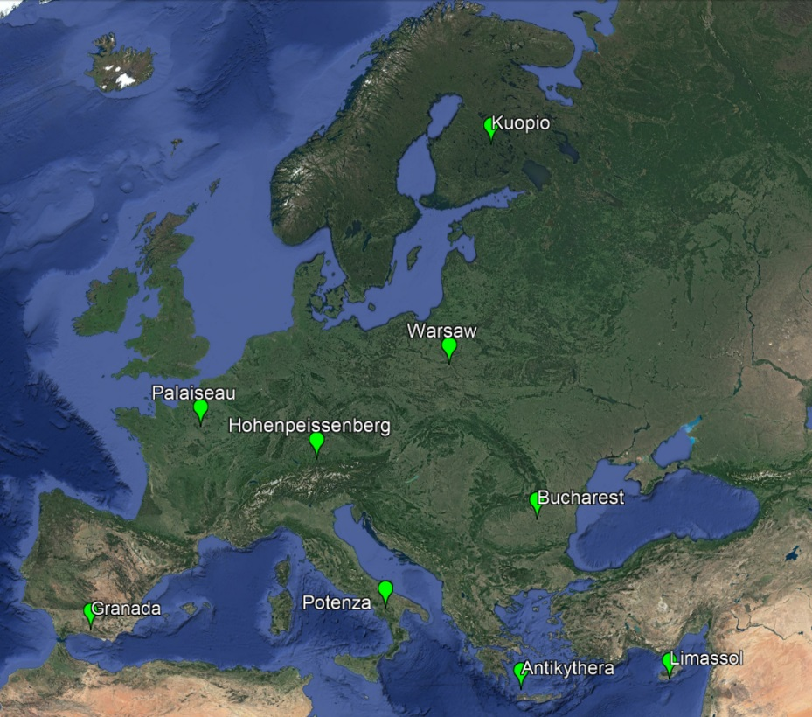
New: Pilot aerosol profile provision to CAMS
A pilot to accommodate the provision of ACTRIS/EARLINET data to the Copernicus Atmosphere Monitoring Service (CAMS)
  Traceability
  Standardization
  Unique data access point
  NRT data provision
9 test stations – new measurement schedule-
centralized processing and data handling

Slide 36
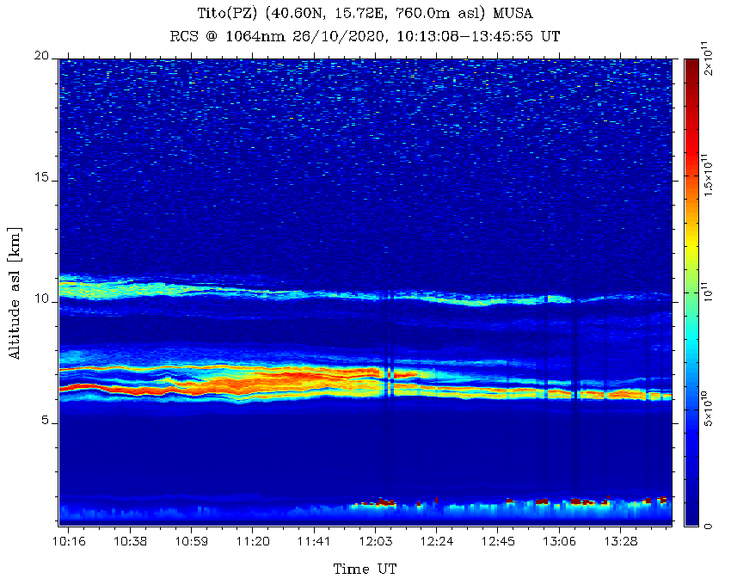
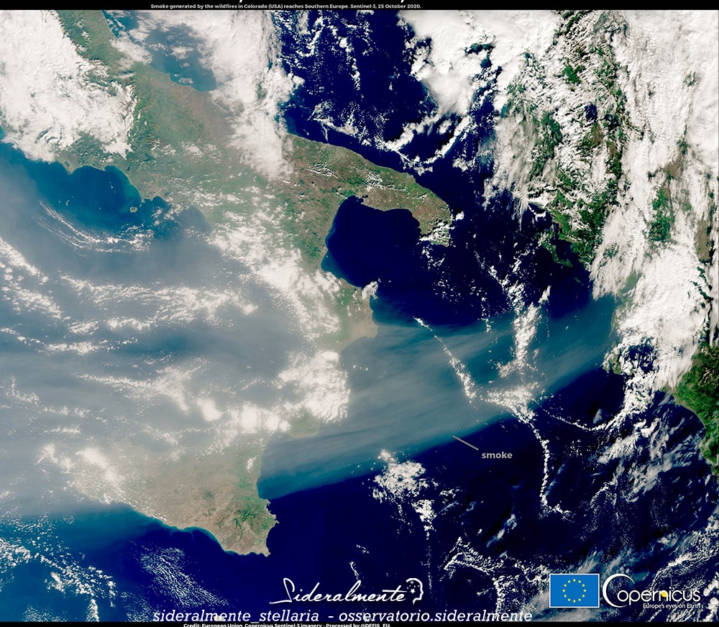
New: Pilot aerosol profile provision to CAMS
Collected observations --- A special case. 26th October 10:13- 13:45 UT
Smoke generated by the wildfires in Colorado (USA) reaches Southern Europe. Sentinel 3, 25 October 2020

Slide 37
THANK YOU
FOR YOUR ATTENCTION

