Slide 1
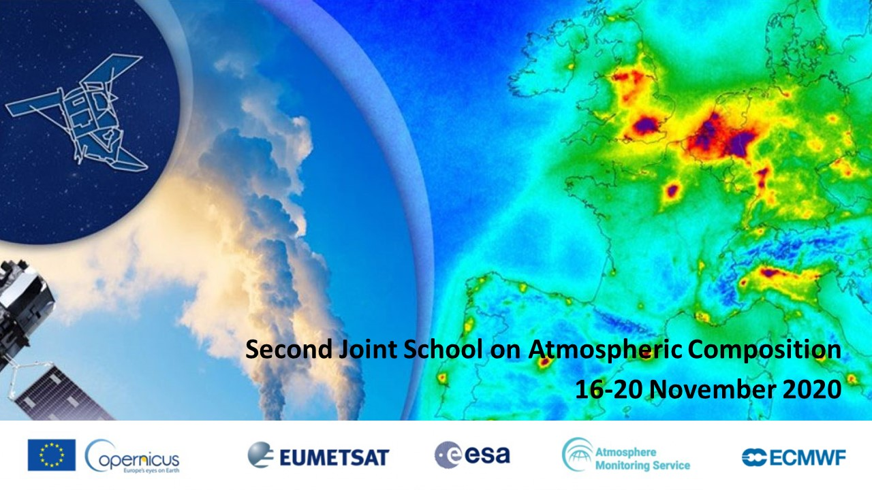
‘Atmospheric models: basic principles and examples of process-based evaluation using satellite data’
by Dr. Apostolos Voulgarakis,
Technical University of Crete/Imperial College London

Slide 2
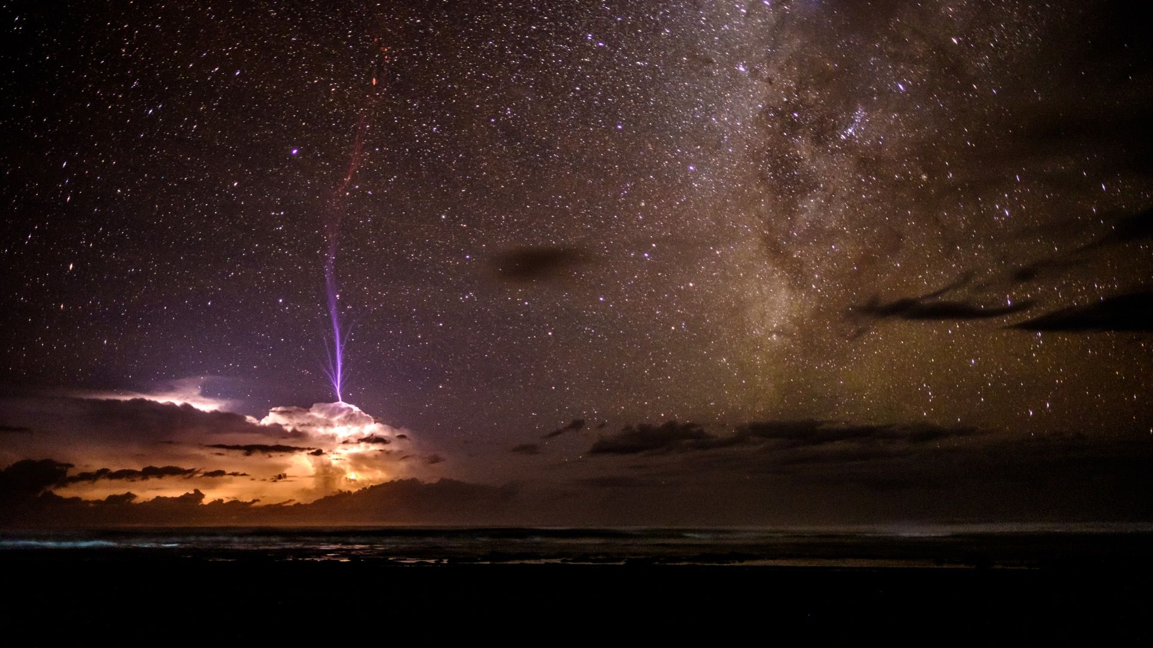

Atmosphere: the great connector
From the 2016 Picture competition of the Royal Meteorological Society
Notes:
Atmosphere: the great communicator (space, ocean, mountains, breathing of air by people, plants, etc). The fast timescales of response are key here.
10 m/s, in one day 10^5 s -> 1000km (10 deg lat).

Slide 3
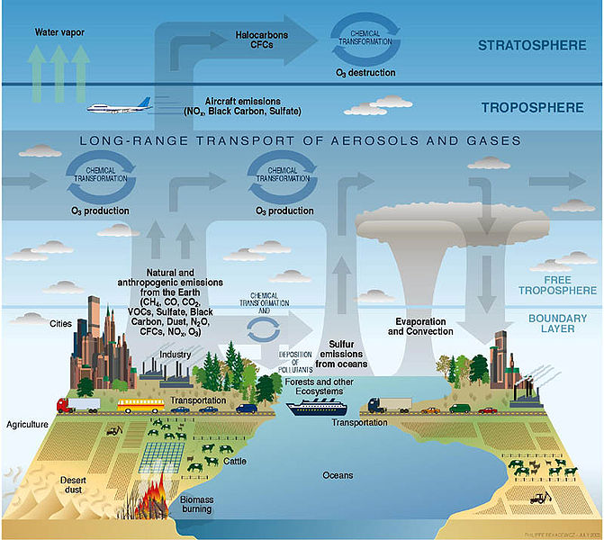
The complex system we need to model:
Source: US Climate Change Science Program.
Notes:
Discuss overview of processes in the composition-climate system (and the Earth system in general) and the fact that there are interactions everywhere. Sometimes we need to simulate components (e.g. atmospheric chemistry, or climate, or the oceans or…) in isolation, and sometimes we need to examine the interactions or include them for more realistic predictions.
I could also add a slide here showing the historical evolution of the field, decade by decade, and how we moved from more focused systems to fully integrated systems.

Slide 4
Processes simulated in an atmospheric model
Jacobson (2005)

Slide 5
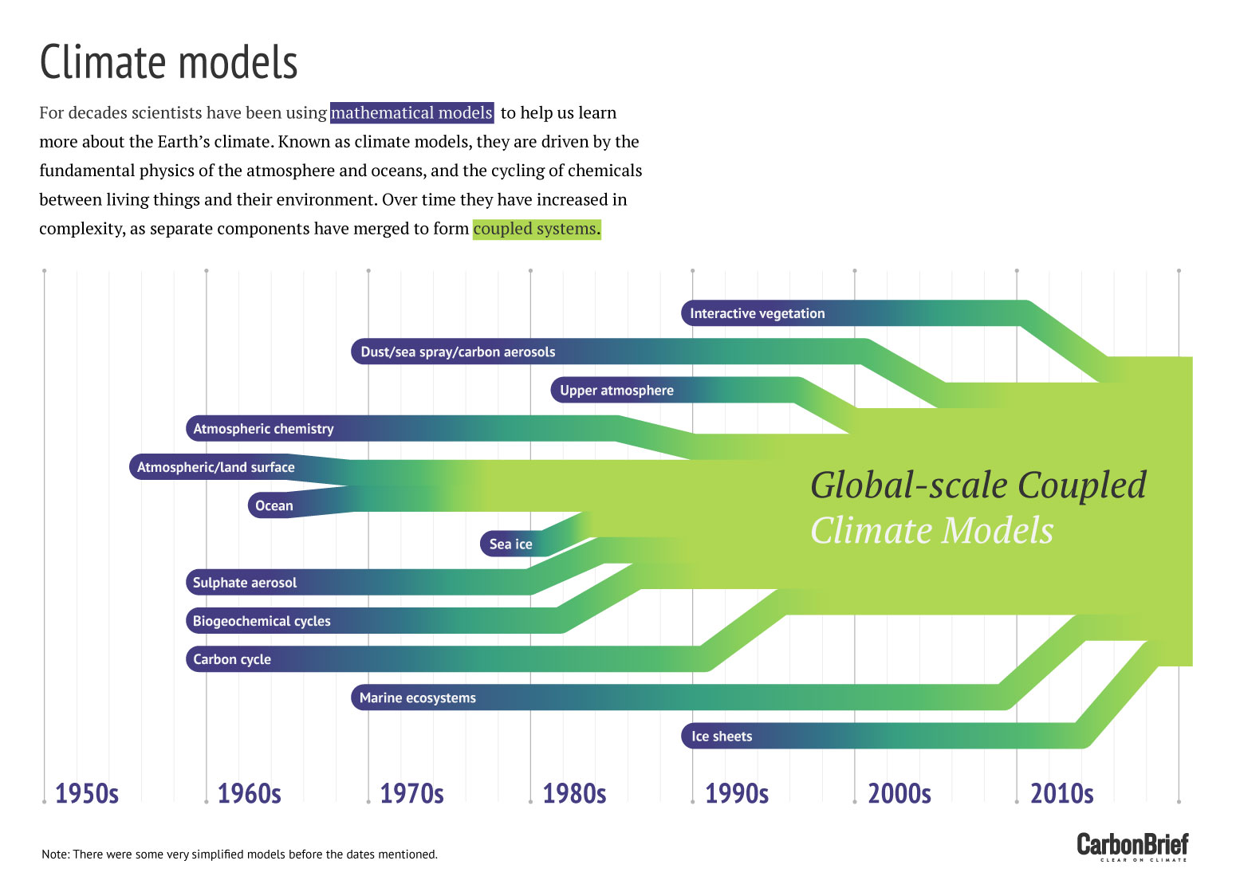
The evolution from separate to coupled modelling systems

Slide 6
Types of large-scale atmospheric models
(global or regional)
• Chemical transport models (CTMs): use external meteorological data as input; simulate the aerosols/gases.
• General circulation models (GCMs): simulate their own meteorology; use external aerosols gas forcings.
• Chemistry-climate models (CCMs, also called composition-climate models): do both.
• Earth system models (ESMs): the atmosphere interacts with the oceans, the biosphere etc.

Slide 7
The three pillars of an atmospheric model
Conservation
of mass
Conservation
of energy
Conservation
of momentum
These equations “talk” each other in a chemistry-climate model.
Notes:
Explain the equations and the way that they are coupled.
Doric, Ionic and Corinthian order of architecture.

Slide 8
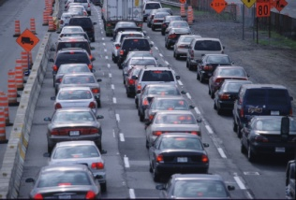
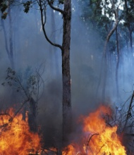
Conservation of mass (mass balance equation) for a gas/aerosol constituent
Small in trop/strat
Local loss term: Chemical loss, wet and dry deposition, microphysics
(in kg m⁻³ s⁻¹).
Change of concentration of constituent with time
(in molec. m⁻³ s⁻¹).
Flux divergence due to transport (advection/convection). U is the wind velocity vector (m s⁻¹).
Flux divergence due to molecular diffusion. D is the molecular diffusion coefficient (m² s⁻¹).
Local production term: Emission, chemical production, microphysics
(in kg m⁻³ s⁻¹).
P+L (local terms)
convection
• This equation is for number concentration, but equivalent equations can be written for mass, mass concentration etc.
advection
Chemistry,
aerosol microphysics.
advection
Emissions, deposition

Slide 9
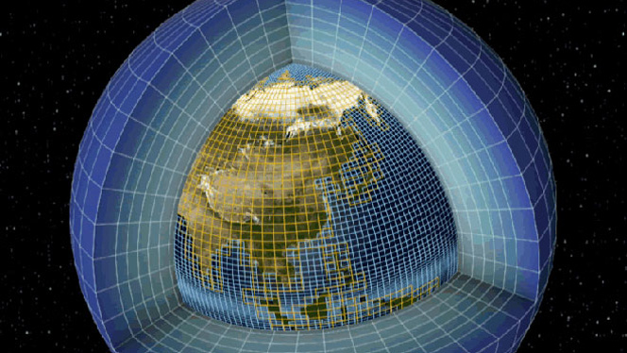
Discretisation of mass balance equation in space
(crucial for large-scale, complex atmospheric models)
• Mass balance is 1st order PDE in space and time. Need initial concentration and boundary conditions (i.e. fluxes at surface, top-of-the-atmosphere).
• Global models have 3D domain with finite number of gridboxes. Typical global models: horizontal resolution of ~100km, vertical of ~1km -> total of ~10⁶ gridboxes. Equation then solved for all gridboxes.
www.sciencemuseum.org.uk

Slide 10
Discretisation of mass balance equation in time
• Split the equation into contributions from transport and local terms:
Emissions, chemistry, deposition etc (P-L).
If several species, then for species i we have P_{i}(n)-L_{i}(n), where n a vector of concentrations of all species on which i depends.
Advection+
convection =
• Use a transport operator and a local operator to decouple the two terms in finite difference form (assumed TRA and LOC are decoupled - can swap to test!):
• Can split further (TRA to TRA_{x}, TRA_{y}, TRA_{z}, or LOC to chemistry, microphysics, emissions, deposition operators).

Slide 11
Simple one-box models (0-dimensional)
• Helpful for quickly testing hypotheses. Also OK for modelling well-mixed greenhouse gases (not very inhomogeneous in space).
• Consider gas (no microphysics) with mass m:
F_{in} (inflow)
Chemical production/
loss (P+L)
F_{out} (outflow)
emissions (E),
deposition (D)
Lifetime (e-folding):

Slide 12
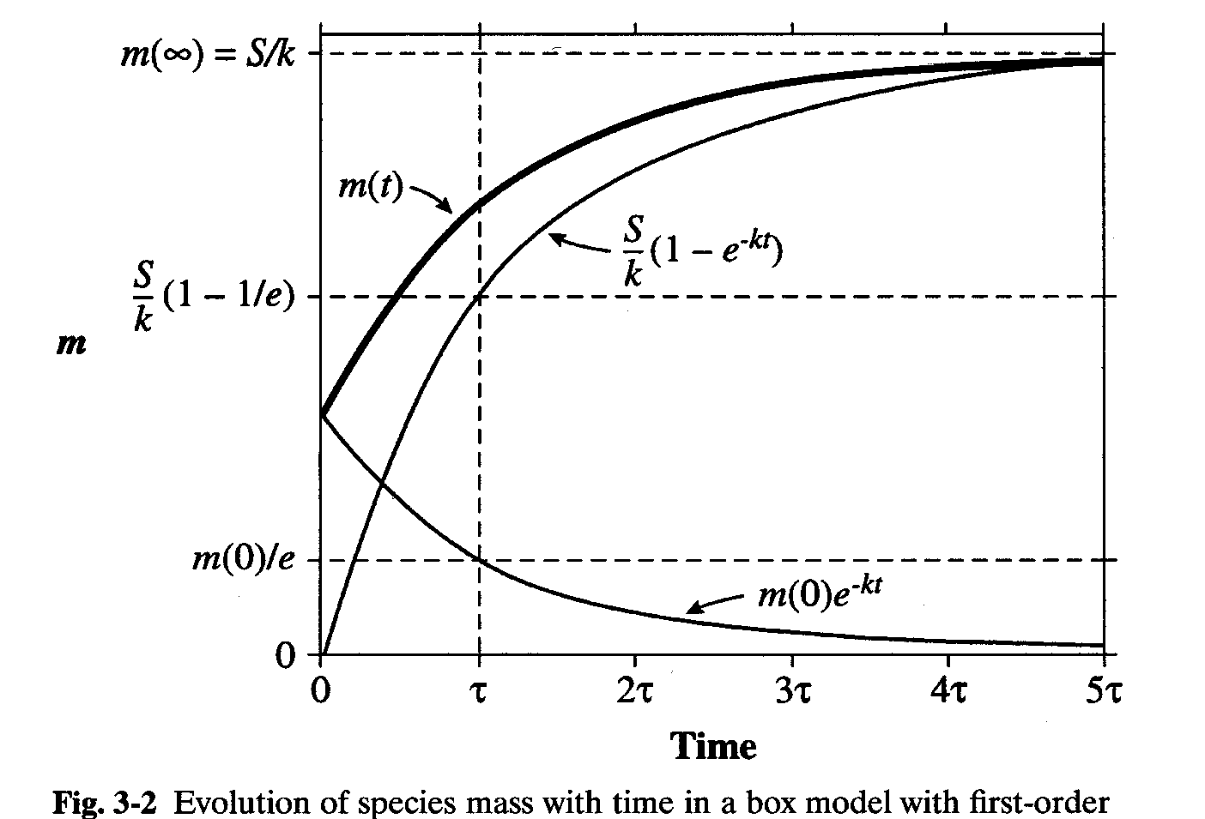
Evolution of constituent mass in a box model
• Assume we have a constant known source S (emission, chemical, microphysical) and constant 1st order loss L (loss rate constant = k).
• Steady state when dm/dt = 0, i.e. abundance does not change with time.
• Takes about 2-3 lifetimes (τ) to reach “quasi steady-state”, though it depends on the initial conditions.
http://acmg.seas.harvard.edu/education/

Slide 13
Simple two-box model
• Useful if we have two distinct environments interacting
(e.g. boundary layer & free troposphere, Europe and the Sahara etc).
Chemical production/
loss (P₁+L₁)
F₁₂
Chemical production/
loss (P₂+L₂)
m1
m2
emissions (E₁),
deposition (D₁)
F₂₁
emissions (E2),
deposition (D2)
(and similar for box 2)
We may be given that some loss process is first order (e.g. the left to right transport flux). Then we can express F₁₂ = k_{F12}m₁.
Note that if we are told that the system has reached steady state, we have two simple algebraic equations.

Slide 14
Back to large-scale models: Thermodynamic energy equation
Change of energy density with time in a gridbox
(in J m⁻³ s⁻¹).
Flux divergence for energy density due to transport. U is the wind velocity vector (m s⁻¹).
Heat production and loss terms (ρ_{A} is the density of air, and θ_{v}/Τ_{v} are the virtual potential temperature and virtual temperature).
Includes diabatic heating/cooling by greenhouse gases/aerosols.
• It is also solved for each timestep in a GCM or a CCM. In the CCM “online” simulated gases/aerosols will be used for diabatic heating
• Simulated heating rates and temperatures are then fed back to the chemistry/aerosol “scheme” to influence atmospheric composition.

Slide 15
Conservation of momentum (Navier Stokes equation)
Change in air velocity in a gridbox
(in m s⁻²).
Advection term for U.
Changes due to diffusion.
Pressure-gradient & gravity terms, exerting local accelerations.
• Familiar? Analogous to the mass balance equation.
• Heating/cooling rates calculated from thermodynamic balance (previous) affect pressures, which are fed into this part of the model (dynamics) to calculate changes in wind velocities (i.e. circulation).
• Then circulation changes, together with other resulting meteorological changes that occur during the timestep, feed into the chemistry/aerosol scheme to affect constituent transport, reaction rates, wet deposition etc.
• Everything coupled (in a CCM or ESM, not a CTM)!

Slide 16
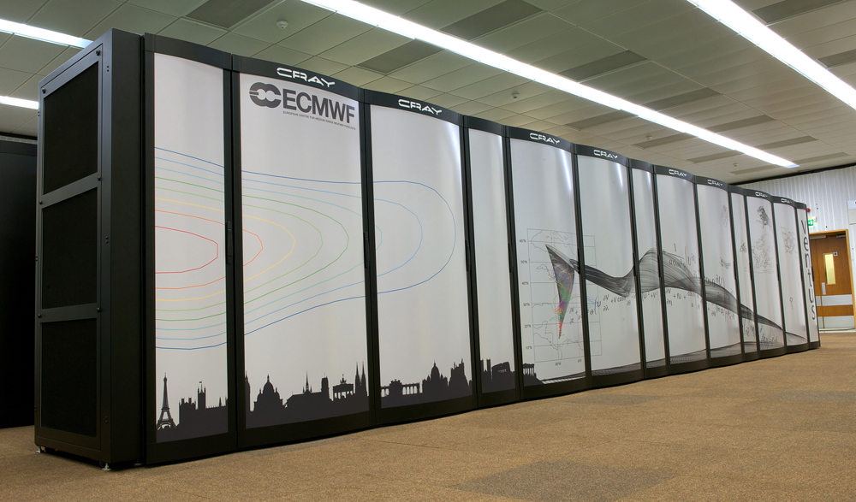
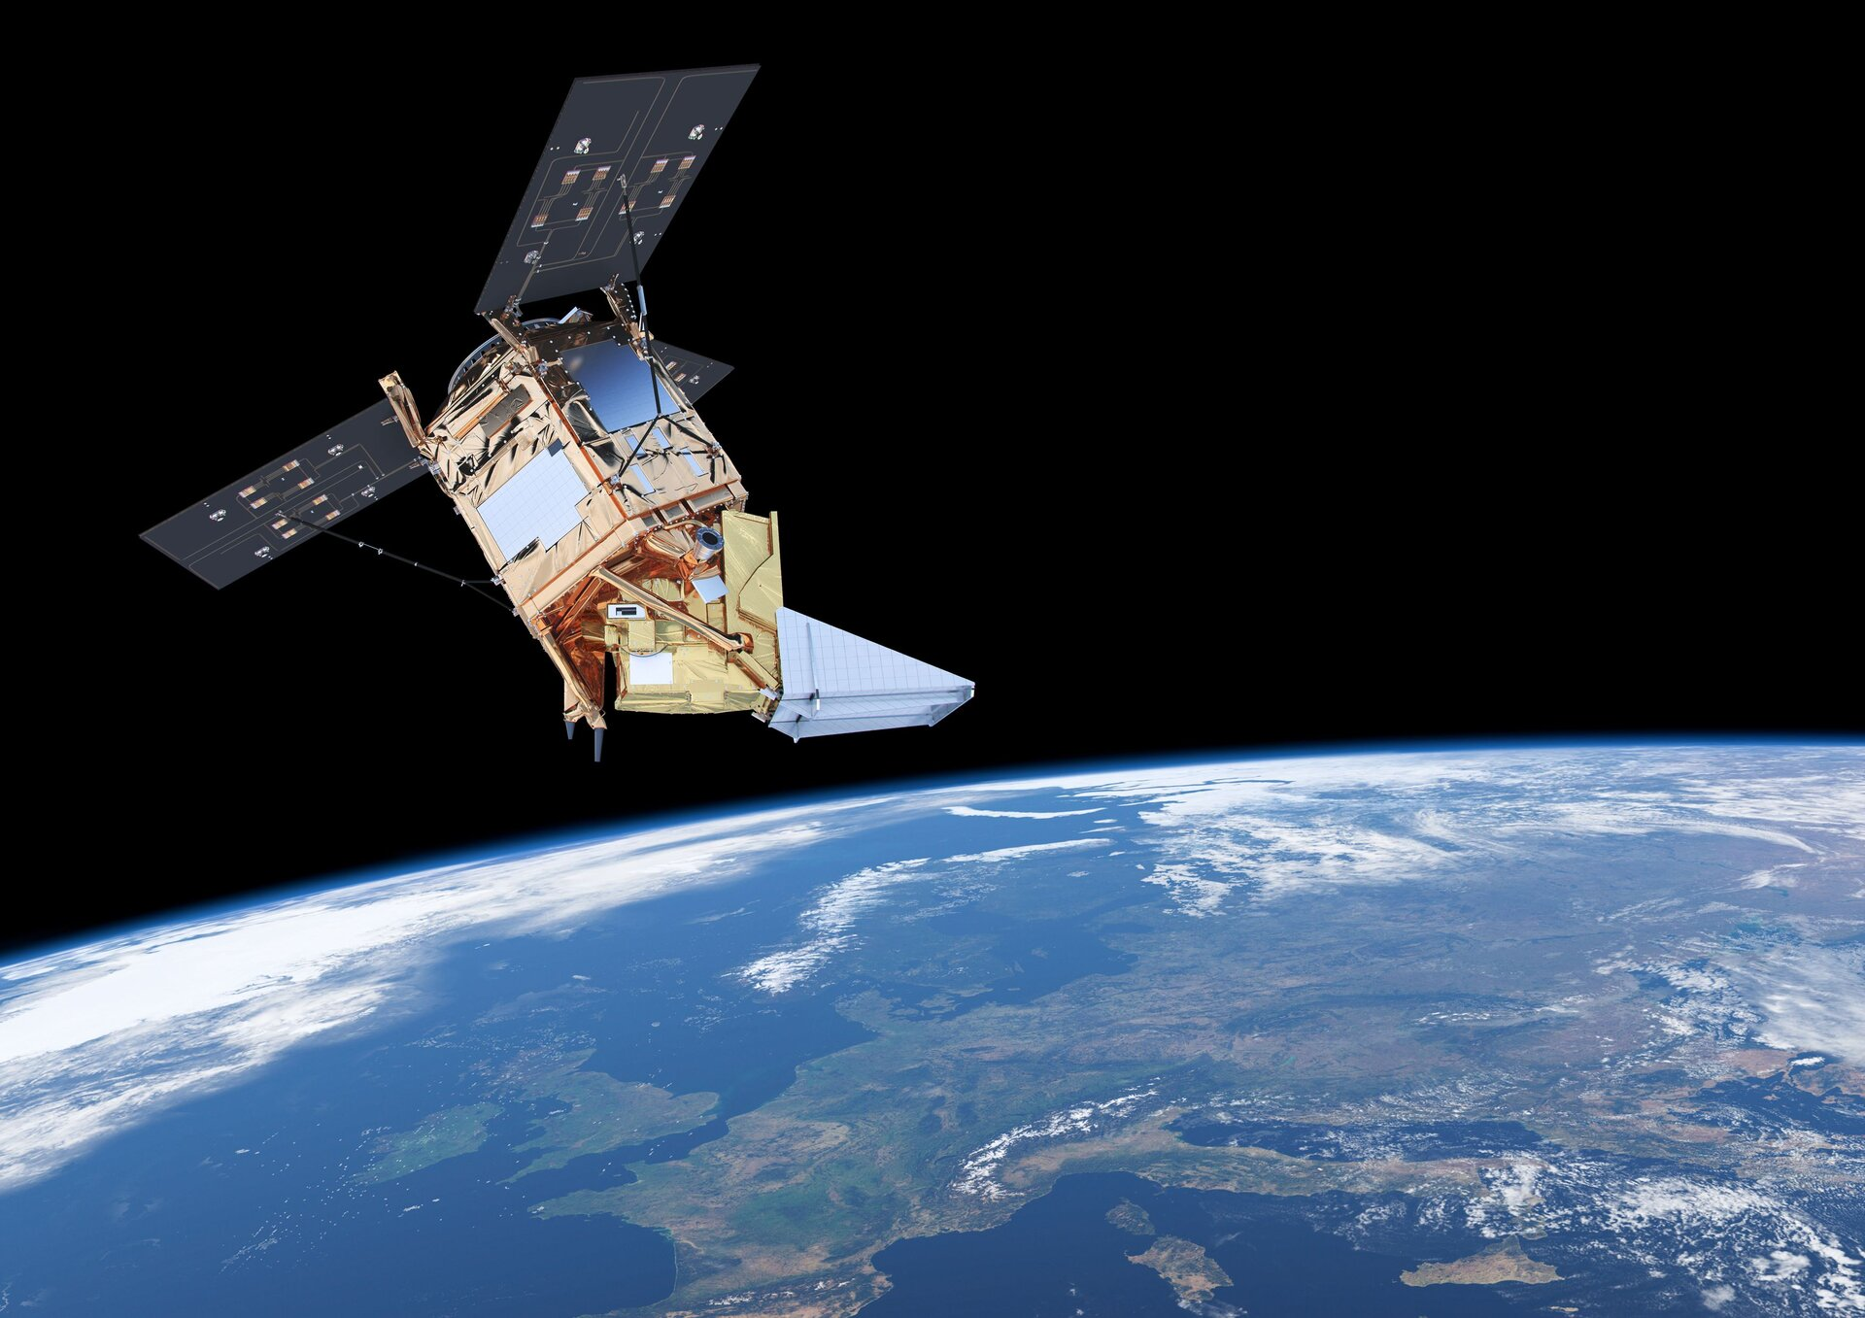
Recent advances that revolutionized atmospheric science
Models have advanced a lot in the last 2-3 decades, with higher and higher resolution and more and more processes included (increasing computational power has been crucial).
Satellite observations of atmospheric constituents have produced a wealth of data that helps us constrain our models in a way that we could not have done before!
ECMWF supercomputers
Sentinel-5P satellite

Slide 17
How to use a model
Improve model, characterize its error
Define problem
of interest and its scale
Design model;
make assumptions to
simplify equations
Design observational system to test model
Evaluate model with observations
Apply model:
test hypotheses, predictions
http://acmg.seas.harvard.edu/education/
Need to be in constant dialogue.
Notes:
Here I will mention that model validation should often be going beyond the more “traditional” single produce comparisons with observations, and could be often involving process-based methods with multiple satellite datasets and/or with the combined use of observations with model sensitivity experiments.
This will lead to the subsequent slides with exmaples.

Slide 18
Example of process-based (multi-) model evaluation: Examining the correlation between O₃ and CO in the troposphere
(see Voulgarakis et al. [2011, ACP])

Slide 19
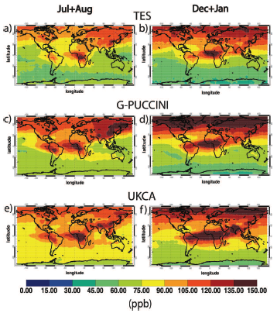
Average 2005-08 CO concentration for 800-400 hPa
Generally, geographical patterns (and to some extent the abundances) of CO are captured fairly well by both models.
GISS
Voulgarakis et al. (2011)

Slide 20
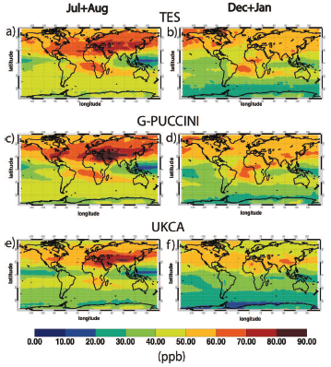
Average 2005-08 O₃ concentration for 800-400 hPa
Similarly, O₃ geographical patterns (and to some extent the abundances) are captured fairly well by both models.
GISS
Voulgarakis et al. (2011)

Slide 21
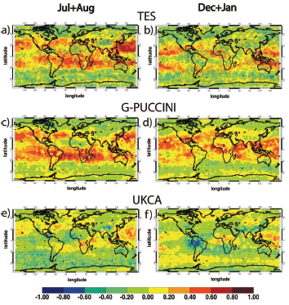
O₃-CO correlation (800-400 hPa average)
(used 2005-08 daily data)
TES: positive correlations in most of the Pacific, central northern Atlantic, much of the Indian Ocean, central Africa. Negative correlations in much of the northern hemisphere (excluding the oceans) and in part of the Southern Ocean.
Many features are very similar in the G-PUCCINI maps.
UKCA results are much different, although the Pacific and the Atlantic features are visible in the summer.
GISS
Voulgarakis et al. (2011)
Notes:
Highlight that models perform very differently in terms of O3-CO correlations, even though they performed similarly for O3 and CO when evaluated separately.

Slide 22
Example of process-based model evaluation: Interannual variability of important constituents and wildfires as a main driver
(see Voulgarakis et al. [2015, JGR]; Voulgarakis et al. [2010, ACP])

Slide 23
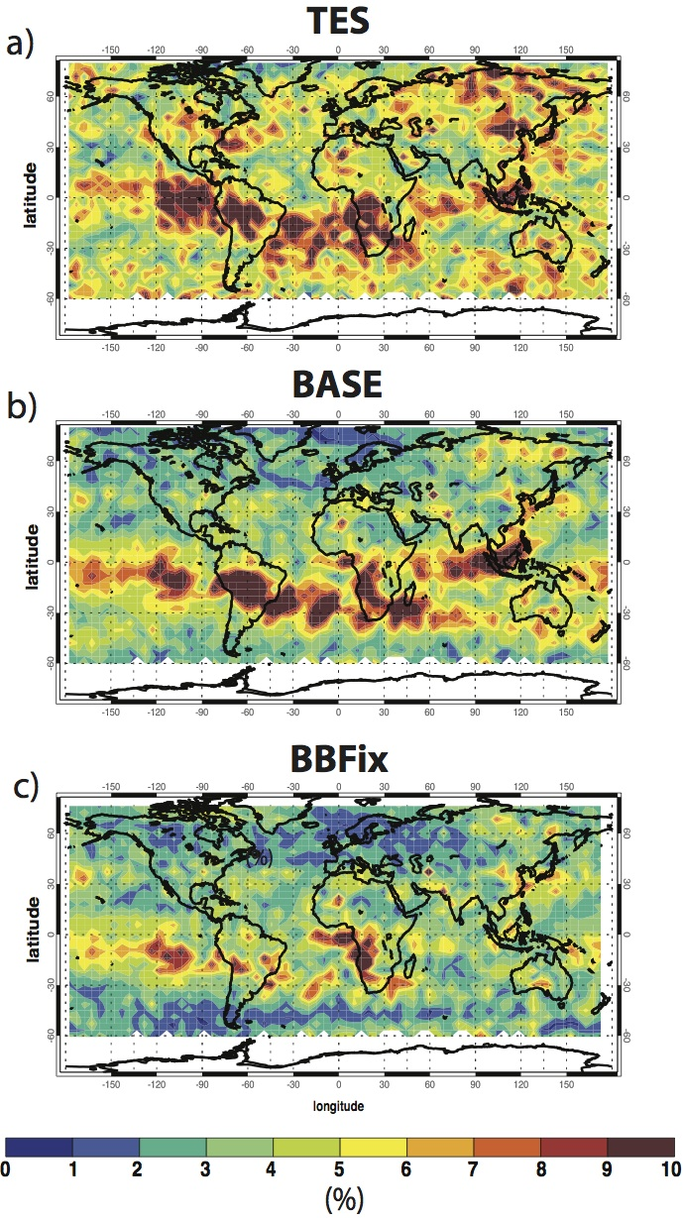
IAV of July-August CO from the Aura satellite (TES) and from the model (2005-09; 800-400hPa)
“Hot-spots” of CO IAV: Central Africa, S America, E Asia and Siberia.
Captured well by the model.
Hot-spots almost disappear when fire emissions are fixed: fire emissions the main driver of CO IAV.
GISS –BASE run
GISS –BBFix run
Voulgarakis et al. (JGR, 2015)

Slide 24
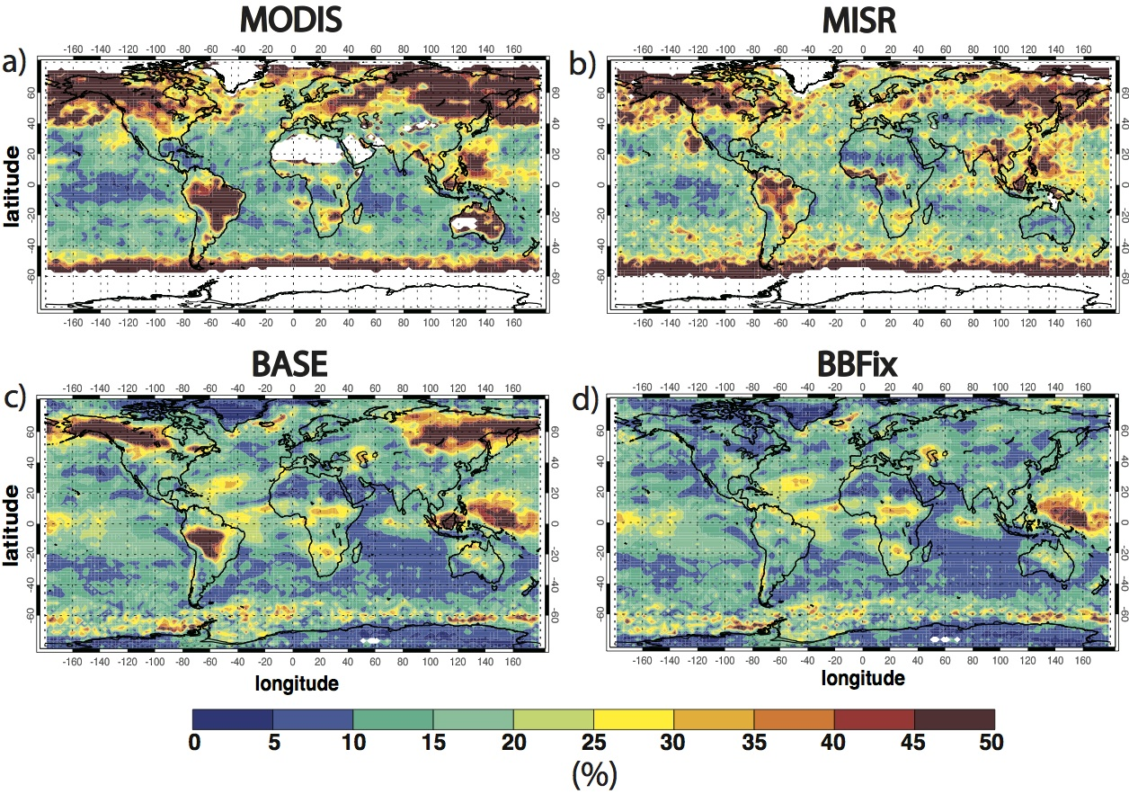
Variability of Jul-Aug aerosols optical depth in observations and model experiments (2000-09 period)
GISS –BASE run
GISS –BBFix run
Hot-spots of variability are in SE Asia, S America and boreal regions.
Biomass burning is the main driver.
Voulgarakis et al. (JGR, 2015)

