Slide 1
Atmospheric composition from GOME-2 / METOP measurements
Alessandra Cacciari
and the Atmospheric Composition team at EUMETSAT
Rosemary Munro (lead), Sebastian Gimeno Garcia, Nan Hao, Rasmus Lindstrot, Gabriele Poli, Frank Ruetrich, Bram Sanders, and
Ruediger Lang

Slide 2

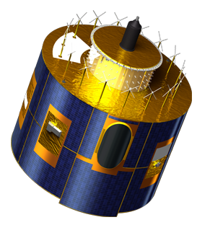
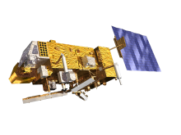
The need for two types of meteorological satellites
Geostationary orbit
Vital for forecasts up to a few hours
Polar orbit
Critical for forecasts up to 10 days

Slide 3
GEO_AQ_Constellation_Geophysical_Validation_Needs_1.1_2Oct2019.pdf, ceos.org

Slide 4
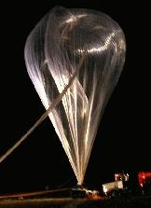

Schematic of Remote Sensing Observations
Validation
Changed Radiation
Radiation
Sensor
Object
What we already know
Measurement
A priori information
What we see
Data Analysis
Final Result
Forward Model
What we should see
Courtesy: Andreas Richter -
University of Bremen

Slide 5
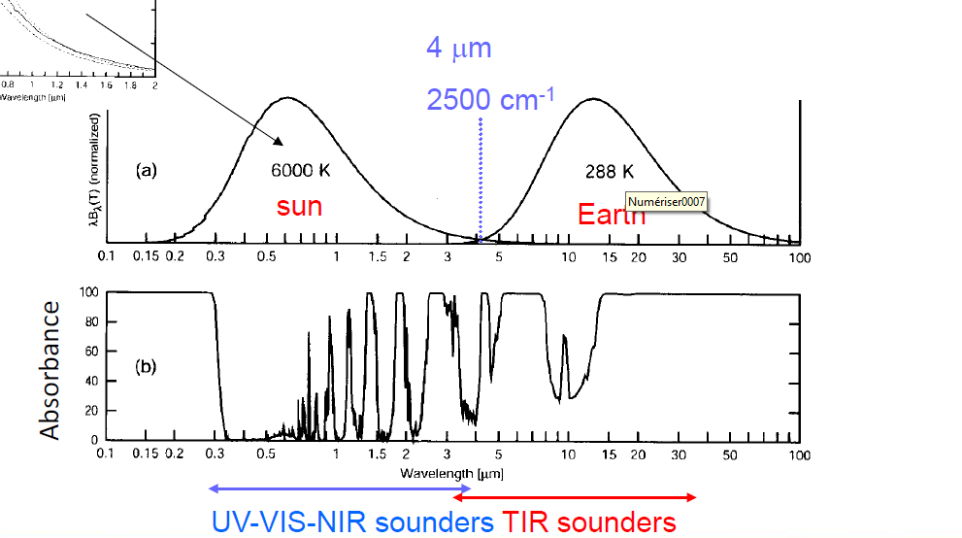
Remote Sensing Observations
Courtesy: Michel Van Roozendael
Royal Belgian Institute for Space

Slide 6
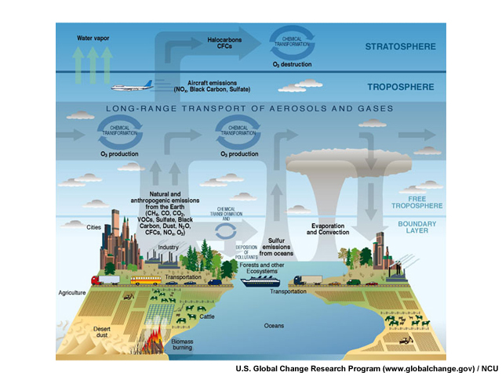
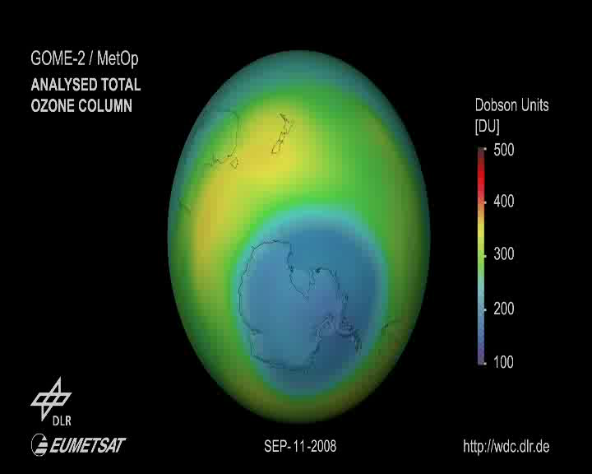
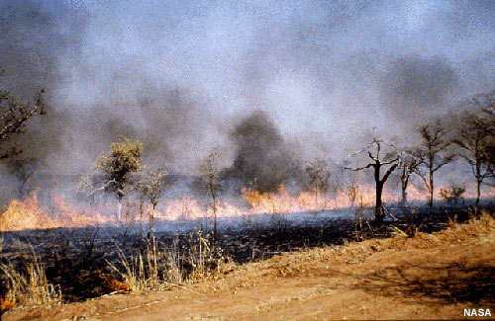
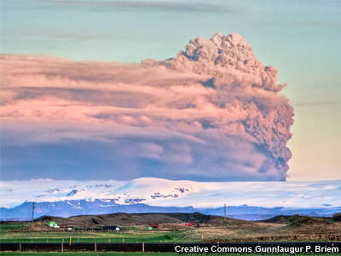
Atmospheric composition
Stratospheric Ozone & Ozone Depletion Monitoring
Air Quality Monitoring & Forecasting
Biomass Burning
Aerosols and Volcanic Emissions

Slide 7
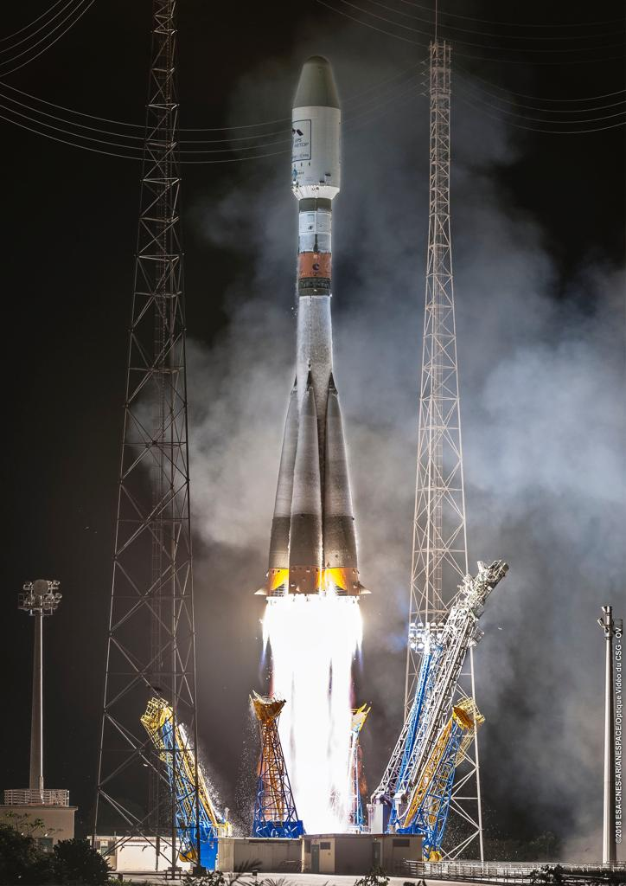
EUMETSAT Current and Future Missions for atmospheric composition
Metop current constellation
Metop A 2006 deorbiting planned Nov 2021
Metop B 2012 primary satellite
Metop C 2019 nominal lifetime 2026
GRAS
GPS Receiver for Atmospheric Sounding
GOME-2
Global Ozone Monitoring Experiment
AVHRR
Advanced Very High Resolution Radiometer
HIRS/4
High-resolution Infrared Radiation Sounder
IASI
Infrared Atmospheric Sounding Interferometer
AMSU-A1
Advanced Microwave Sounding Unit-A1
AMSU-A2
Advanced Microwave Sounding Unit-A2
MHS
Microwave Humidity Sounder
ASCAT
Advanced SCATterometer

Slide 8
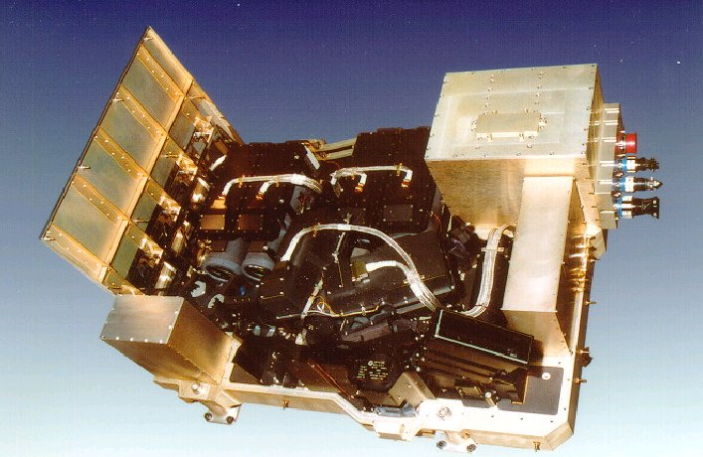
The GOME-2 instrument on Metop
Measuring atmospheric composition from space
Metop 2006 – present
Item | Specification
Spectral band (nm) | 240‑790
Spectral resolution (nm) | 0.26‑0.51
Spatial resolution (km2) | 80 × 40 (main channels) 80 × 10 (PMD)
Earth coverage (km) | 120‑1920
Spectral channels | 4096 (in four separated optical channels)
Polarization channels | 30 (in two separated optical channels)
Calibration system | Spectral lamp, white lamp, solar diffuser LED
Dimensions | 600 mm × 800 mm × 500 mm
Weight | 68 kg
Main bus voltage | 22‑37 V
Power consumption | 50 W
Data rate interface | 400 kbit

Slide 9
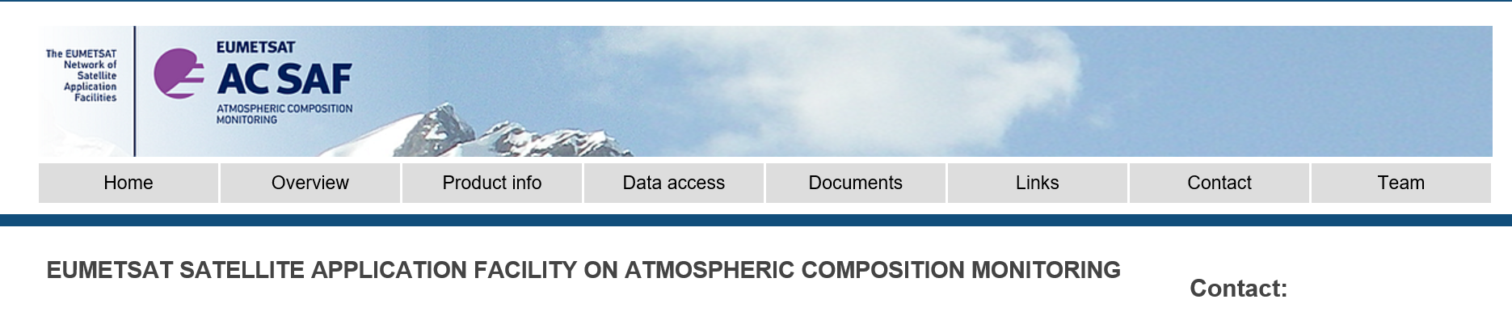
GOME-2 Level2 products
https://acsaf.org/
process, archive, validate and disseminate
O3, NO2, SO2, BrO, HCHO, H2O, OClO columnar content
Ozone profile
AAI
UV indexes
available to
users
Near Real Time Off-line products Data records
products
< 3 hr < 2 weeks after reprocessing activities

Slide 10
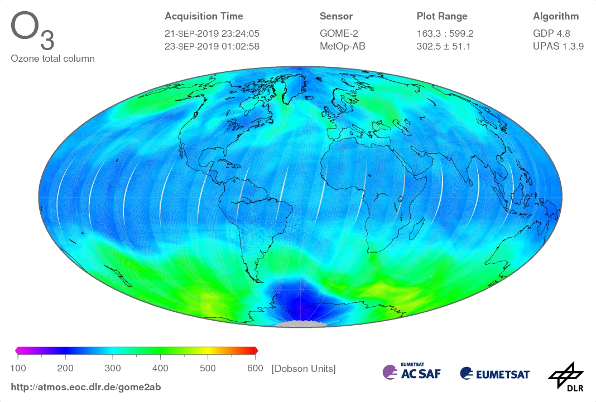
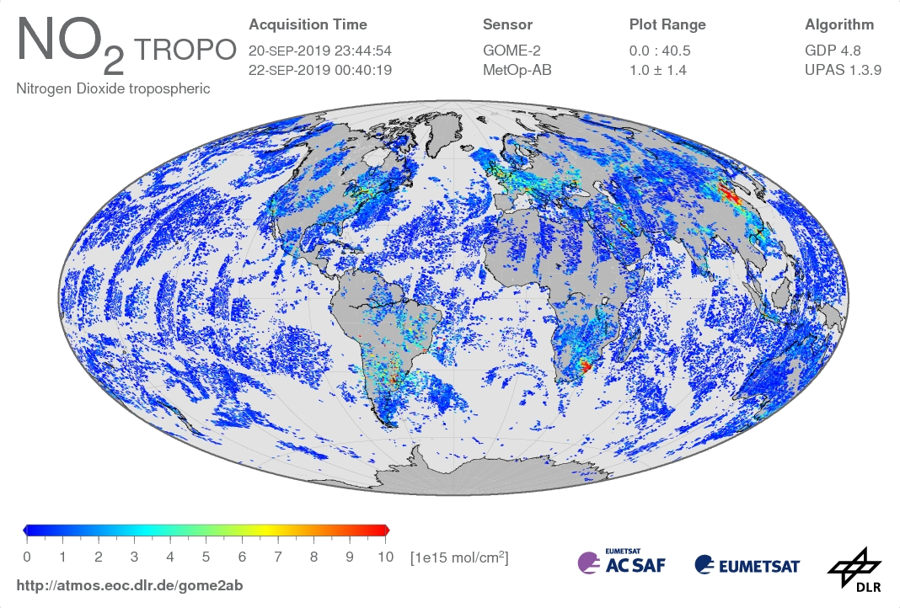
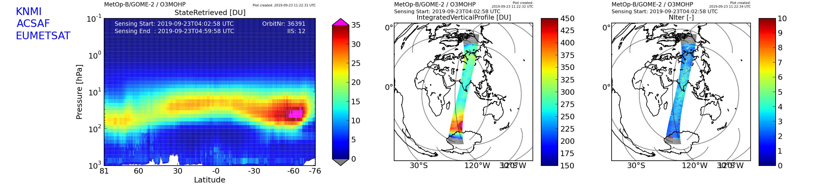
GOME-2 Level 2 products

Slide 11
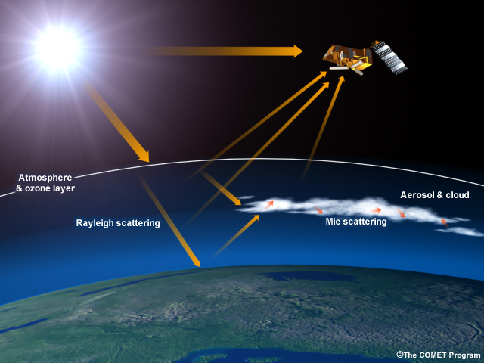
Atmospheric composition measurement Techniques
UV/Visible/NIR/SWIR (UVNS) Solar Backscatter
GOME-2 Measurement Concept
I₀ Spectral
Solar
Irradiance
I Spectral
Radiance
Slide: 11

Slide 12
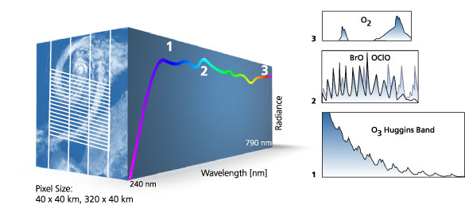
The GOME-2 instrument on Metop
Measuring atmospheric composition from space
Spectra collected from 240‑790 nm
80 × 40 (main channels) 80 × 10 (PMD)
Courtesy: WDC – DLR

Slide 13
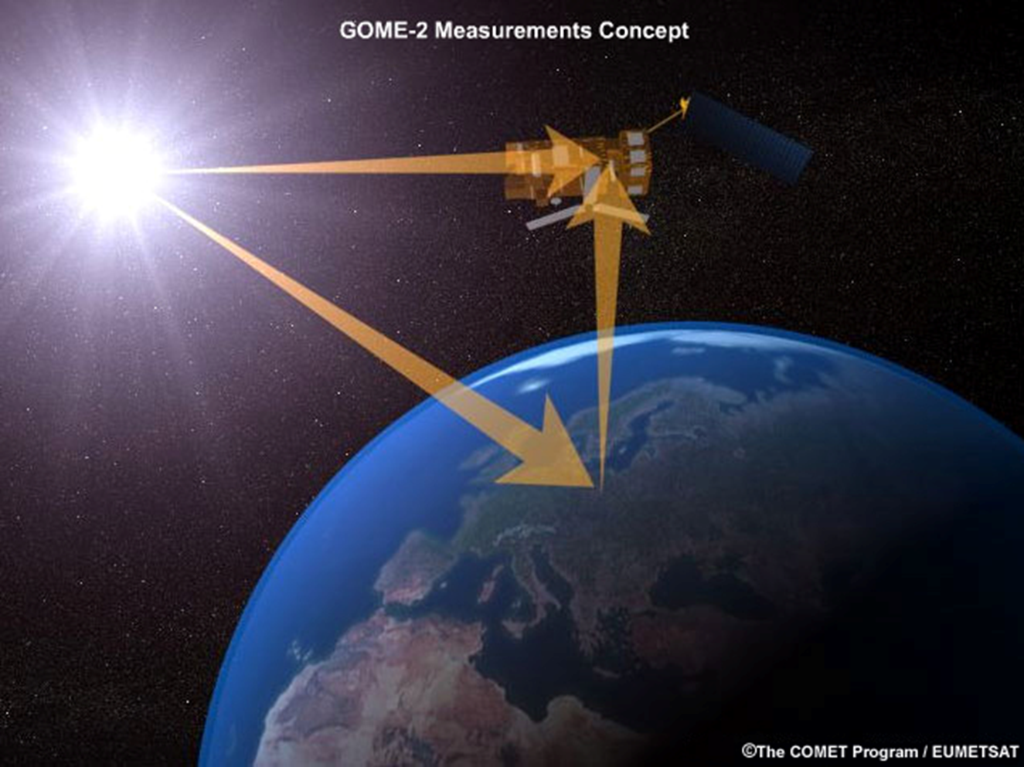
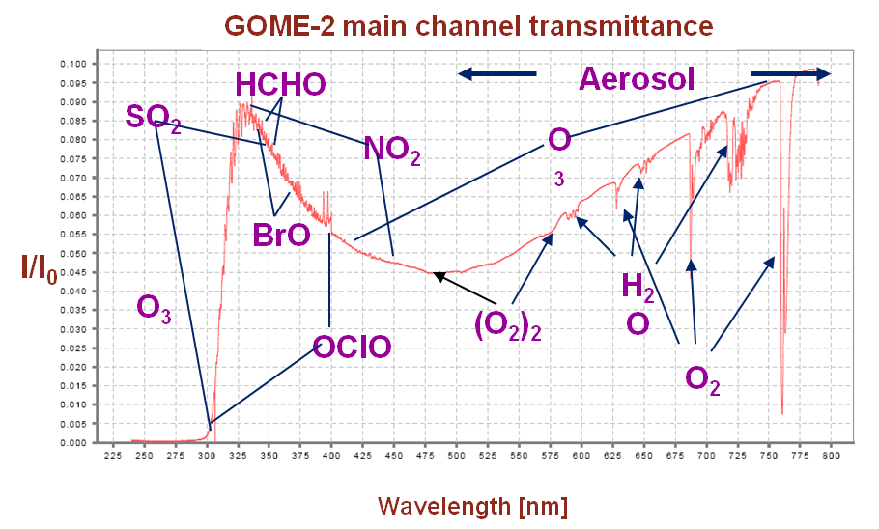
The GOME-2 instrument on Metop
Measuring atmospheric composition from space
I₀ Spectral
Solar
Irradiance
I Spectral
Radiance

Slide 14
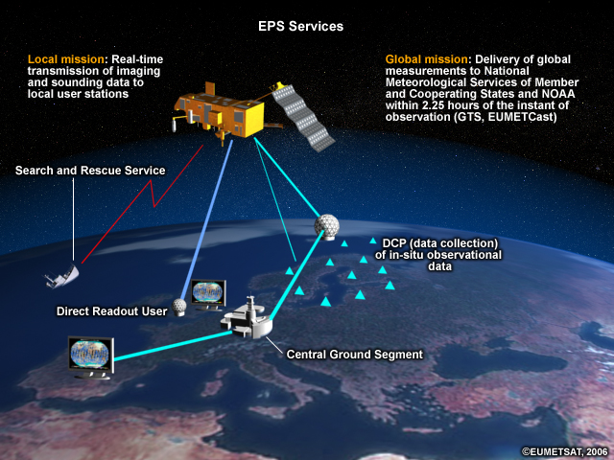
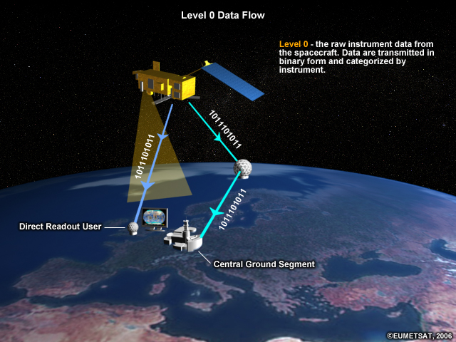
EPS Services and Level 0 data flow

Slide 15
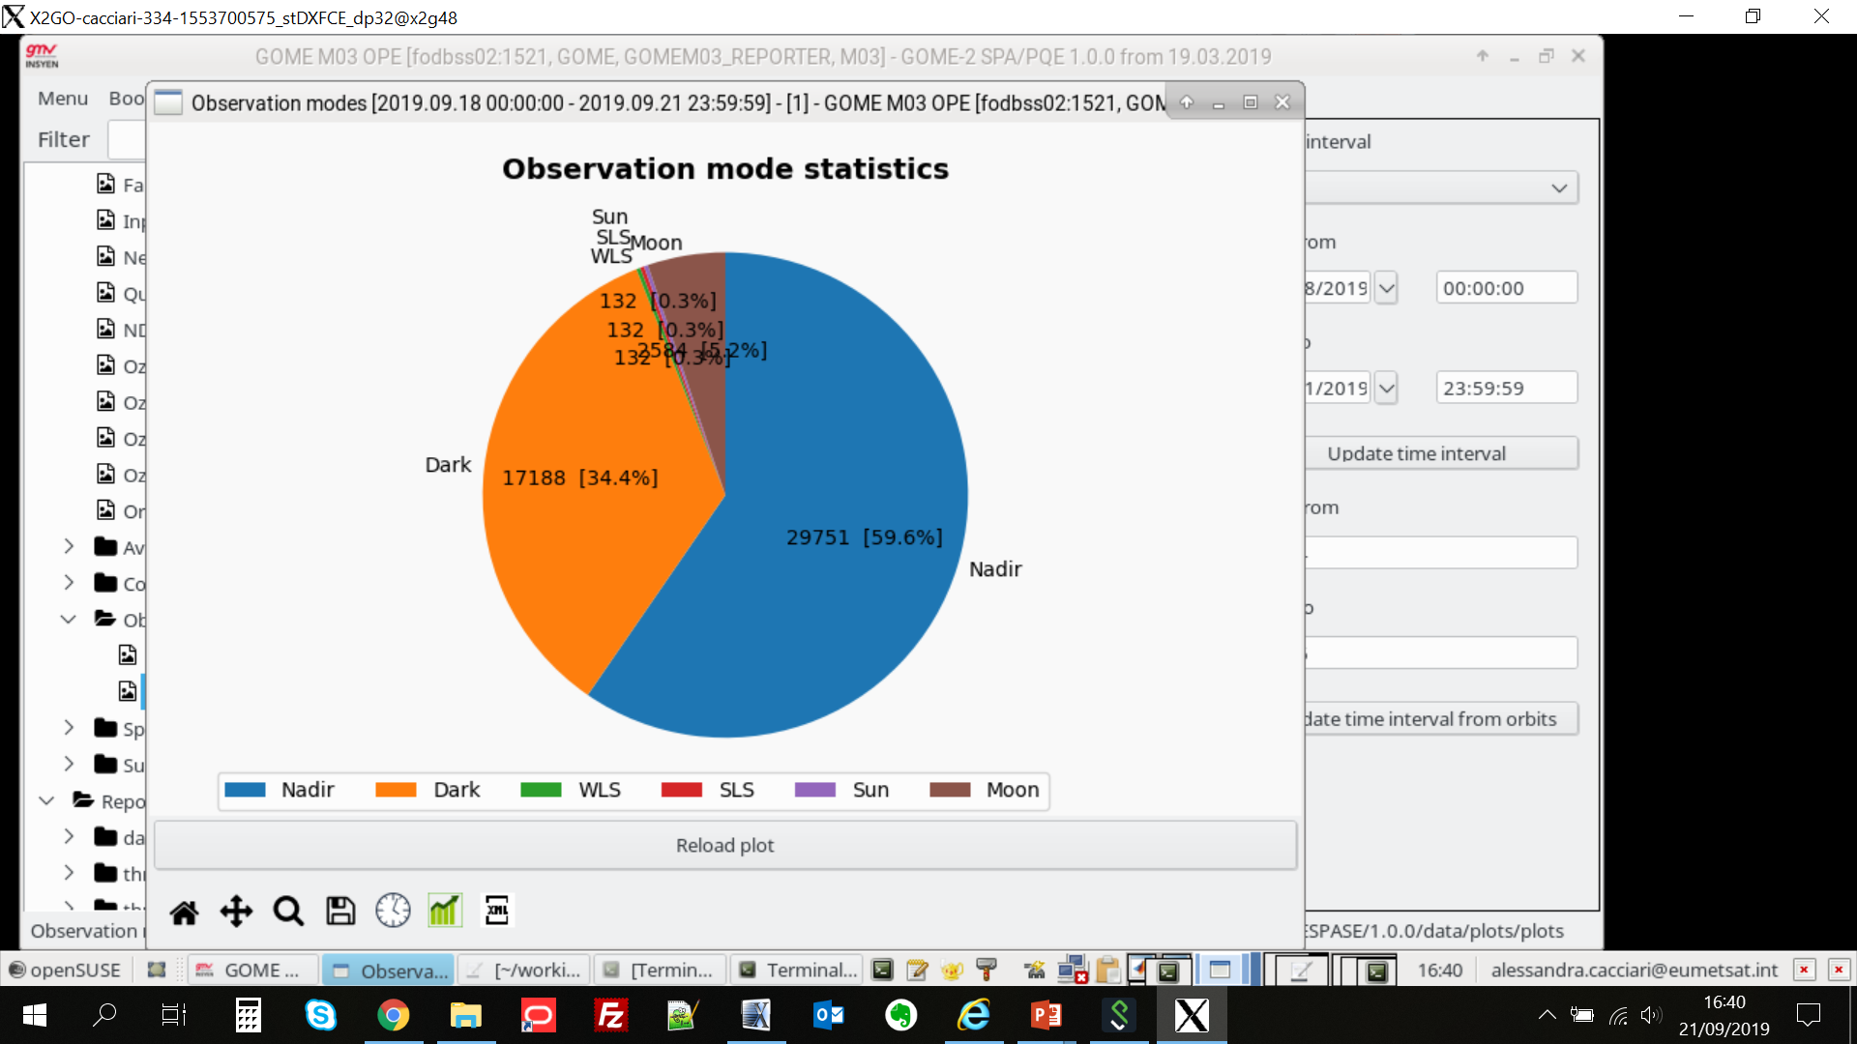
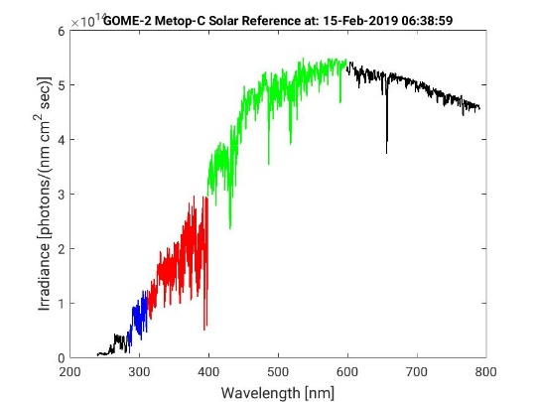
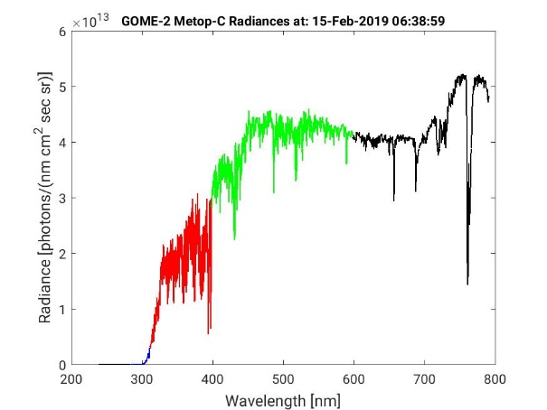
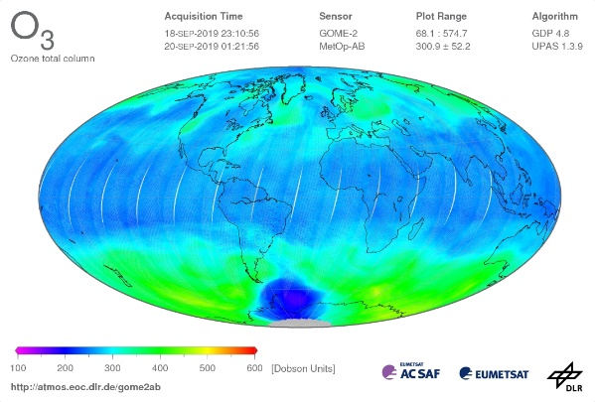
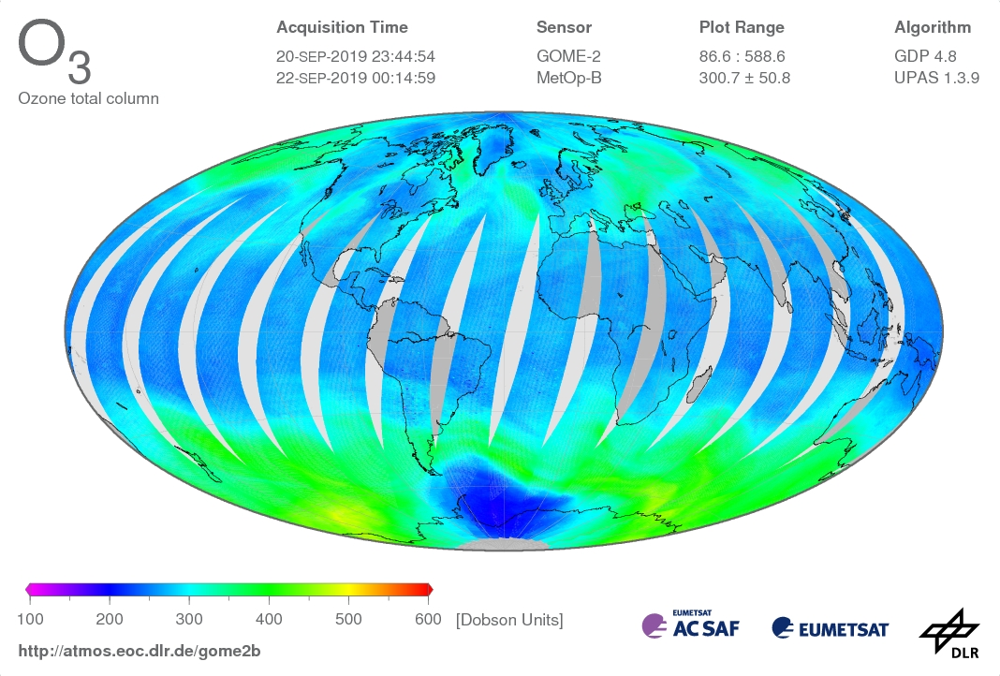
Data Processing Levels
Data Level | Description
Lev0 | Reconstructed, raw instrument data and payload data at full resolution [BU]
Lev1A | Reconstructed, unprocessed instrument data at full resolution, time-referenced, and annotated with ancillary information, including in-flight calibration coefficients and georeferencing parameters computed and appended but not applied to Level 0 data
Lev1B | Level 1A data processed geolocated and calibrated radiance Eartshine data Solar Spectrum measurements [Wm²sr⁻¹um⁻¹, Wm²um⁻¹]
Lev2 | Retrieved geophysical variables at the same resolution and location as Level 1 source data
Lev3 | Variables mapped on uniform space-time grid scales, usually with some completeness and consistency.

Slide 16
Data Processing Level and Processing Steps
Data Level | Description
Lev0 | Reconstructed, raw instrument data and payload data at full resolution [BU]
Lev1A | Reconstructed, unprocessed instrument data at full resolution, time-referenced, and annotated with ancillary information, including in-flight calibration coefficients and georeferencing parameters computed and appended but not applied to Level 0 data
Lev1B | Level 1A data processed geolocated and calibrated radiance Eartshine data Solar Spectrum measurements [Wm²sr⁻¹um⁻¹, Wm²um⁻¹]
Lev2 | Retrieved geophysical variables at the same resolution and location as Level 1 source data
Lev3 | Variables mapped on uniform space-time grid scales, usually with some completeness and consistency.
 | Processing
CALIBRATION Lev0 TO Lev1B | Signals calibration and correction producing measurements independent from the instrument INPUT instrument signal [BU] - scene-dependent corrections polarisation straylight spatial aliasing - detector-dependent corrections spectral calibration (ISRF) radiometric calibration OUTPUT radiance/irradiance [Wm²sr⁻¹um⁻¹, Wm²um⁻¹] Spectral radiance in the UV-VIS-NIR Solar spectra in the UV-VIS-NIR
RETRIEVAL Lev1B TO Lev2 | Retrieval Techniques INPUT radiance/irradiance [Wm²sr⁻¹um⁻¹, Wm²um⁻¹] Full retrieval (OE) Fast retrieval (DOAS, AAI) OUTPUT O₃ [DU], NO₂ [molec cm⁻²], HCHO, BrO, SO₂

Slide 17
Data Processing Steps CALIBRATION
Lev 0 TO Lev1b NRT processing
EUMETSAT Central Ground Segment
 | Processing
Lev0 TO Lev1B | Signals calibration and correction producing measurements independent from the instrument INPUT instrument signal + Calib Coeff [BU] On-Ground In-flight - scene-dependent corrections polarisation straylight spatial aliasing - detector-dependent corrections for GOME e.g. dark signal, PPG, etalon, … spectral calibration (ISRF) radiometric calibration geo-referencing OUTPUT radiance, irradiance [Wm²sr⁻¹um⁻¹, Wm²um⁻¹] Spectral radiance in the UV-VIS-NIR Solar spectra in the UV-VIS-NIR

Slide 18
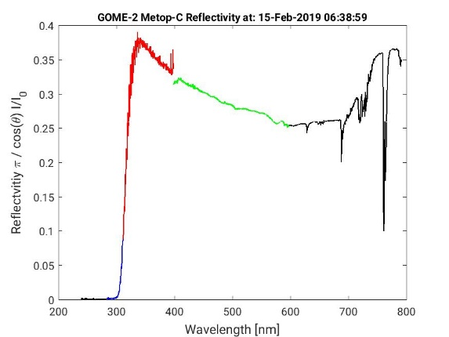
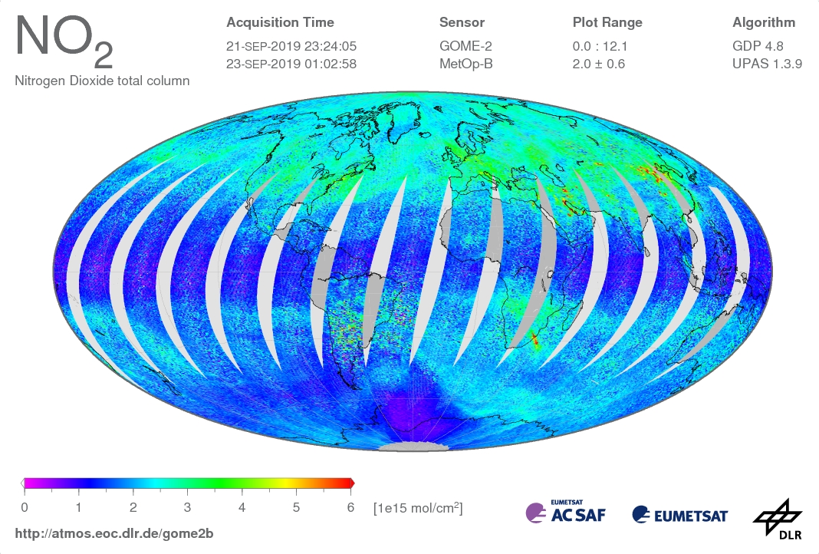
Data Processing Steps RETRIEVAL
 | Processing
Lev1B TO Lev2 | Retrieval Techniques INPUT radiance, irradiance + auxDB [Wm²sr⁻¹um⁻¹, Wm²um⁻¹] RETRIEVAL Full retrieval (OE) Fast retrieval (DOAS, AAI) OUTPUT O₃ [DU], NO₂ [molec cm⁻²], HCHO, BrO, SO₂

Slide 19
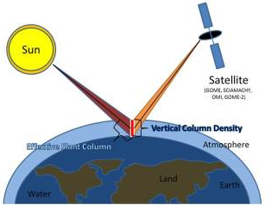
Data Processing Steps RETRIEVAL
Satellite measurements
Radiation emerged from the interaction with the Atmosphere-Surface system
COMPARED TO
Modelleded measurements
- A priori information on the system (atmospheric scenarios)
- Model of the system (Forward model)

Slide 20
Data Processing Steps RETRIEVAL
 | Processing
Lev1B TO Lev2 | Retrieval Techniques INPUT radiance, irradiance + auxDB [Wm²sr⁻¹um⁻¹, Wm²um⁻¹] RETRIEVAL Full retrieval (OE) Fast retrieval (DOAS, AAI) OUTPUT O₃ [DU], NO₂ [molec cm⁻²], HCHO, BrO, SO₂
Lev1b TO Lev2 processing
FULL retrieval
→ full detailed FWD model
→ time consuming techniques
→ error estimates on the retrieved parameters
→ Optimal Estimation
→ mostly used as reference techniques
FAST retrieval
Simplified methods based on approximations
→ assumptions on properties of the atmospheric constituents (spectral extinction, vertical distribution,…)
→ fast computational times
→ Differential Optical Absorption Spectroscopy,
Absorbing Aerosol Index
→mostly used in operational Level2 processing

Slide 21
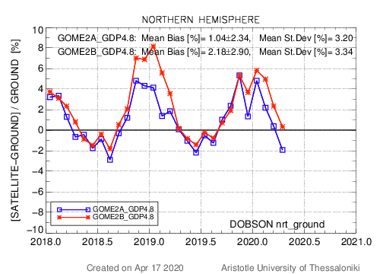
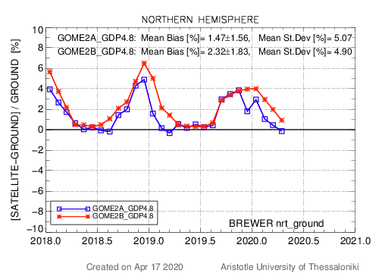
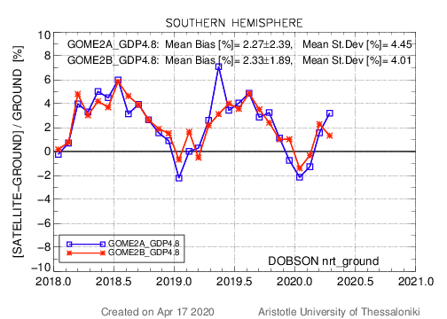
Comparison wrt to ground-based measurement in 2nd and 3rd gap
Time series of the % differences to (nrt) ground-based measurements up to 10 April 2020.
GOME2-A and GOME2-B GDP4.8 Level-2 total ozone column (TOC) up to 10 April 2020
Ground-based measurements: Near-real-time TOC data from Brewer and Dobson ground-based stations, collected by the WMO’s Ozone Mapping Centre hosted by LAP/AUTH (available until 16 April 2020).
Green rectangle: 2nd gap
Differences between the two sensors up to 3-4% (January)
Blue rectangle: 3rd gap
Differences between the two sensors up to 2.5 % (December)
Courtesy of Laboratory of Atmospheric Physics of Aristotle University of Thesssaloniki

Slide 22
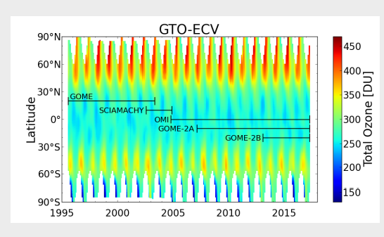
GOME-2 L2 products
Total Ozone
The same retrieval algorithm is applied to measurements of from GOME/ERS-2, SCIAMACHY/ENIVSAT, OMI/AURA and
GOME-2/MetOp-A and MetOp-B
monthly latitudinal mean of the merged data set for the time period between 1995 and 2017
the merged data set is regularly extended
Covering a period of more than 22 years the time series can be used to determine trends,
or look for correlations with other datasets
Heue, K. 2018. ‘Two Decades of Homogenized Satellite Ozone Measurements for Climate Services’. In: Deutsche Klima Tagung.

Slide 23
Thank you

Slide 24
Data Processing Steps CALIBRATION
Lev 0 TO Lev1b NRT processing
EUMETSAT Central Ground Segment
 | Processing
Lev0 TO Lev1B | Signals calibration and correction producing measurements independent from the instrument INPUT instrument signal + Calib Coeff [BU] On-Ground In-flight - scene-dependent corrections polarisation straylight spatial aliasing - detector-dependent corrections for GOME e.g. dark signal, PPG, etalon, … spectral calibration (ISRF) radiometric calibration geo-referencing OUTPUT radiance, irradiance [Wm²sr⁻¹um⁻¹, Wm²um⁻¹] Spectral radiance in the UV-VIS-NIR Solar spectra in the UV-VIS-NIR
Raw data #photons collected at different detector pixels
CALIBRATION
On-ground characterization and calibration
→ lab campaign (environmental tests)
→ Key data (calibration coefficient)
In-flight calibration
→Calibration Unit
measurements with reference sources
(Spectral Light, White Light, Sun)
→Update of the Key data wrt to the actual status of the instrument

Slide 25
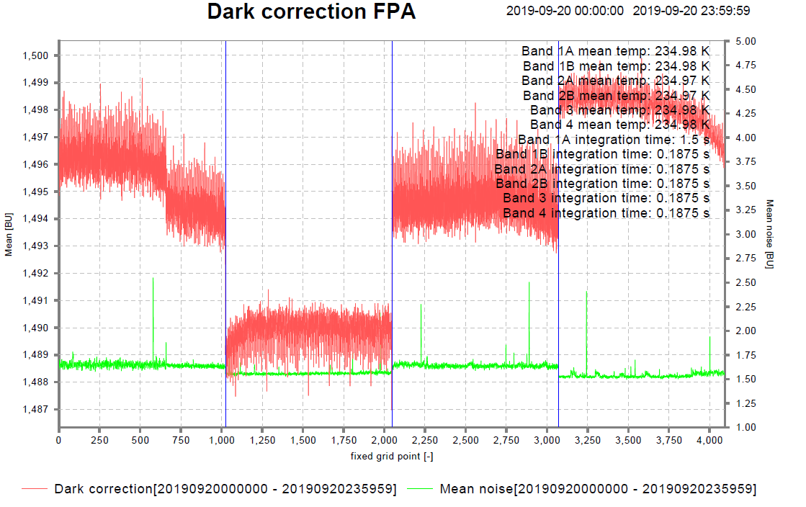
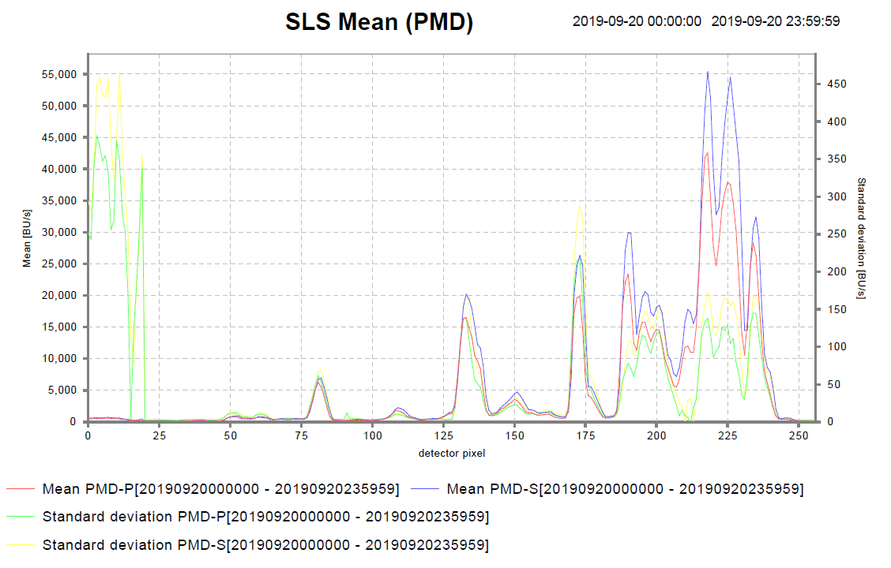
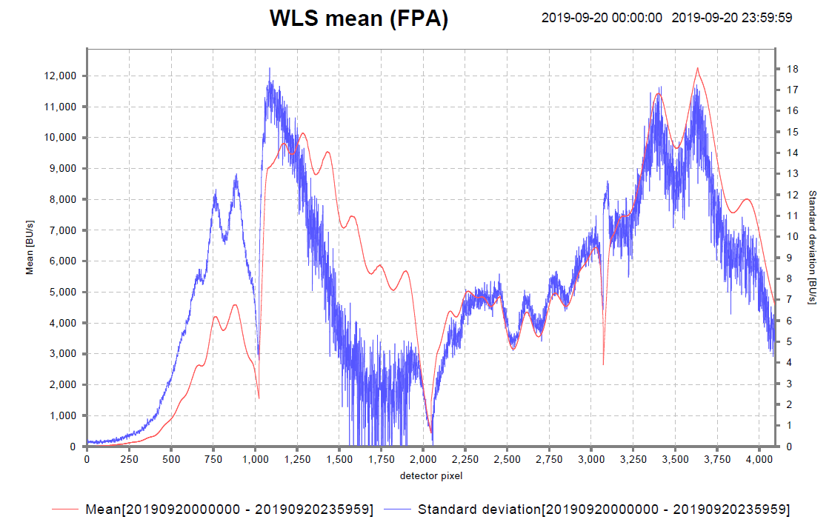
Data Processing Steps CALIBRATION
Lev 0 TO Lev1b NRT processing
EUMETSAT Central Ground Segment
 | Processing
Lev0 TO Lev1B | Signals calibration and correction producing measurements independent from the instrument INPUT instrument signal + Calib Coeff [BU] On-Ground In-flight - scene-dependent corrections polarisation straylight spatial aliasing - detector-dependent corrections for GOME e.g. dark signal, PPG, etalon, … spectral calibration (ISRF) radiometric calibration geo-referencing OUTPUT radiance, irradiance [Wm²sr⁻¹um⁻¹, Wm²um⁻¹] Spectral radiance in the UV-VIS-NIR Solar spectra in the UV-VIS-NIR
Photons per pixel → photons per unit wavelength
photons um-1 → W m2 sr-1 um-1

