Slide 1
Retrieval and Validation of MODIS and GOES FRP
Wilfrid Schroeder^{1,2}
Louis Giglio¹
Ivan Csiszar²
Christopher Justice¹
¹Department of Geographical Sciences
University of Maryland, College Park
²NOAA/NESDIS Center for Satellite Applications and Research
3rd SALGEE Workshop
March 2013 - Ericeira, Portugal

Slide 2
Moderate Resolution Imaging Spectroradiometer (MODIS)
On board AM-1 (“Terra”) and PM-1 (“Aqua”) polar orbiters
  Terra 10:30 & 22:30 local overpass
  Aqua 01:30 & 13:30 local overpass
36 spectral bands covering 0.4 to 14.4 µm
  Two 250-m bands
  Five 500-m bands
  Twenty nine 1-km bands
Dedicated 1 km fire bands
  Channel 21: 3.96 µm, ≈ 500 K saturation
  Channel 31: 11.0 µm, ≈ 400 K saturation
Lower noise, lower quantization error, 1-km multipurpose band
  Channel 22: 3.96 µm, ≈ 330 K saturation

Slide 3
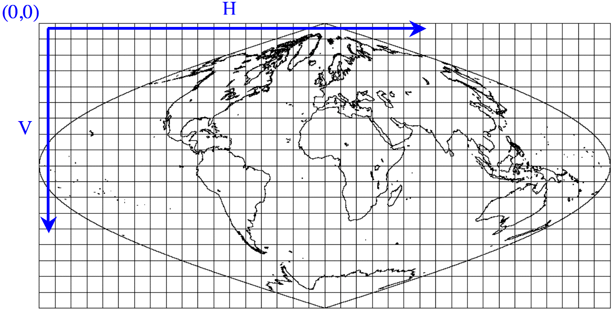
MODIS Data Vocabulary
“Collection”
  Reprocessing round or version
  Currently at Collection 5
  Collection 6 reprocessing later this year
  Swath data arranged as 5-min granules HDF-EOS format
MODIS Tile
  Global sinusoidal grid (10º resolution @ equator)

Slide 4
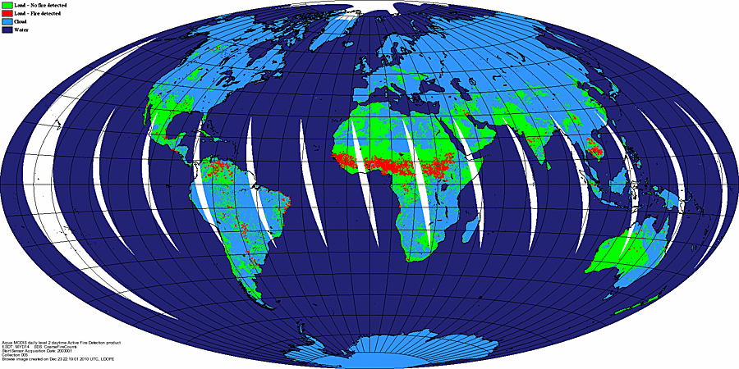
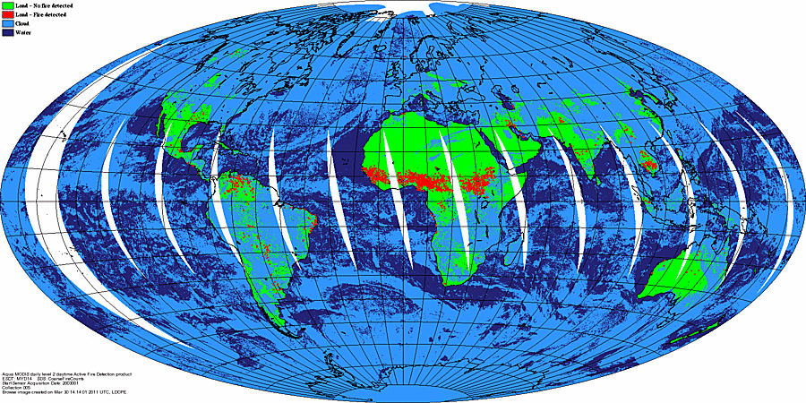
MODIS Collection 6 Active Fire
Algorithm Refinements
Reduced false alarms in problem areas
Processing extended to oceans and other large water bodies (to detect gas flaring)
Improved cloud mask
Improved detection confidence estimate
Improved land/sea mask*
Improved input data quality*
Use of alternative FRP derivation formula
Collection 5
Collection 6

Slide 5
MODIS Active Fire Product Formats
Active Fire (Level 2 -- native 5-min swath)
  Fire mask
  QA layer
  Detailed information about each fire pixel
  MOD14 (Terra), MYD14 (Aqua)
Active Fire (Level 3 -- tiled, 10º sinusoidal grid)
  Cumulative fire mask
  Maximum fire radiative power (FRP)
  Daily and 8-day summaries
  MOD14A1 & MOD14A2 (Terra), MYD14A2 & MYD14A1 (Aqua)
Climate Modeling Grid
  Global, 0.5° resolution
  Monthly, 8-day
  MOD14CMH & MOD14C8H (Terra) MYD14CMH & MYD14C8H (Aqua)
Fire Locations
  ASCII
  Monthly
  MCD14ML

Slide 6

Origins of MODIS Fire Radiative Power
Kaufman et al. 1998
[JGR, 103(D24), 32,215-32,238pp]
Derivation of fire radiative power via simulation of thousands of fire pixel scenarios for MODIS
“… rate of emission of radiative energy and the rate of combustion are proportional to the size of subpixel fire and to the density of the biomass burned in it”
Simplifies traditional
emission estimates:
MODIS ~4 μm channel 21/22 data
Combustion factor
Biomass load
Fire area

Slide 7
MODIS Fire Radiative Power
Up to Collection 5
Brightness Temperature
Brightness Temperature
Top of Atmosphere
Fire pixel
Background
(adjacent pixels)
Pixel Area
Radiance
Radiance
New with Collection 6

Slide 8
Geostationary Operational Environmental Satellite Imager
(GOES)
On board East (75ºW) and West (135ºW) NOAA geostationary satellites
  Western Hemisphere coverage with ≤ 30 min observation frequency
  Rapid Scan Operation (RSO) allowing for higher observation frequency (~5min) during significant events
  Standby unit at 105ºW, plus a dedicated Imager over South America
5 spectral bands covering 0.52 to 13.7 µm
  One 1-km band (0.52-0.71 µm)
  Four 4-km bands including 3.73-4.07 µm channel
  Spatial oversampling of ~50% along scan (east-west)
    Most fires will generate two detections
    WF_ABBA (see next slide) will select the brightest of two
Saturation temperature of ~337K in the 4 µm fire channel

Slide 9
WF_ABBA v6.5 Active Fire Product
Version 6.5 incorporates spatially explicit fire classification product
  Flagging fire/non-fire pixels including clouds, water, block-out zones (e.g., sun-glint regions)
  FRP retrieval
  Fire size and temperature retrievals
Variable scan sectors and schedules (e.g., full disks, CONUS, etc.)
Active Fire Mask
  McIDAS AREA format (flags fire/non-fire pixels and preserves spatial oversampling)
  Some HDF data
Fire Locations
  ASCII
  Temporally filtered/non-filtered (two coincident detections in less than 12h to avoid false alarms)
  List of individual fire detections and retrievals (size, temp, FRP) + limited metadata
  Removes extra pixels due to GOES Imager spatial oversampling
Additional data available upon request (ASCII format)
  Complete metadata
  Complete list of fire pixels (including extra detections from oversampling)

Slide 10
WF_ABBA Fire Retrievals
Corrected primarily for atmospheric attenuation (water vapor) and surface emissivity
Fire Size and Temperature (Dozier)
Fire Radiative Power (FRP)
4 & 11 µm
Fire pixel AND background must be correctly determined
4 µm only

Slide 11
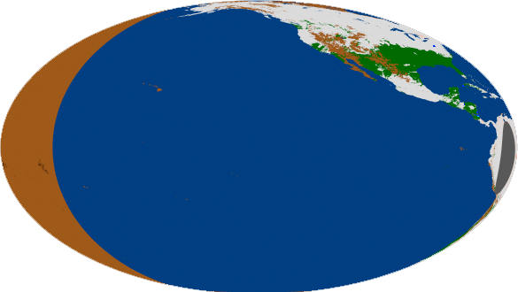
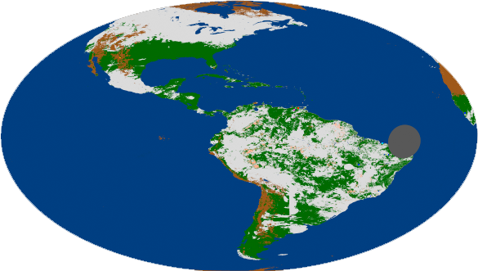
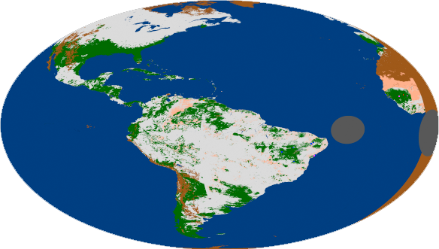
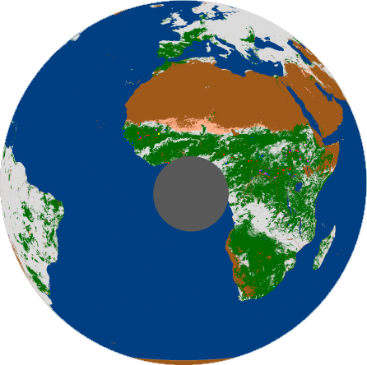
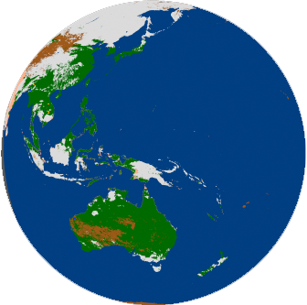
Available WF_ABBA Data Sets
GOES West
GOES East
GOES SA (60ºW)
METEOSAT
MTSAT-2

Slide 12
Satellite Fire Data Validation

Slide 13
Factors Affecting
Fire Detection and Characterization
Fire size
Fire temperature
Biome
Season
Surface temperature
Cloudiness
Types of clouds
Position of sun
Viewing geometry
Characteristics of smoke
Instrument issues
Other

Slide 14
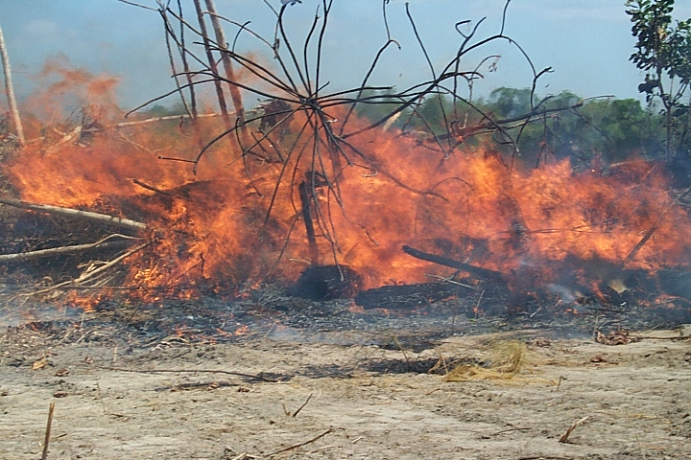
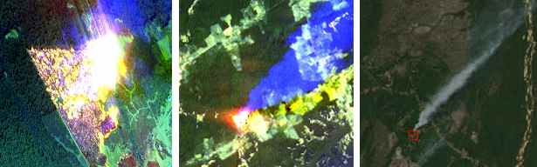
Satellite Active Fire Validation
Primary Validation: “The process of assessing by independent means the quality of the data products derived from the system outputs” [Justice et al., 2000]
  Use of independent data to directly estimate product uncertainty
  Use of in-situ, airborne or spaceborne reference data sets
    Having more than one coincident reference data set is highly desirable
Ground (point data)
Airborne (<10m)
Spaceborne (10<>100m)
Satellite Product (~1-4km)
Secondary Validation
  Can be used to verify product consistency (e.g., spatial and temporal distribution of fires)
    Example of application includes assessment of product performance immediately after launch when reference data aren’t available
    Ideally, reference data set must be validated
  May complement primary validation

Slide 15
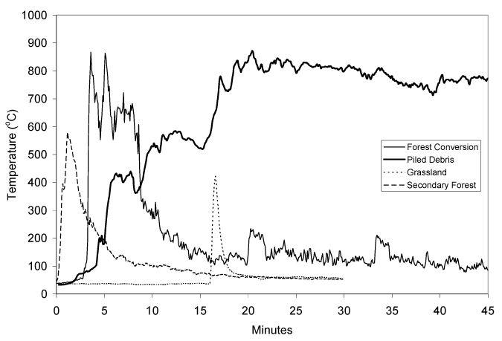
Reference Data Requirements
Maximum separation between satellite fire and independent reference data must be limited to ~15min
➔±15 min from GOES
➔±15 min from GOES
Credit: Schroeder et al, 2008
➔30 min ahead of MODIS
➔Coincident with MODIS
Credit: Giglio, 2007
Credit: Csiszar and Schroeder, 2008

Slide 16
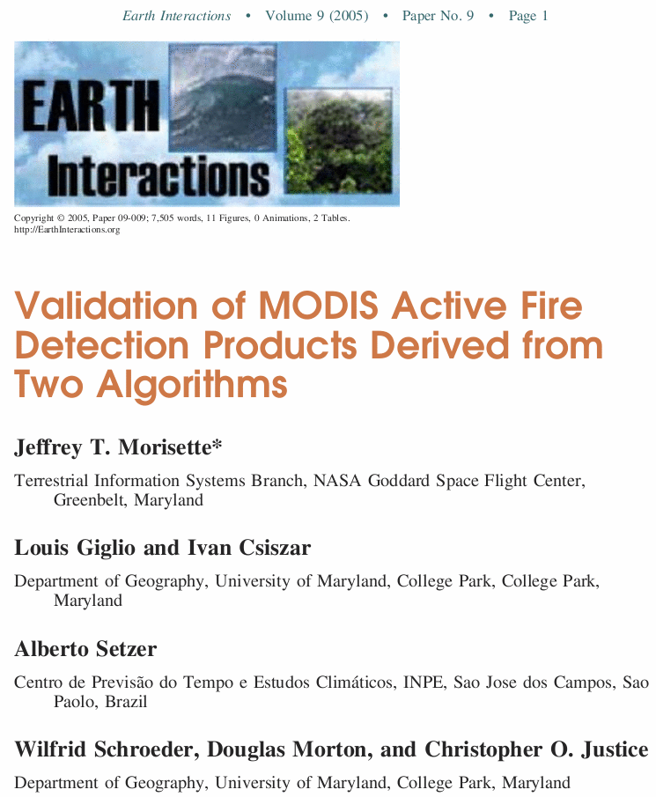

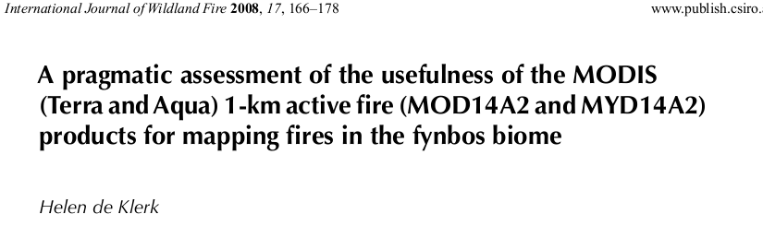
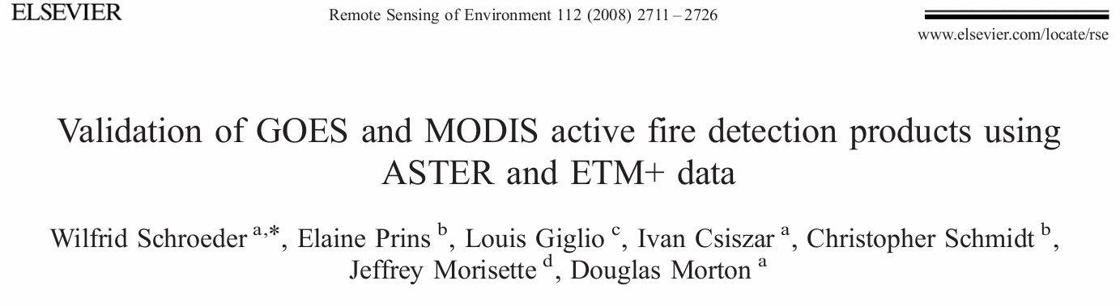
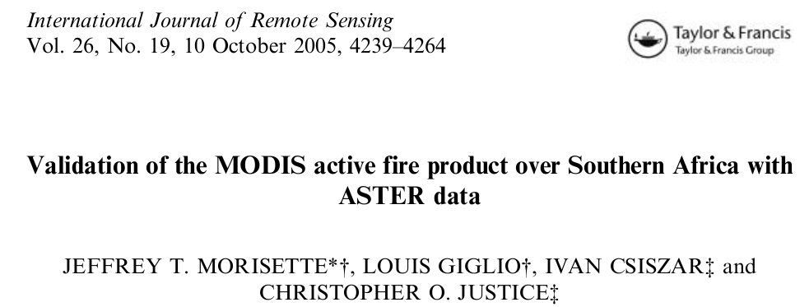
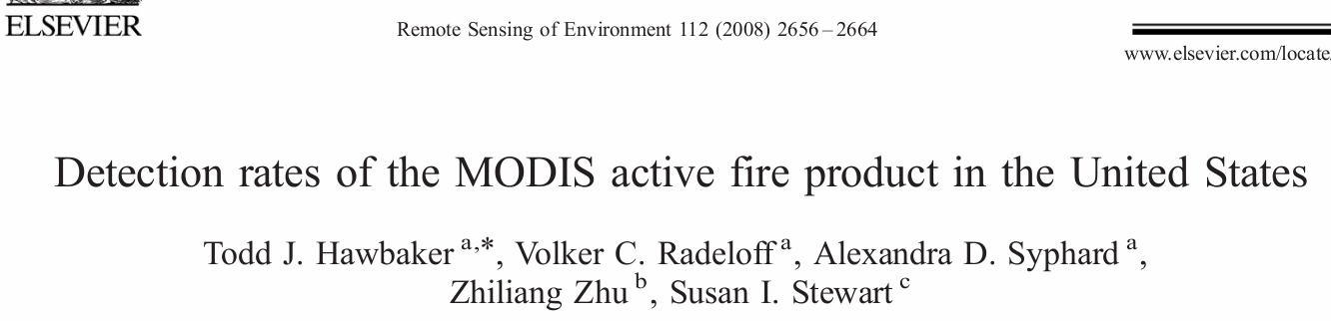
MODIS & GOES Active Fire Detection Validation

Slide 17
Active Fire Validation (1)
Primary method based on higher resolution Landsat-class imagery. The following data sets were used in support of MODIS and GOES fire validation:
  “Advanced Spaceborne Thermal Emission and Reflection Radiometer”
    Terra only (no Aqua ASTER) – coincident MODIS acquisition
    14 channels
      15 m, 30 m, 90 m
  Landsat Thematic Mapper (TM) and Enhanced Thematic Mapper (ETM+)
    Higher latitude orbit convergence of TM with Terra/MODIS, near-coincident data
    7 channels
      30 m
Always within ≤ 15min from Geostationary data

Slide 18
Active Fire Validation (2)
Fire mask using Landsat-class imagery
  Sometimes degraded by sensor artifacts (TM-5)
Fire radiative power retrieval using ASTER [Giglio et al., 2008]
  Cannot use simple middle-infrared band approach used with ASTER
  Often degraded by frequent ASTER saturation
Simulated imagery
  Simulating coarse resolution satellite data using ASTER surface temperature, emissivity, and thermal IR input data
Independent burn scar maps
  Burn scars may be associated with false alarms
  Some fires may not leave a scar (piled debris burning in slash/burn sites)
Product intercomparison
  Used to verify consistency among different products (e.g., MODIS x GOES)

Slide 19
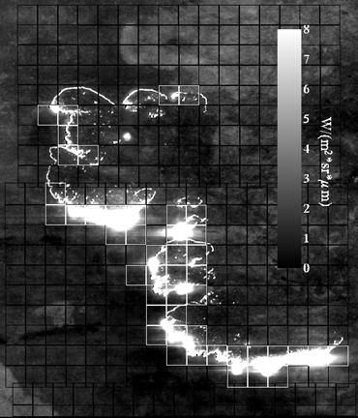
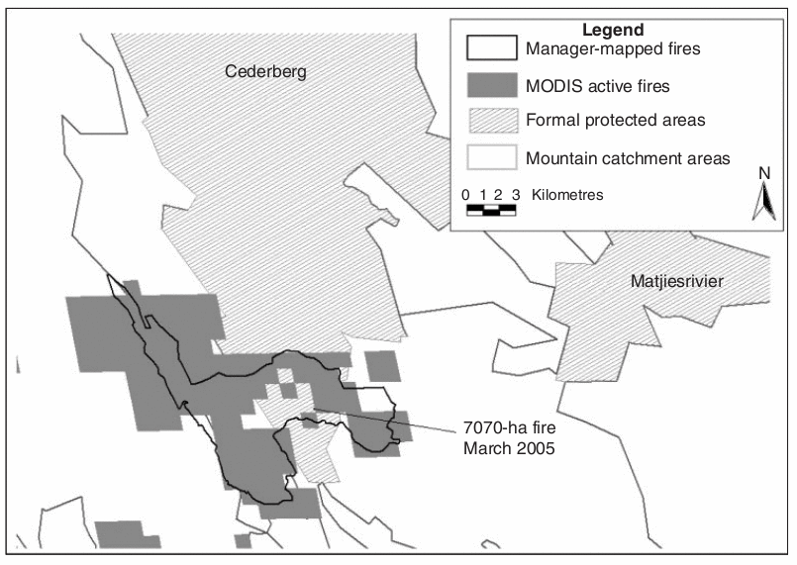
Active Fire Detection Validation
Post-Fire Burn Scar Maps
de Klerk (2008)
Coincident MOD14 and 30-m ASTER Imagery

Slide 20
Landsat-class
Fire Detection Approach
Use two reflective bands
  One sensitive to emissive radiation from fires
    SWIR band (2.3 μm)
  One insensitive to emissive radiation from fires
    NIR band (0.86 μm)
  Otherwise highly correlated and sensitive to reflective, non-fire radiation
Approach is reasonable for 30 m pixels, but not applicable to coarser spatial resolution

Slide 21
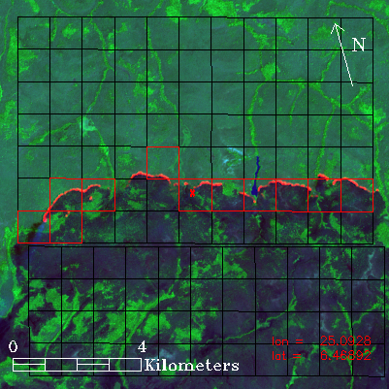
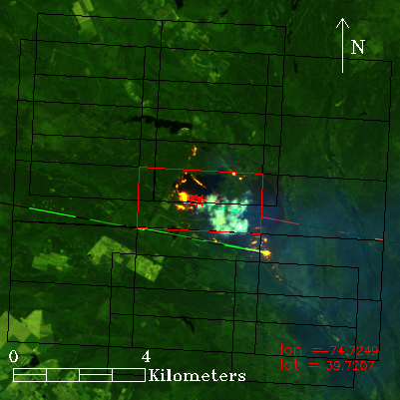
MODIS Active Fire Detection Validation Results
Near-nadir pixels
(using coincident ASTER scenes)
Off-nadir pixels
(using near-coincident TM scenes)
ASTER
SWIR detector problem after May 2007
Landsat5 TM
Fire-related artifacts – saturation/bleeding
MODIS/ASTER 19 Jan 2006 0852UTC (near nadir)
MODIS/TM 04 Aug 2007 1533UTC (52º scan angle)

Slide 22
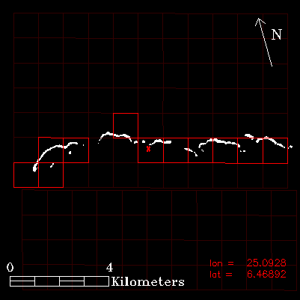
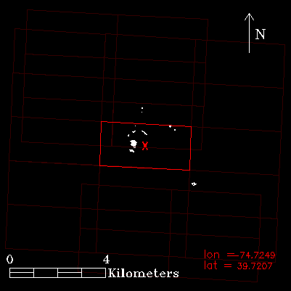
MODIS Active Fire Detection Validation Results
Near-nadir pixels
(using coincident ASTER scenes)
Off-nadir pixels
(using near-coincident TM scenes)
ASTER
SWIR detector problem after May 2007
Landsat5 TM
Fire-related artifacts – saturation/bleeding
MODIS/ASTER 19 Jan 2006 0852UTC (near nadir)
MODIS/TM 04 Aug 2007 1533UTC (52º scan angle)

Slide 23
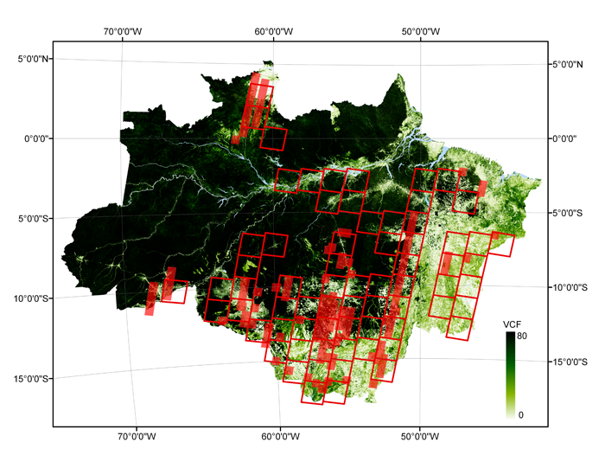
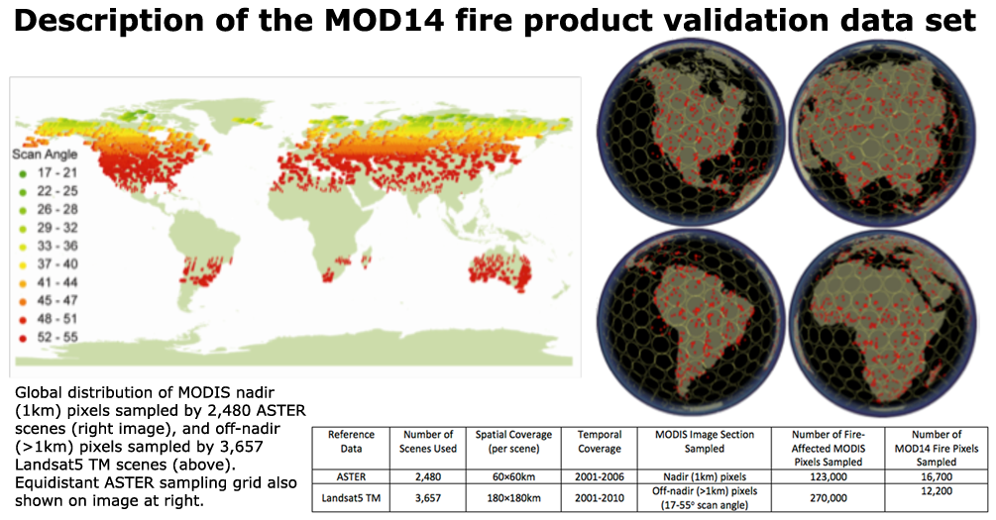
Regional & Global Validation
Comprehensive global validation analyses using ~7,000 ASTER and Landsat TM5 scenes
Biomass burning studies in the Amazon – regional data analyses using a couple hundred reference ASTER & Landsat ETM+ scenes
http://landval.gsfc.nasa.gov/ProductStatus.php?ProductID=MOD14

Slide 24
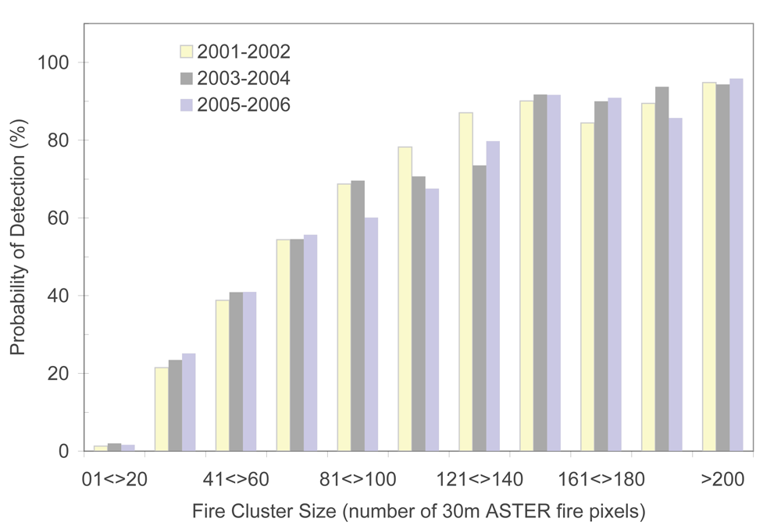
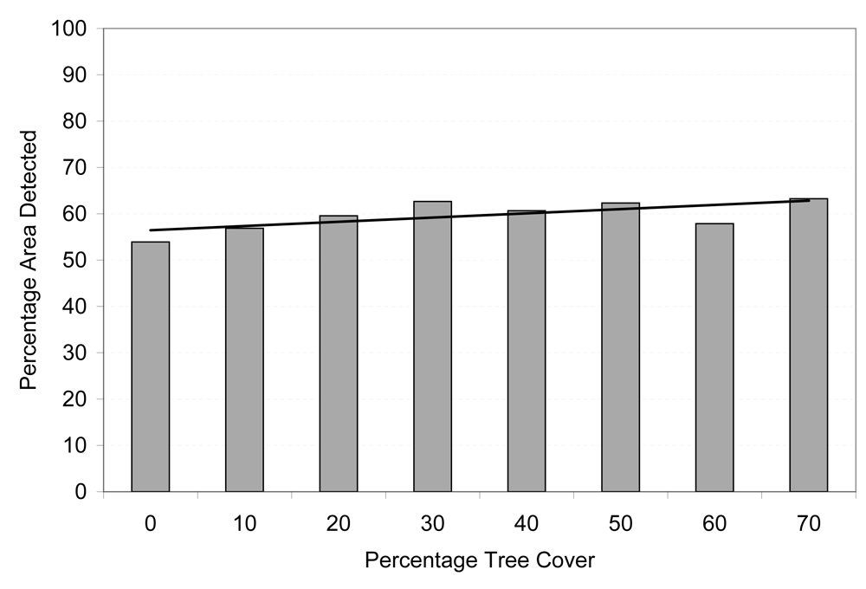
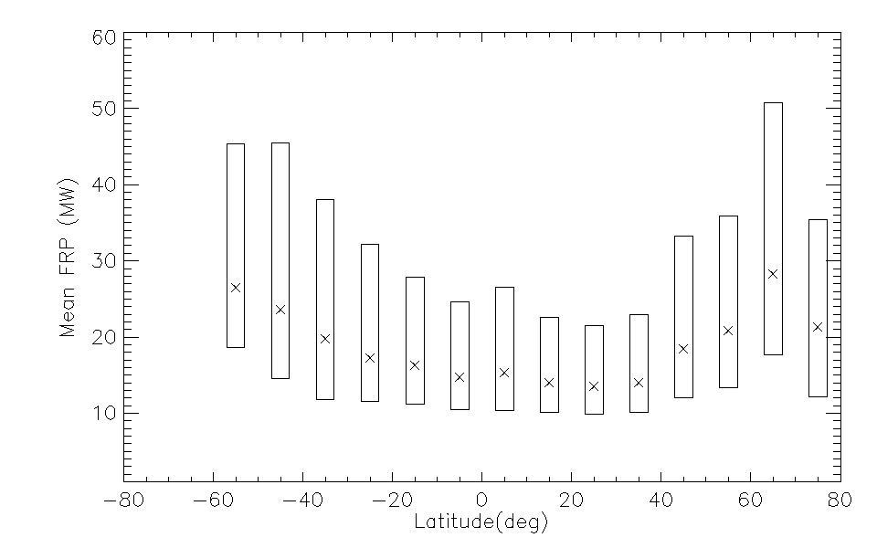
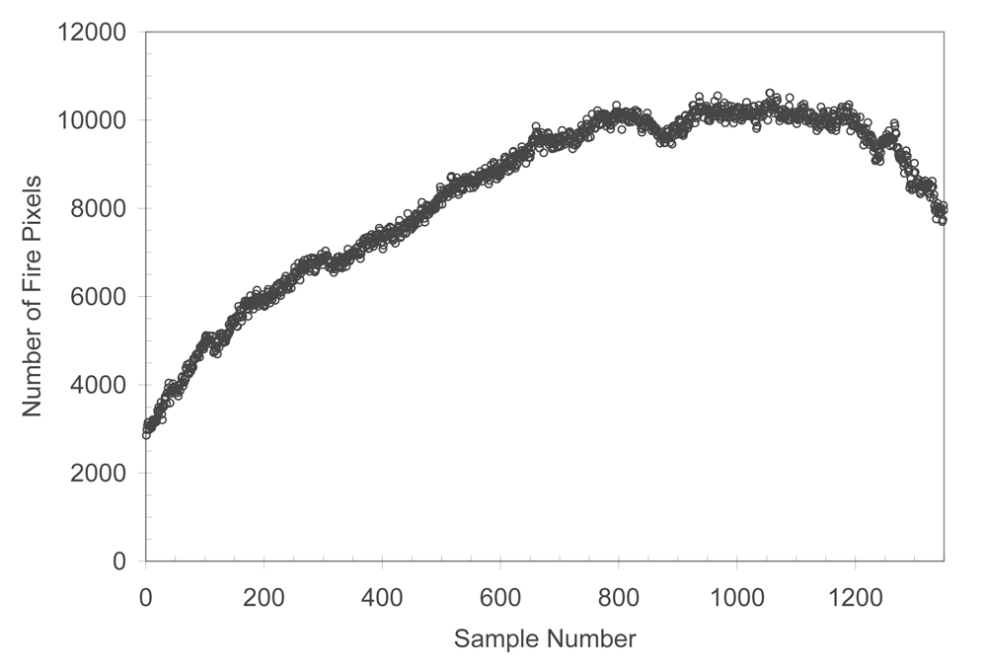
MODIS Active Fire Detection Validation Results
Temporal Consistency
Overall Detection Rate
Mean FRP
Fire Pixels Detected per Sample

Slide 25
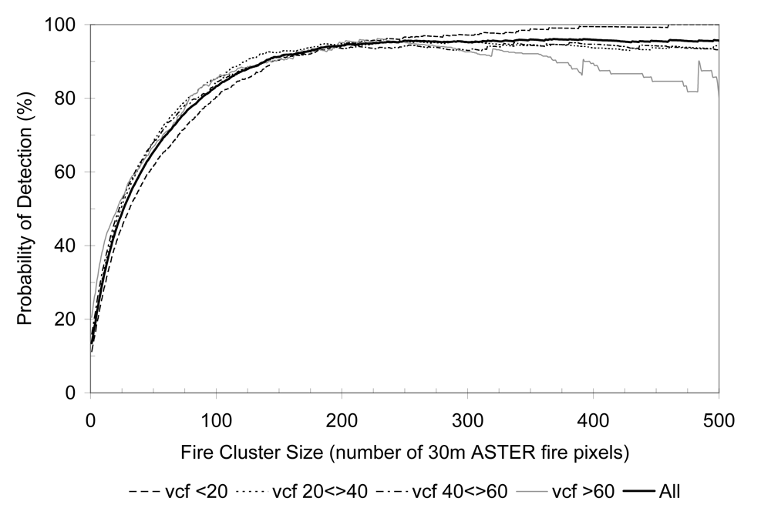
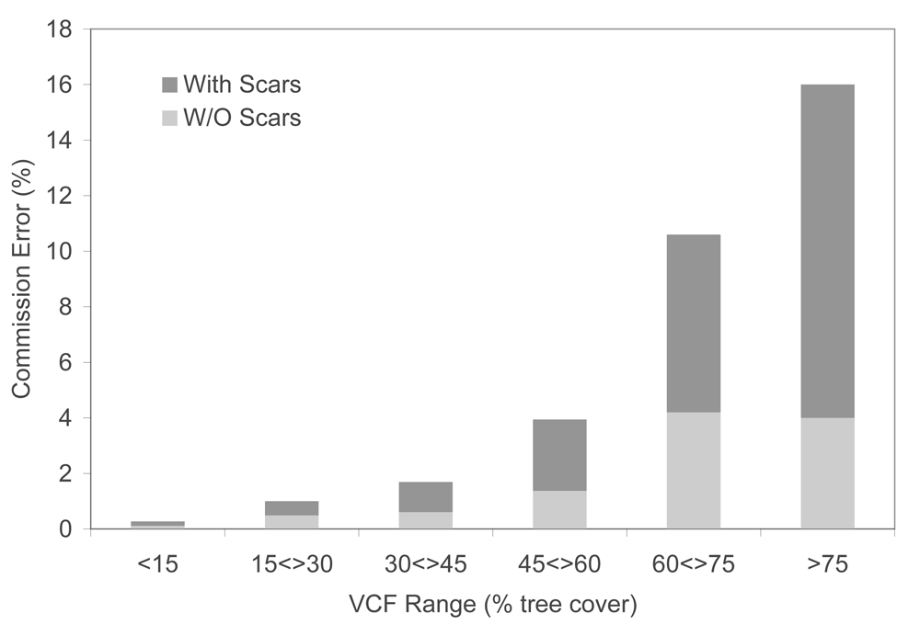
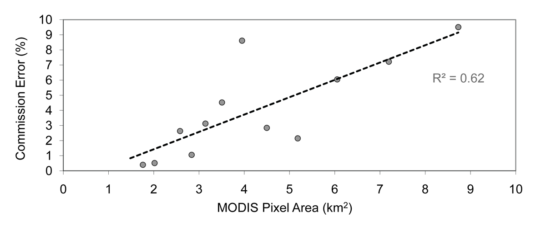
MODIS Active Fire Detection Validation Results
Probability of Detection (ASTER/nadir)
Probability of Detection (TM5/off nadir)
Commission Error (ASTER/nadir)
Commission Error (TM5/off nadir)

Slide 26
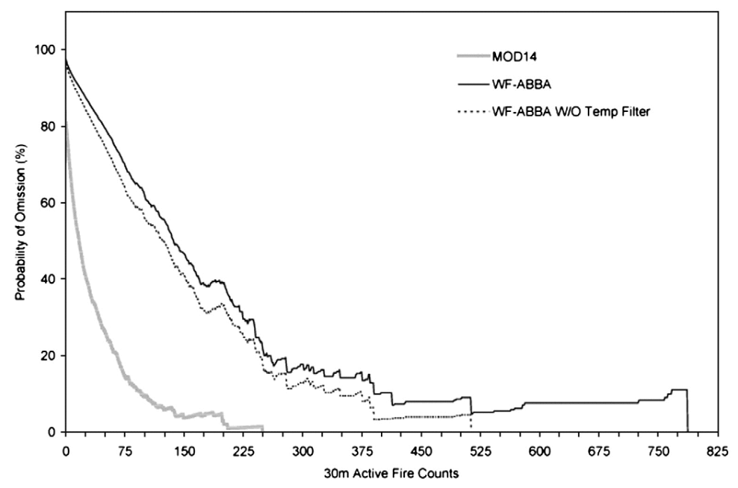
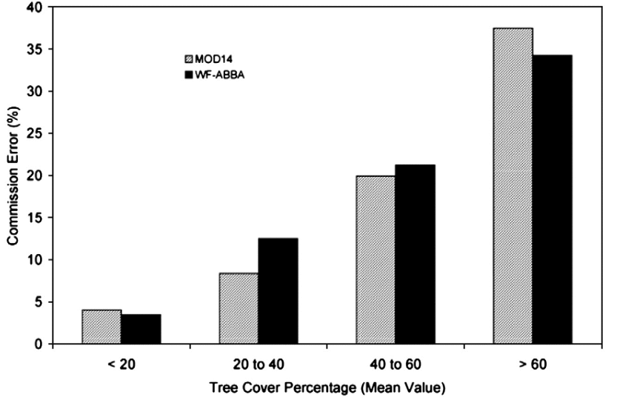
MODIS Active Fire Detection Validation Results
MODIS x GOES Detections in the Amazon

Slide 27
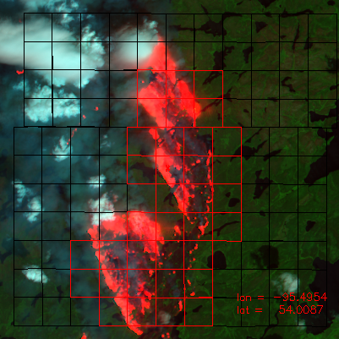
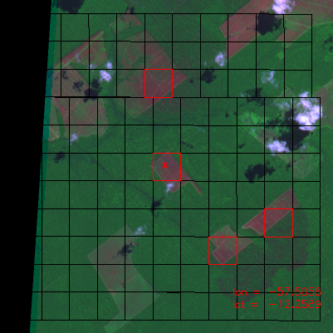
Examples of pixel misclassification
Omission error due to smoke
(confusion w/ clouds)
Commission error (false alarm)

Slide 28
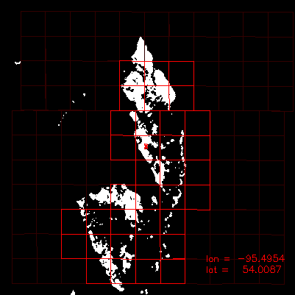
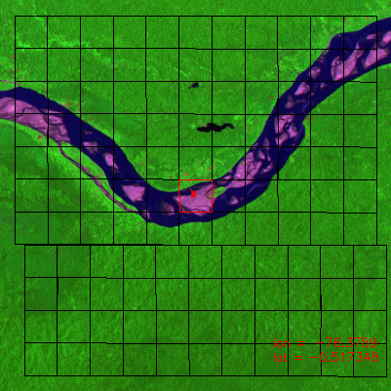
Examples of pixel misclassification
Omission error due to smoke
(confusion w/ clouds)
Commission error (false alarm)

Slide 29
Data Simulation &
Product Testing

Slide 30
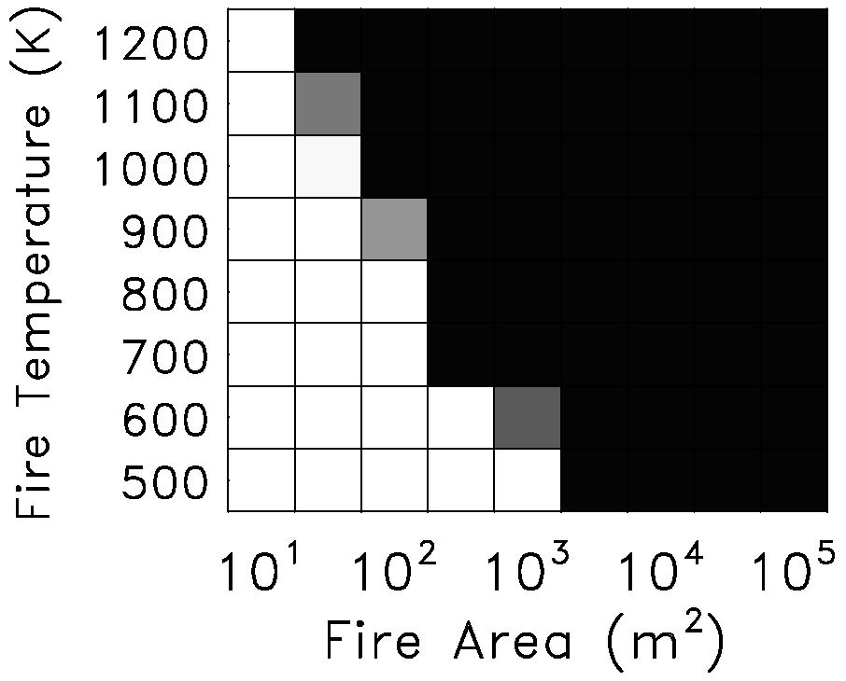
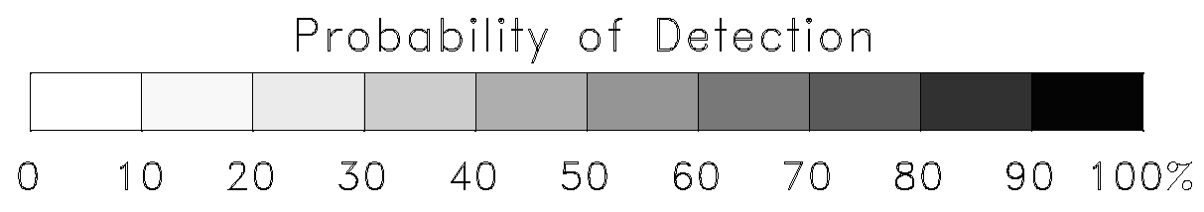
Example Simulation Results
MODIS
Temperate deciduous rainforest
Night
0° scan angle
Summer
No background fires

Slide 31
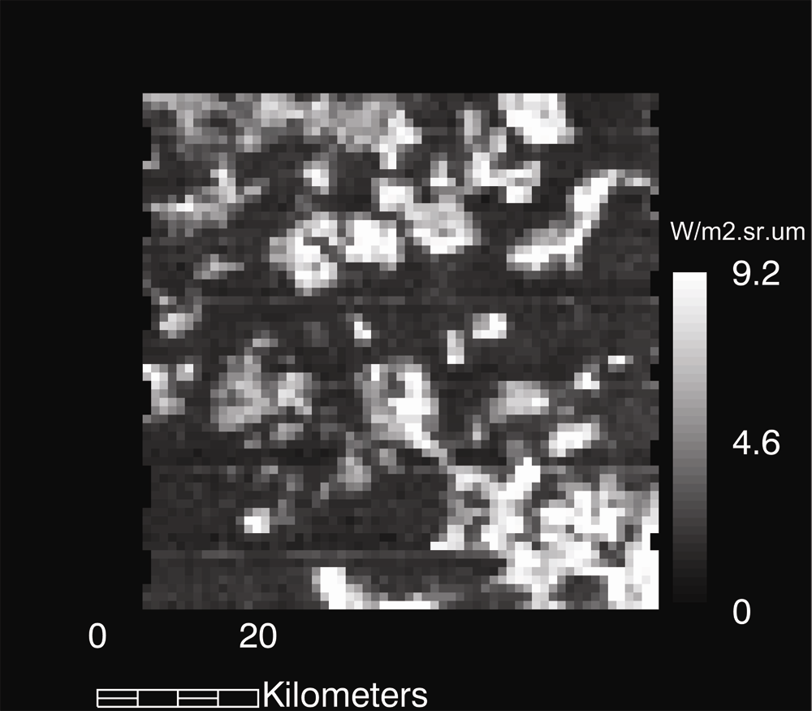
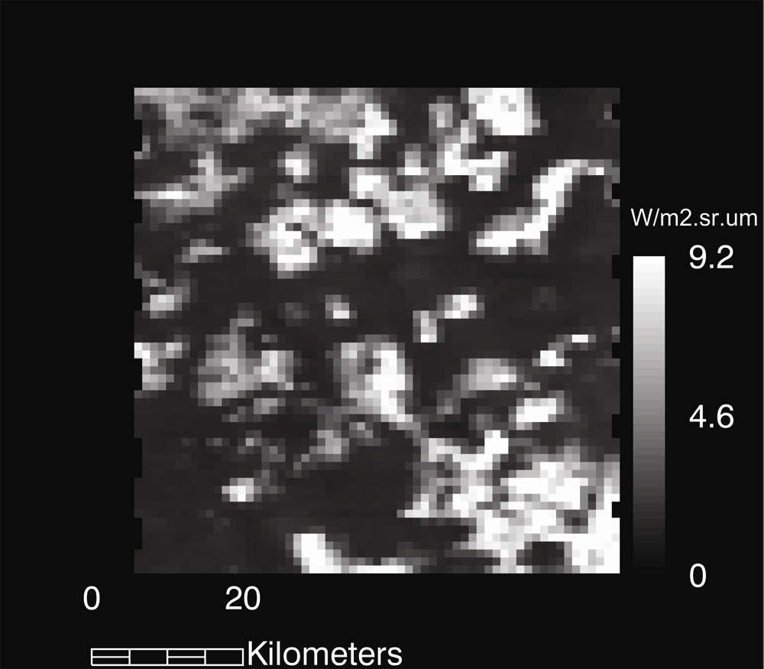
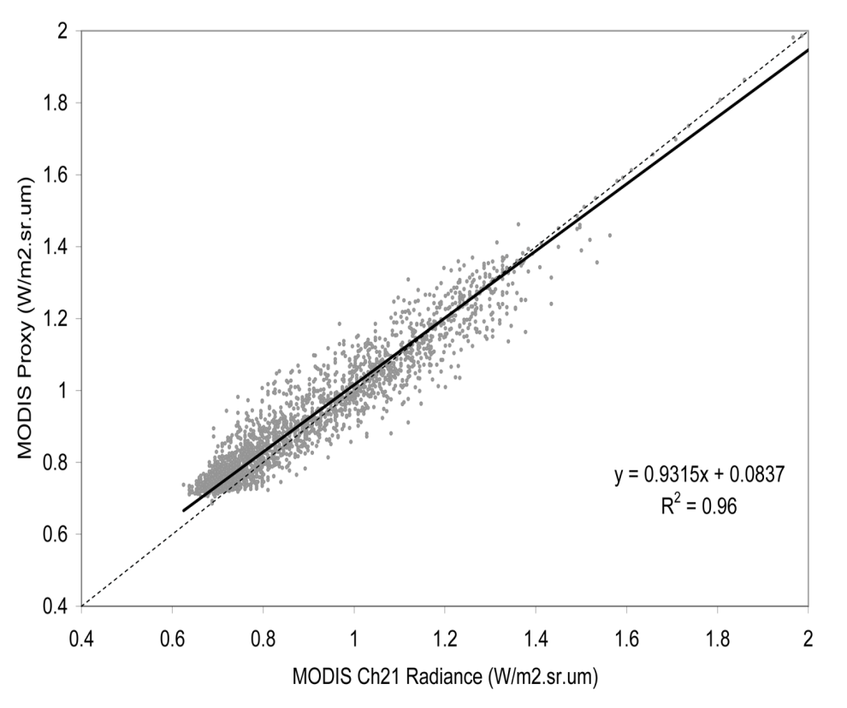
Example Simulation Results
Data simulation building on higher spatial resolution data sets to re-create fire scenes and test data and algorithm performance
Observed MODIS/Terra (Ch21)
Simulated (Ch21) using ASTER data to constrain

Slide 32
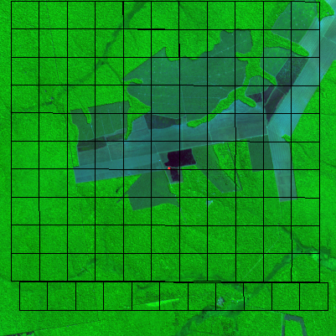
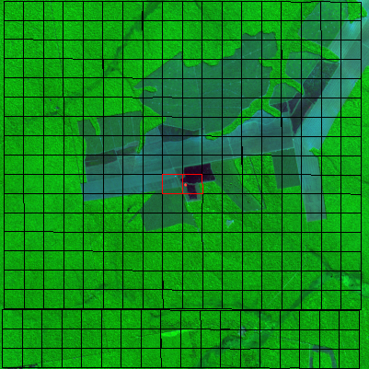
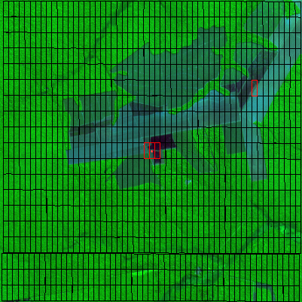
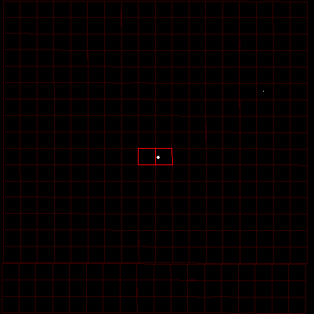
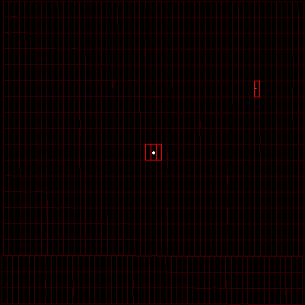
Example Simulation Results
a
b
d
a ⇒ MODIS/Terra (1km)
b, c ⇒ VIIRS (750m)
d, e ⇒ VIIRS (250x750m)
Background ⇒ ASTER (RGB 8-3-1)
c
e

Slide 33
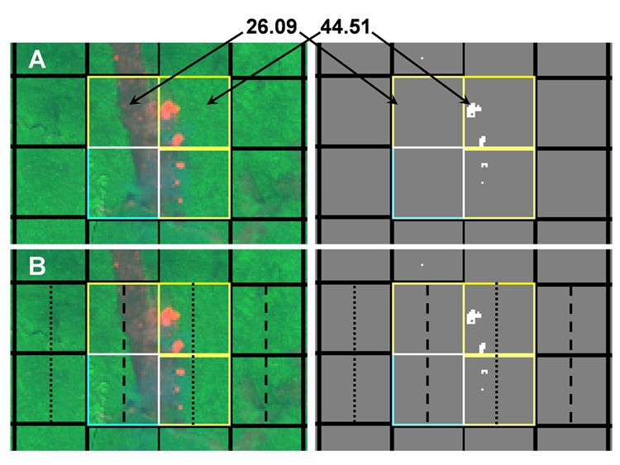
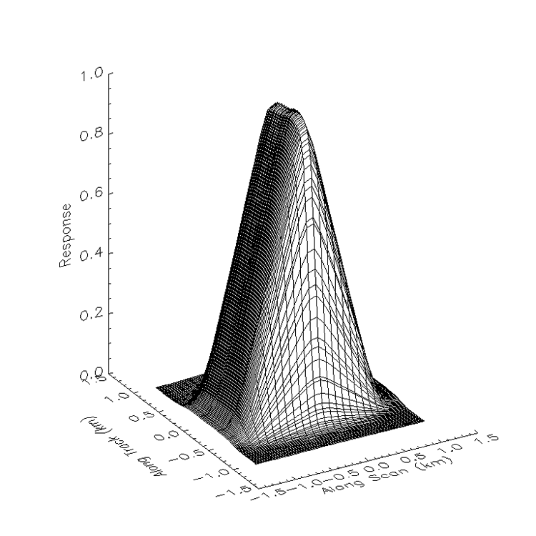
Other Important Issues:
Pixel Spatial Response Characteristics
Point Spread Function (PSF) MODIS
Nominal 1x1km rectangular response
MODIS/Terra FRP (MW)
A = Nominal pixel area
B = Effective pixel area
Adjusted Values (PSF):
Left pixel = 69.81 MW
Right pixel = 63.03 MW
Nominal
1x1 km pixel
Effective
2x1 km pixel

Slide 34
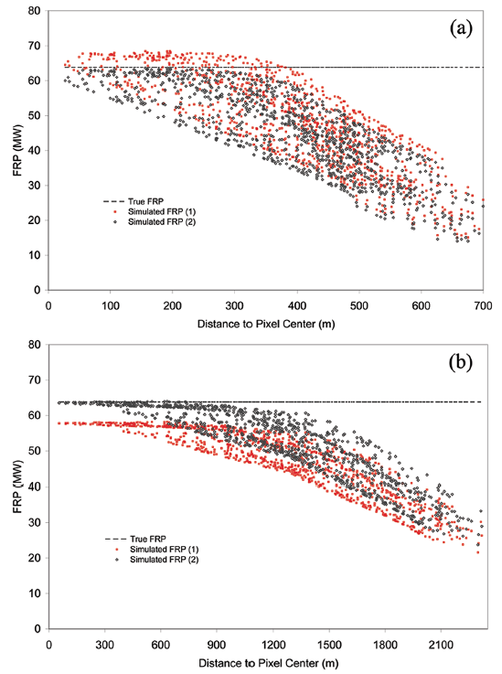
Potential effects from pixel spatial response characteristics
“true FRP”
Difference in retrieved FRP due to PSF influence
“true FRP”
Difference in retrieved FRP due to PSF influence

Slide 35
Validation of Satellite Fire Retrievals:
FRP, Size, Temperature

Slide 36


MODIS x GOES FRP Intercomparison
Inter-comparison of MODIS/Terra FRP with near-coincident GOES Imager data
3/4 of points show >20% difference
MODIS = 360MW
GOES = 509MW
MODIS = 344MW
GOES = 518MW
MODIS = 1965MW
GOES = 112MW
Credit: Schroeder et al, 2010

Slide 37






Validation of Satellite Fire Retrievals Using Airborne Sensor Data
NASA/Ames AMS
Multispectral
Linescanner
NASA/JPL
MASTER
Multispectral
Linescanner
USFS
FireMapper
Bi-spectral
Focal Plane Array
RIT
WASP
Bi-spectral
Focal Plane Array
MASTER Image of “Day Fire” Los Padres National Forest/CA Sep 19 2006

Slide 38
Test Case Analysis I
Prescribed Fire at Henry Coe State Park
San Jose, California
18 Oct 2011

Slide 39




Ground Sampling
(actual photos from site)
Fuel load: 30 individual plots
Fire energy: dual-band radiometers (3 sites)
Fire weather: instrumented tower (1 site)

Slide 40

Pre-Fire Mapping (13 Oct 2011)
NASA/Ames AMS image and flight paths on Google Earth
Two flight lines separated by 3km from each other and extending for 8km north-south
<8km >
Near-coincident Aqua/MODIS acquisition
< 3km >
13 Oct 2011
21:41UTC

Slide 41

Fire Mapping (18 Oct 2011)
Sequential airborne (NASA/Ames AMS) imaging plus
coincident acquisition with MODIS Terra and Aqua
Three flight lines separated by 3km from each other and extending for 10km north-south
<10km >
< 3km >
18 Oct 2011
18:12UTC
1 fire pixel detected by MODIS/Terra

Slide 42

Fire Mapping (18 Oct 2011)
Sequential airborne (NASA/Ames AMS) imaging plus
coincident acquisition with MODIS Terra and Aqua
18 Oct 2011
21:24UTC

Slide 43



Fire Mapping (18 Oct 2011)
Sequential airborne imaging plus
coincident acquisition with MODIS Terra and Aqua
18 Oct 2011
22:25UTC
4 fire pixels detected by MODIS/Aqua

Slide 44

Airborne Fire Mapping (18 Oct 2011)

Slide 45

Results:
Radiant Heat Flux
Ground
(radiometers)
Airborne
(NASA/AMS)

Slide 46

Results:
Radiant Heat Flux
Ground
(radiometers)
Airborne
(NASA/AMS)
Minutes

Slide 47


Results:
MODIS Fire Radiative Power
MODIS/Terra:
42.7 MW
AMS:
65.8 MW
~15 seconds apart
MODIS/Aqua:
360 MW
AMS:
458. 8 MW
~20 seconds apart

Slide 48
Results:
GOES Fire Radiative Power

Slide 49
Results:
GOES Fire Radiative Power

Slide 50

Results:
Fire Radiative Power
Airborne
(NASA/AMS)
Spaceborne
(MODIS&GOES)
Airborne data available only for two ~2h segments due to aircraft (NASA/Dryden KingAir) & crew restrictions
Hours

Slide 51

50km

Slide 52


Emissions Calculations
Biomass burning emissions are calculated using two methods:
  Bottom-up: starts from the ground/fire pixel level calculating the associated emissions using the time-integrated fire metrics (area, energy released) and/or fuel and burning properties (biomass load, burning efficiency, emissions factors)
  Top-down: starts from atmospheric level using particle and/or trace gas concentrations calculating ground fire emissions from clusters of fire pixels
?
☑
Fire location&duration
Fire area
(active/burned)
☑
FRP
?

Slide 53
Preliminary Emissions Results
In-situ
  Fuel-consumption
  Fuel consistent of entirely grass and was 100% consumed.
  Mean fuel consumption for site 1: 0.225 kg/m²
  Mean fuel consumption for site 2: 0.160 kg/m²
  ^{Energy released}
  Radiometer 1: 0.827 MJ/m²
  Radiometer 2: 0.800 MJ/m²
  Radiometer 3: 0.587 MJ/m²
Remote Sensing
  Fuel-consumption factor (FRE-based)
  0.275 kg/MJ
  Total fuel consumed
  (using integrated FRE)
  3.98+06 kg
  Carbon estimates
  (assuming 50% content)
  C = 1.99+06 kg
  CO2 = 7.29+06 kg
  FRE-based OCBC
  (Vermot et al., 2009)
  3.57+04 kg

Slide 54
Test Case Analysis II:
Use of small/lightweight UAVs in support of fire science applications:
RxCadre Experiment at Eglin Air Force Base,
Niceville,FL Nov/2012
Lead by USDA Forest Service

Slide 55


Calibration site for airborne IR data
Fixed-wing RC imaging system (VIS-TIR)

Slide 56

Military-grade small UAV (VIS-TIR)

Slide 57

Small quad-rotor “scout” (VIS-TIR)

Slide 58



Data Integration
VIIRS 375m Fire Detection Data
Small UAV thermal-IR data
Ground Radiometer Fire Intensity Data
Coincident data sets are being co-located & reduced allowing for proper characterization of prescribed fire from unique measuring/observation systems

Slide 59
Conclusions
Major satellite fire products continue to evolve and improve
  Algorithm refinement must be accompanied by data reprocessing
Validation activities have greatly expanded in the last 10 years
  Different studies providing information on algorithm qualities and limitations
Fire retrieval validation and algorithm refinement still requiring attention
  Resources are limited and/or costly
  Community organization is required involving other related disciplines when possible (e.g., atmospheric sciences, fire ecology)
New fire products being developed should take advantage of available techniques and validation data sets
  Landsat-class fire detection products
  Airborne sensors onboard manned/un-manned aircrafts should be more frequently used

