Slide 1
Meteorological Conditions Favourable To The Occurrence Of Severe Episodes Of Wildfire Over Eastern Mediterranean Basin
3rd SALGEE Workshop 2013
MSG LAND SURFACE APPLICATIONS: DROUGHT AND FIRE EMISSIONS
Ericeira, Hotel Vila Galé, 20 a 21 March 2013
Malik Amraoui(1,2), Margarida L. R. Liberato(1,2), Teresa J. Calado(1,3), Carlos C. DaCamara(1), Luís Pinto Coelho(3), Ricardo M. Trigo(1), Célia M. Gouveia(1).
(1) – Instituto Dom Luiz, Universidade de Lisboa, Portugal
(2) – Universidade de Trás-os-Montes e Alto Douro, Portugal
(3) – Instituto Português do Mar e da Atmosfera, Portugal

Slide 2
Outline
Introduction
Data and methods
Fire activity
Meteorological parameters
Fire risk
Results
Episode of 24-25 July 2007
Episode of 22-27 August 2007
Conclusions
3rd SALGEE Workshop 2013 - MSG LAND SURFACE APPLICATIONS: DROUGHT AND FIRE EMISSIONS - Ericeira, Hotel Vila Galé, 20 a 21 March 2013

Slide 3
Introduction
Fire is a global phenomenon and Southern Europe occupies a prominent position, given the occurrence of devastating summertime wildfires;
The Mediterranean basin is also considered a ‘‘hot spot’’ for climate change studies, with a significantly higher risk of intense heat wave episodes as well as an increase in fire risk;
The rainy and mild winters, which increase fine fuel load available, followed by warm and dry summers, which increase the fire risk, make the Mediterranean region especially prone to the occurrence of a large number of fire events and to the onset of extreme episodes;
Information on fire activity as derived from Meteosat-8 imagery has the appropriate spatial and temporal resolutions to be used to uncover the role played by land cover and by meteorological conditions on fire events in Mediterranean Europe, namely on large fire events associated to persistent fire activity.
3rd SALGEE Workshop 2013 - MSG LAND SURFACE APPLICATIONS: DROUGHT AND FIRE EMISSIONS - Ericeira, Hotel Vila Galé, 20 a 21 March 2013

Slide 4
Data and methods: Fire activity
Information about fire events was derived from the so-called Fire Detection and Monitoring (FD&M) product that is running, in near real time, in the framework of EUMETSAT’s LSA SAF and consist of fire pixels and active fires detected over Southern Europe during July-August period of 2007, 2008 and 2009;
1- Fire pixels are those where at least one active fire was detected by the algorithm;
2- Active fires are given by the number of fire occurrences continuously detected in a given fire pixel. Active fires may be viewed as an indicator of persistence (and therefore as a proxy of severity) of a given fire event.
A full description of the algorithm may be found in:
Amraoui, M., C.C. DaCamara, & Pereira, J.M.C. (2010). Detection and monitoring of African vegetation fires using MSG-SEVIRI imagery. Remote Sensing of Environment, 114 (5), 1038-1052.
3rd SALGEE Workshop 2013 - MSG LAND SURFACE APPLICATIONS: DROUGHT AND FIRE EMISSIONS - Ericeira, Hotel Vila Galé, 20 a 21 March 2013

Slide 5
Data and methods: Meteorological parameters
Horizontal fields consist of Interim Reanalyses (ERA-Interim) from ECMWF at 12 UTC full resolution (0.75x0.75 lat/lon) over European sector (12ºW–55ºE, 24ºN–57ºN) for July and August 1989-2009:
mean sea level pressure (SLP);
air temperature at 2 m height (T2);
dew point temperature at 2 m height (Td2);
24 h accumulated precipitation (P24);
horizontal wind vectors at 10 m height;
wind speed at 10 m height (U10);
250, 500 and 850 hPa geopotential heights (Z250, Z500 and Z850);
temperature and relative humidity at 850 hPa (T850 and RH850);
wind speed at 250 hPa (U250).
3rd SALGEE Workshop 2013 - MSG LAND SURFACE APPLICATIONS: DROUGHT AND FIRE EMISSIONS - Ericeira, Hotel Vila Galé, 20 a 21 March 2013

Slide 6
Data and methods: Meteorological parameters
Vertical profiles were obtained from the Department of Atmospheric Science of the University of Wyoming (http://www.uwyo.edu) and consist of soundings of:
temperature;
dew point temperature;
wind.
3rd SALGEE Workshop 2013 - MSG LAND SURFACE APPLICATIONS: DROUGHT AND FIRE EMISSIONS - Ericeira, Hotel Vila Galé, 20 a 21 March 2013

Slide 7
Data and methods: Fire risk
ERA-Interim reanalysis data, at 12 UTC for the period 1989–2009, namely T2, Td2, U10 and P24 were accordingly used to compute:
Build-Up Index (BUI) that is a rating of the total amount of fuel available for combustion (timescale of the order of 2 weeks up to 50 days);
Initial Spread Index (ISI) that rates fire spread (timescale of the order of a day);
Fire Weather Index (FWI) that rates fire intensity and is a function of ISI and BUI.
BUI, ISI and FWI are parte of the Canadian Forest Fire Weather Index System (CFFWIS).
3rd SALGEE Workshop 2013 - MSG LAND SURFACE APPLICATIONS: DROUGHT AND FIRE EMISSIONS - Ericeira, Hotel Vila Galé, 20 a 21 March 2013

Slide 8
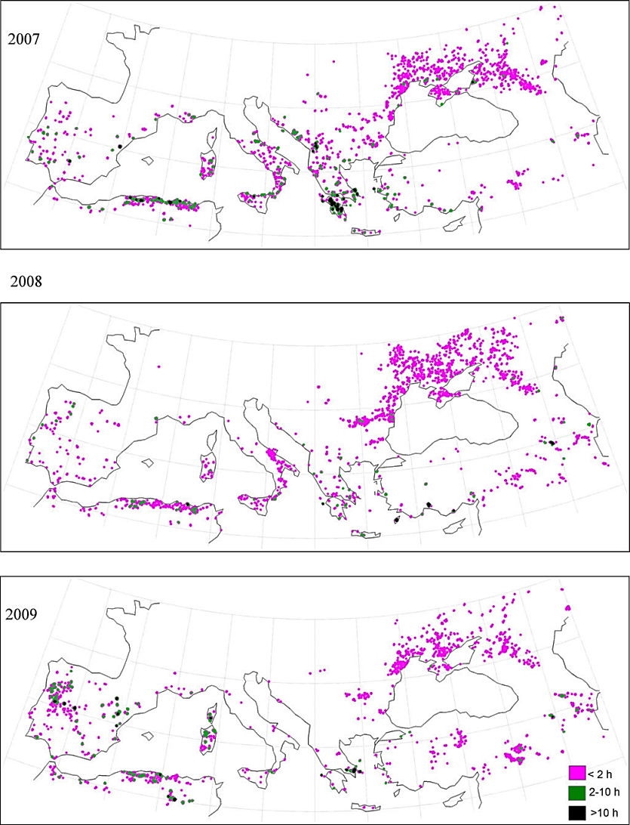
Results: Fire activity
Active fires, fire pixels and ratio of active fires to fire pixels as detected over Europe during July–August 2007, 2008 and 2009:
 | 2007 | 2008 | 2009 | 2007-2009
Active fires | 31772 (53%) | 10497(18%) | 17579 (29%) | 59848
Fire pixels | 4195 (40%) | 3233 (31%) | 2976 (29%) | 10404
Ratio | 7.6 | 3.2 | 5.9 | 5.8
Distribution of fire pixels among the different GLC2000 land cover groups for Europe, during July–August 2007–2009:
2007-2009 | Fire pixels | %
Forest | 2675 | 26
Shrublands | 2520 | 24
Cultivated | 5209 | 50
Total | 10404 | 100
The figures present, For each July–August period the spatial distribution of fire pixels together with the respective persistence (in hours).
3rd SALGEE Workshop 2013 - MSG LAND SURFACE APPLICATIONS: DROUGHT AND FIRE EMISSIONS - Ericeira, Hotel Vila Galé, 20 a 21 March 2013

Slide 9
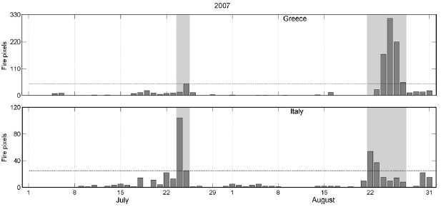
Results: Fire activity
The figures present time series of daily amounts and the spatial distribution of fire pixels during July–August 2007 over Greece and Italy.
It may be observed that fire activity concentrates into two periods, namely 24–25 July and 22–27 August, the first one mainly affecting Italy and the second one both Italy and Greece.
24-25 Jul | Italy
Fire pixels | 129 of 436 (30%)
Active fires | 552 of 1551 (36%)
22-27 Aug | Italy | Greece
Fire pixels | 138 of 436 (32%) | 783 of 1035 (76%)
Active fires | 566 of 1551 (36%) | 11263 of 13013 (87%)
3rd SALGEE Workshop 2013 - MSG LAND SURFACE APPLICATIONS: DROUGHT AND FIRE EMISSIONS - Ericeira, Hotel Vila Galé, 20 a 21 March 2013

Slide 10
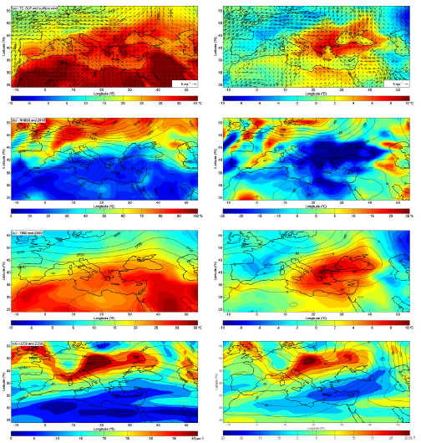
Results: Extreme meteorological conditions
The episode of 24-25 July:
Composites
Anomalies
Synoptic conditions:
Azores high extending from the Atlantic to Central and Eastern Europe;
Thermal low centred on southern Turkey and eastern Mediterranean;
Strong northerly advection of continental dry and hot air over Greece, Romania, Bulgaria and Turkey;
Height field at 850 hPa is similar to the one of sea-level pressure but the gradients of Z850 tend to be stronger than those of SLP;
Relative humidity composites indicate the presence of very dry air (lower than 30%) over the entire Mediterranean basin and the Middle East, with anomalies greater than 25% on a large region from southern Italy and Greece up to the Black Sea basin;
The atmospheric flow at the 500 and 250 hPa levels is dominated by a synoptic baroclinic wave, with a pronounced ridge whose axis is directed from SW to NE;
The subtropical jet stream axis is located over Central Europe, at abnormally high latitudes as suggested by the anomaly composites.
T2 – SLP –
Surf. wind
RH850 – Z850
T850 – Z500
U250 – Z250
3rd SALGEE Workshop 2013 - MSG LAND SURFACE APPLICATIONS: DROUGHT AND FIRE EMISSIONS - Ericeira, Hotel Vila Galé, 20 a 21 March 2013

Slide 11
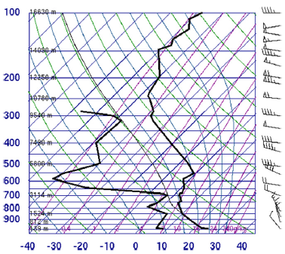
Results: Extreme meteorological conditions
The episode of 24-25 July:
Composites
Anomalies
25 July 2007 (12 UTC) at the station of Belgrade (Serbia).
T2 – SLP –
Surf. wind
RH850 – Z850
Synoptic conditions:
Composite anomalies at the 500 and 250 hPa levels exhibit positive departures, revealing a region with less clouds than normal and where there is an enhancement of the subsidence of air into the troposphere, and a reinforced increase of air temperature through adiabatic heating at lower levels;
T850 – Z500
This effect is also clear in the skew-T log-P diagram at Belgrade where a layer of stable dry air region is conspicuous around 600–650 hPa, associated to strong westerly winds of the jet stream, over a turbulent layer of northerly winds.
U250 – Z250
3rd SALGEE Workshop 2013 - MSG LAND SURFACE APPLICATIONS: DROUGHT AND FIRE EMISSIONS - Ericeira, Hotel Vila Galé, 20 a 21 March 2013

Slide 12
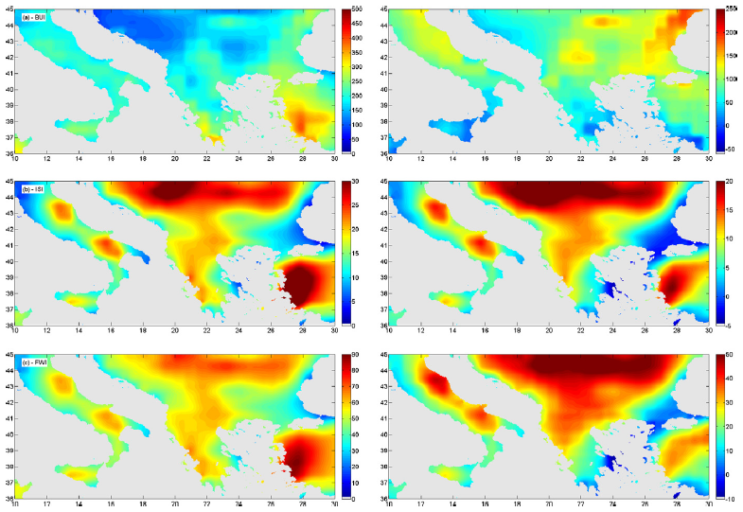
Results: Fire risk
The episode of 24-25 July:
Composites
Anomalies
BUI
ISI
FWI
Fire risk conditions:
Composites and anomaly composites of FWI show a large region of high values of FWI over the Balkan Peninsula and Italy, which closely matches:
the already described region of hot and dry air that resulted from the intense hot and dry northerlies;
the region of subsidence associated to the extended ridge in the troposphere,
the region of subsidence at the upper tropospheric levels associated to the jet streak.
3rd SALGEE Workshop 2013 - MSG LAND SURFACE APPLICATIONS: DROUGHT AND FIRE EMISSIONS - Ericeira, Hotel Vila Galé, 20 a 21 March 2013

Slide 13
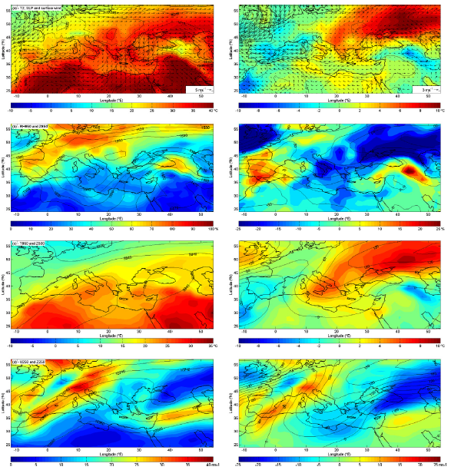
Results: Extreme meteorological conditions
The episode of 22-27 August:
Composites
Anomalies
Synoptic conditions:
Anticyclonic circulation over central Europe;
Thermal depression centred over southwest Asia;
Extremely intense northerly advection of continental hot and dry air (etesian winds);
High values of surface air temperature and low values of relative humidity are well apparent over the eastern Mediterranean basin, mainly in some regions of Italy and southern Greece, Romania, Bulgaria and Turkey;
The flow at the 500 and 250 hPa levels is dominated by a pronounced ridge extending from northern Europe through Russia and by a pronounced trough over Eastern Mediterranean, with the axes directed from SW to NE;
As suggested by the wind field at the 250 hPa level, the meandering of the jet stream is even more pronounced than in the previous period.
T2 – SLP –
Surf. wind
RH850 – Z850
T850 – Z500
U250 – Z250
3rd SALGEE Workshop 2013 - MSG LAND SURFACE APPLICATIONS: DROUGHT AND FIRE EMISSIONS - Ericeira, Hotel Vila Galé, 20 a 21 March 2013

Slide 14
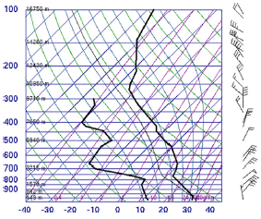
Results: Extreme meteorological conditions
The episode of 22-27 August:
Composites
Anomalies
25 August 2007 (00 UTC) at Athens (Athinai Airport).
T2 – SLP –
Surf. wind
RH850 – Z850
Synoptic conditions:
The abnormal location of the jet streak at high latitudes is associated to positive departures of Z500 and Z250 which delimit a region over Italy and Greece characterized by a strong enhancement of the subsidence of air into the troposphere, leading to an increase of air temperature through adiabatic heating at lower levels;
T850 – Z500
This effect is also clear in the skew-T log-P diagram at Athens where a stable dry air layer may be identified around 650–750 hPa, associated to north-easterly strong winds associated with the ridge, over a turbulent layer of winds about the 800 hPa level.
U250 – Z250
3rd SALGEE Workshop 2013 - MSG LAND SURFACE APPLICATIONS: DROUGHT AND FIRE EMISSIONS - Ericeira, Hotel Vila Galé, 20 a 21 March 2013

Slide 15
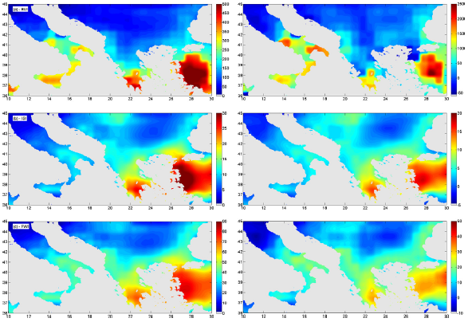
Results: Fire risk
The episode of 22-27 August:
Composites
Anomalies
BUI
ISI
FWI
Fire risk conditions:
The region of high values and of high positive anomalies of FWI is more concentrated than in the previous episode, mainly locating over the Peloponnese and Attica peninsulas;
The same region is also associated to high values and high positive anomalies of ISI, displaying an arch-like structure along the coasts of the Adriatic and Black Seas which reflects the influence of the etesian winds;
The extremely severe fires that occurred in the Peloponnese are located in the area of higher values and more positive anomalies of FWI.
3rd SALGEE Workshop 2013 - MSG LAND SURFACE APPLICATIONS: DROUGHT AND FIRE EMISSIONS - Ericeira, Hotel Vila Galé, 20 a 21 March 2013

Slide 16
Conclusions
Mediterranean regions are some of the most affected by wildfires which are strongly conditioned by human action, morphology of the landscape, and vegetation land cover;
Weather and climate also strongly affect wildfire activity, in particular, meteorological factors play a crucial role in the case of the larger fire events;
satellite information appears as a very appealing tool to monitor fire activity, especially if provided by instruments on-board geostationary platforms that are able to observe the target with a high temporal resolution (e.g. every 15 min in the case of Meteosat-8);
Structural similarities were found among the atmospheric circulation and the thermo-hydrodynamic processes that dominated the seasonal background (July–August 2007) and have prevailed in the two extreme periods (24–25 July and 22–27 August).
3rd SALGEE Workshop 2013 - MSG LAND SURFACE APPLICATIONS: DROUGHT AND FIRE EMISSIONS - Ericeira, Hotel Vila Galé, 20 a 21 March 2013

Slide 17
A full description of this work may be found in:
Amraoui, M., et al. Fire activity over Mediterranean Europe based on information from Meteosat-8. Forest Ecol. Manage. (2012),
http://dx.doi.org/10.1016/j.foreco.2012.08.032
Thank you
3rd SALGEE Workshop 2013 - MSG LAND SURFACE APPLICATIONS: DROUGHT AND FIRE EMISSIONS - Ericeira, Hotel Vila Galé, 20 a 21 March 2013

